Slide 1
NanoVNA
Mark Braunstein WA4KFZ
Ole Virginia Hams
November 2024

Slide 2
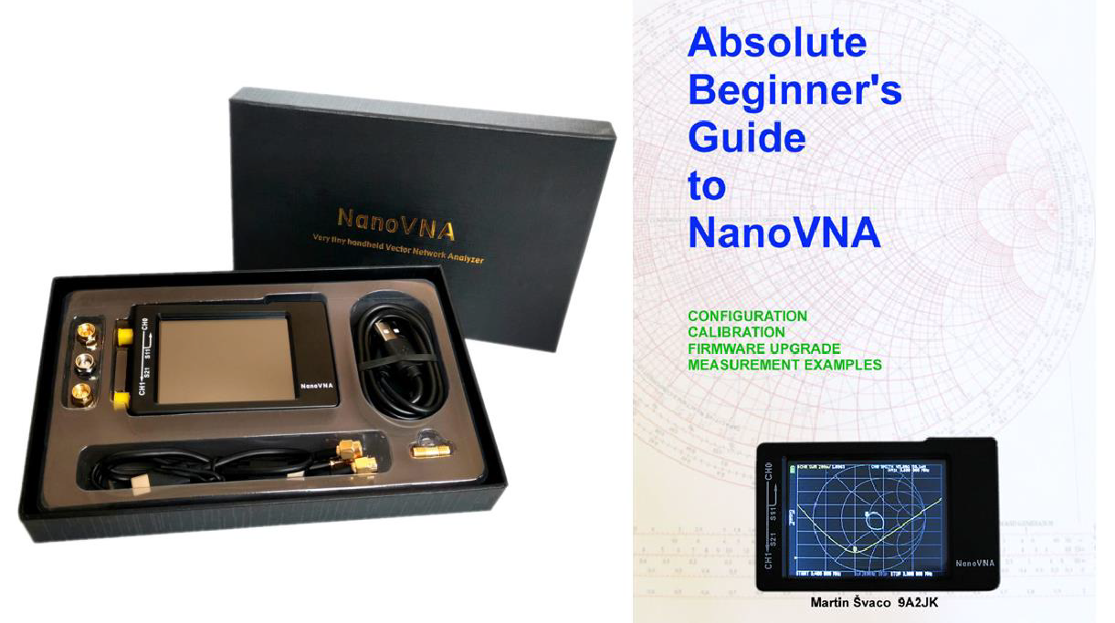
NanoVNA Overview
A low-cost vector network analyzer
  $60-$90 range Includes:
USB cable
SMA extension cables
SMA calibrations
  short
  open
  load
  thru
https://nanovna.com/
https://groups.io/g/nanovna-users

Slide 3
NanoVNA Overview
Different models available
Frequency range starts at 50kHz
Some variants cover up to 3GHz
Measurements are made over 101 ‘points’
  Evenly distributed over the measurement’s Start and Stop frequency range
Dynamic range: 40-70dB (depending on frequency range)

Slide 4
NanoVNA Display Modes
LOGMAG (log magnitude in dB)
Phase
Delay
Smith (Smith Chart)
SWR
Polar
Linear
Four traces can be displayed at the same time
Markers can be set for each trace

Slide 5
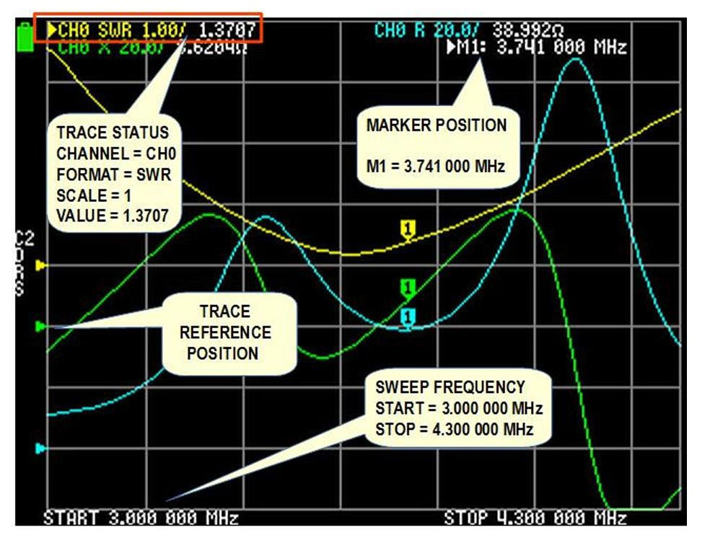
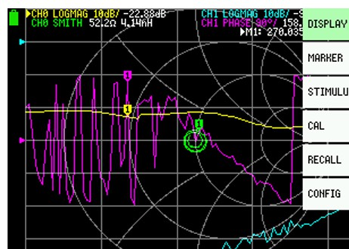
NanoVNA Display Modes
https://groups.io/g/nanovna-users
One-port SWR Example
https://groups.io/g/nanovna-users
Two-port Device Example

Slide 6
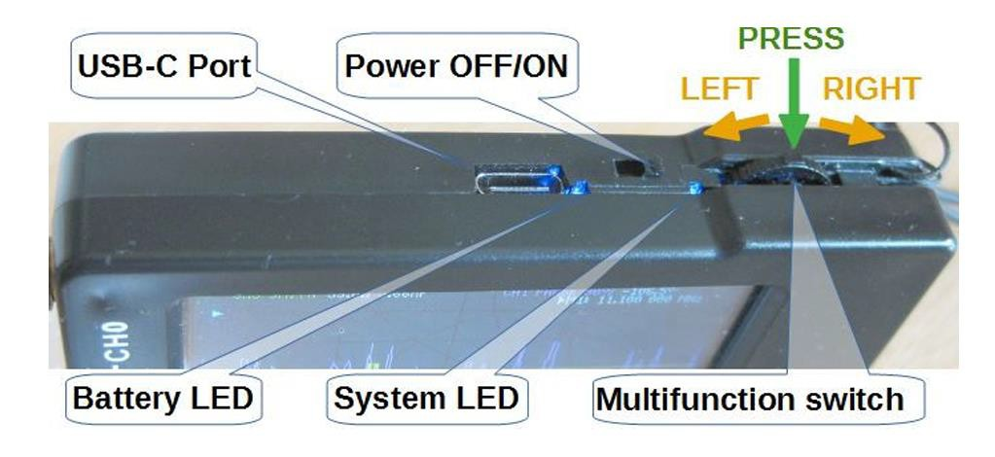
NanoVNA User Interface
Touchscreen operation for all other functions
https://groups.io/g/nanovna-users

Slide 7
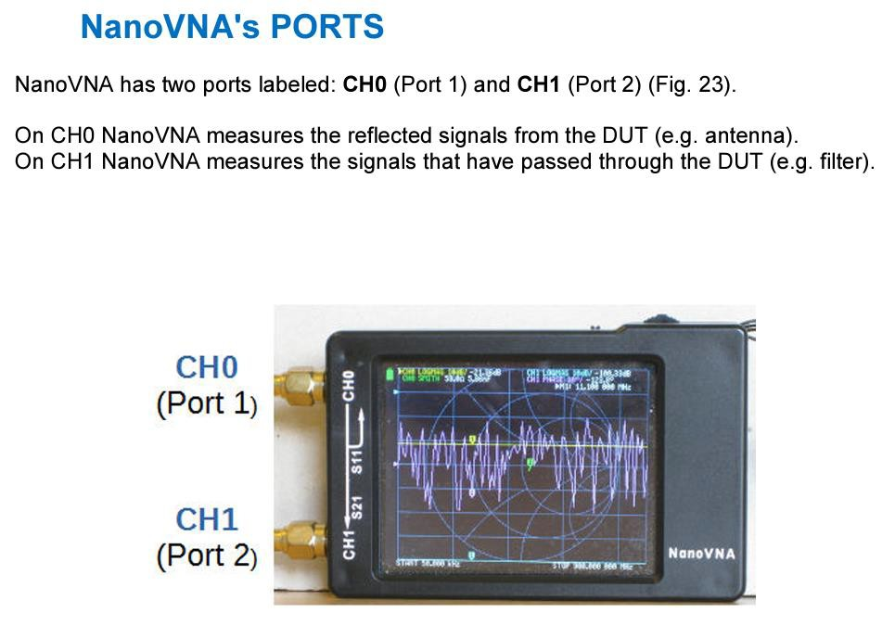
NanoVNA Typical Use Cases
Ant.
Filter
incident
reflected
incident
returned
Port 1
Port 2
Port 1
Port 2
^{S}11
“one-port”
measurement
^{S}21
“two-port”
measurement
https://groups.io/g/nanovna-users
7

Slide 8
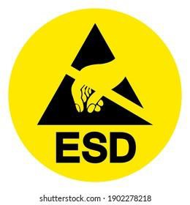
NanoVNA Use Case Warning
Several web sites, user forums, etc. indicate that the NanoVNA (and similar variants) do not have ESD (static) protection on the inputs
Directly connecting a large outdoor antenna can induce voltages large enough to damage the input
circuitry
Antenna protectors (Polyphaser, Alpha Delta, etc.) use gas discharge tubes (GDT) that do not offer the necessary low-voltage protection
ESD protection diode circuit
  https://www.qrpforum.de/index.php?attachment/23764-nanovna-input-protector-pdf/
NanoVNA protection video
  https://youtu.be/totwu4IbavE?si=gSg0mIKITo0l3UEb

Slide 9
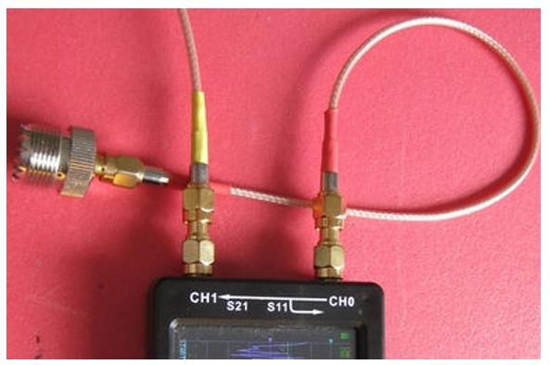
NanoVNA Test Port Cables
The use of short test port cables is HIGHLY recommended
Prevents accidental damage to the NanoVNA connectors
Reduces stress and wear on NanoVNA SMA connectors
https://groups.io/g/nanovna-users

Slide 10
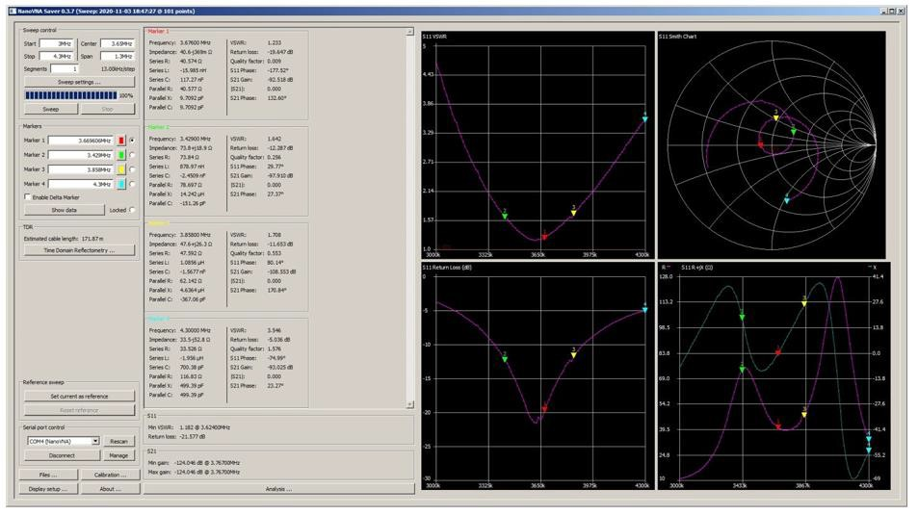
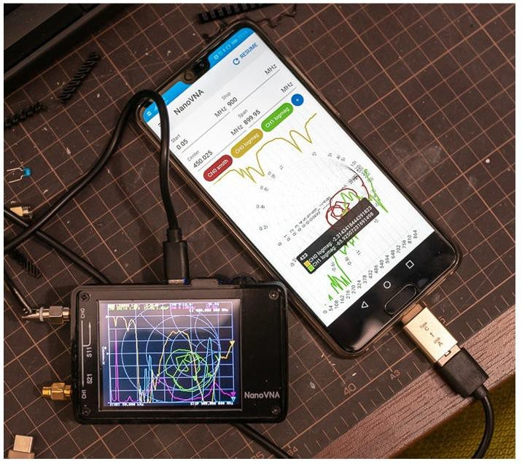
NanoVNA Display Software
Windows PC
Android App
https://groups.io/g/nanovnausers/wiki#Software

Slide 11
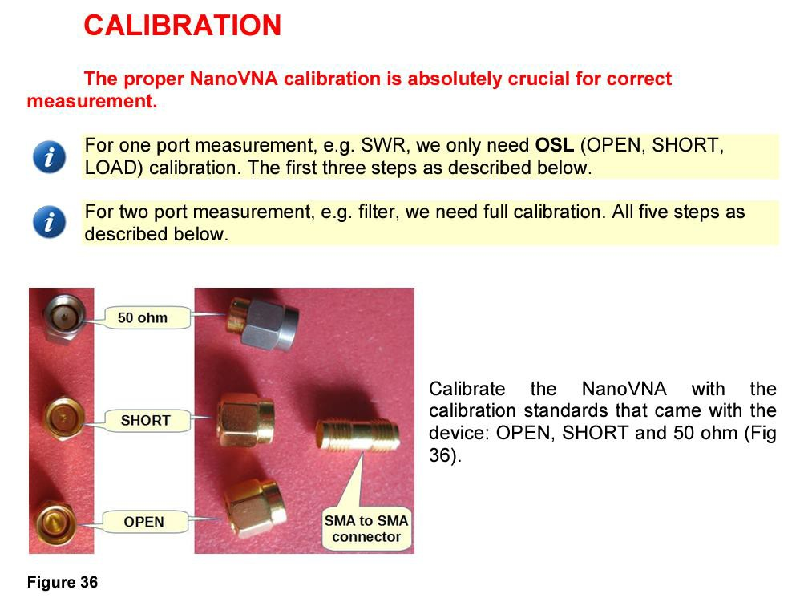
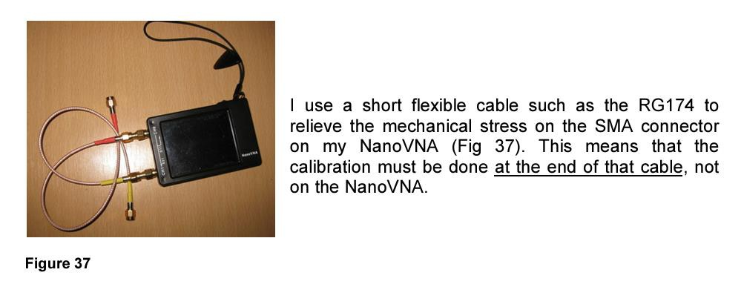
NanoVNA Calibration
https://groups.io/g/nanovna-users
Calibration Steps | Measurements
Open | One & Two Port
Short | One & Two Port
Load | One & Two Port
Isolation | Two Port
Thru | Two Port
https://groups.io/g/nanovna-users
11

Slide 12
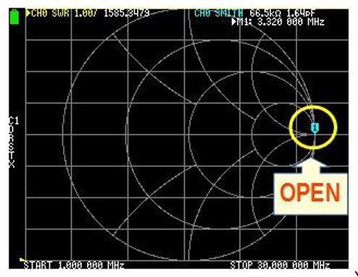
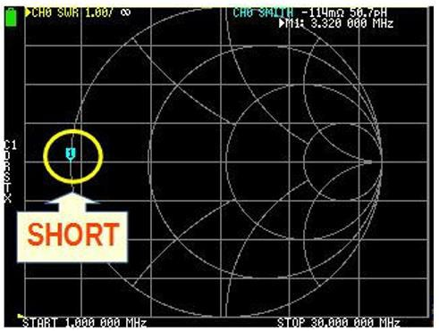
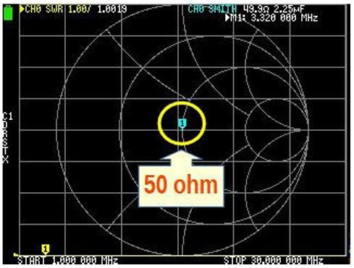
NanoVNA Calibration
The calibration process compensates for frequency-dependent imperfections in the internal circuitry
https://groups.io/g/nanovna-users
12

Slide 13
“I know you are but what am I…?”
There are multiple variants of the NanoVNA on the market
Some are “genuine” while others are poor quality clones
“Turf wars” for some of the variants regarding licensing

Slide 14
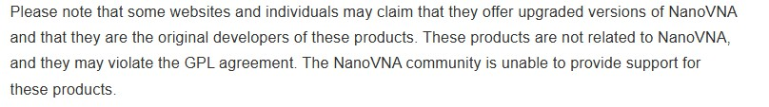

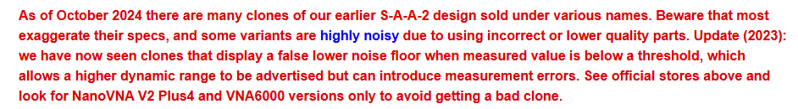
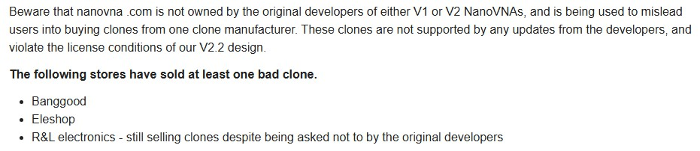
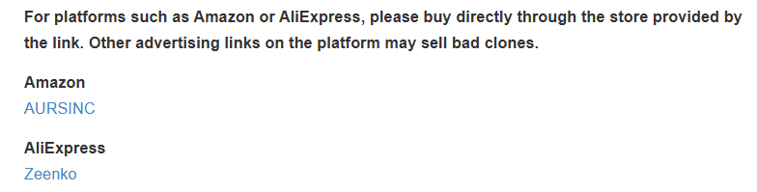
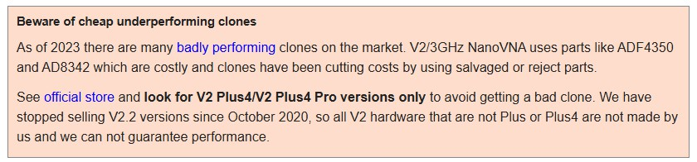

Typical “Scary” Language…

Slide 15
Conclusion
Overall, the NanoVNA is a good unit for general amateur radio use
  Best performance (based on dynamic range) is below 300MHz
Buy the NanoVNA from “approved” vendors
Be mindful of ESD precautions
Handle SMA connectors with care

Slide 16
Backup – Technical Material

Slide 17
What is a ‘VNA’?
VNA = Vector Network Analyzer
What’s a ‘vector’?
What’s a ‘network’?

Slide 18
What’s a Vector?
A measure of the magnitude and angle of a signal in an AC circuit
In RF, the angle is a representation of the phase difference between two
signals
In RF, the magnitude is a representation of the amplitude difference between two signals
The phase and magnitude are measured at a single frequency

Slide 19
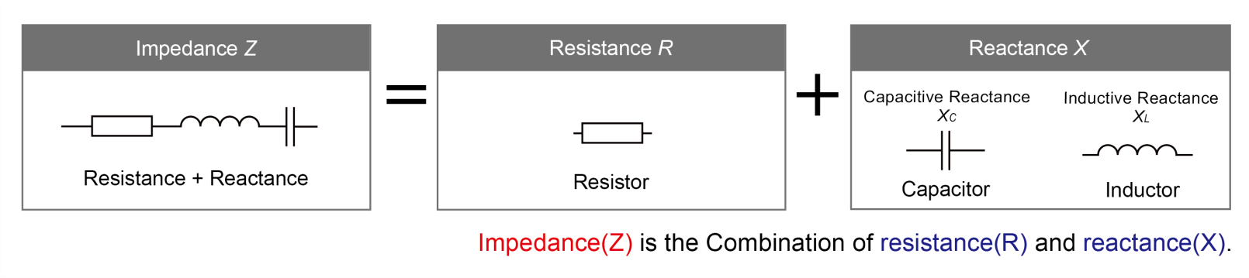
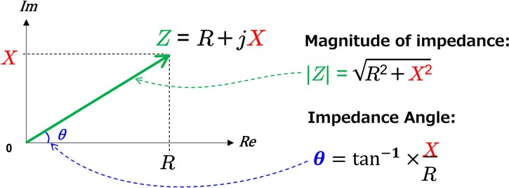
What’s a Vector?
Resistance: current and voltage are always in phase
Reactance: current and voltage are 90 degrees out of phase
https://techweb.rohm.com/product/power-device/si/15939/

Slide 20
What’s a Network?
A network is a “stimulus/response” representation of an electronic circuit
A network could consist of multiple components – we are analyzing the
cumulative behavior
Think of a network as a “black box” where you don’t know exactly what’s inside – you’re trying to figure out how it behaves by stimulating it with a signal and measuring the corresponding response

Slide 21
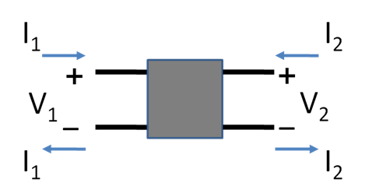
What’s a Network?
Types of low-frequency Network Parameters
H parameters (hybrid)
G parameters (inverse hybrid)
Z parameters (impedance)
Y parameters (admittance)
ABCD parameters (cascade)
Low frequencies
Typical network numbering convention:
Port 1 = input and Port 2 = output
A generalized two-port network The voltage and current at each port can be independently measured
https://en.wikipedia.org/wiki/Two-port_network

Slide 22
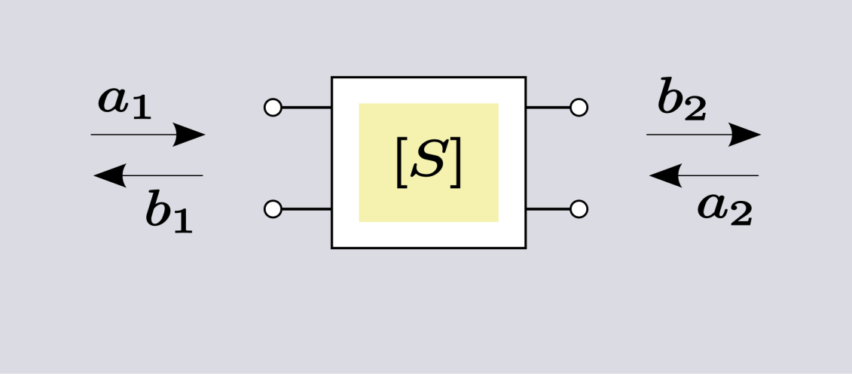
What’s a Network?
Notation
S21
Output at port 2 Due to input at port 1
S11
RF & Microwave frequencies
Output at port 1 Due to input at port 1
An S-parameter two-port network
The incident and reflected power at each port can be independently measured
Typical network numbering convention:
Port 1 = input and Port 2 = output
https://en.wikipedia.org/wiki/Two-port_network

Slide 23
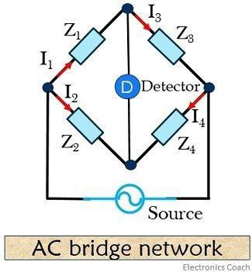


The ‘Bridge’ is the Key Component
The bridge is predominantly used in low frequency measurements
When the bridge is ‘balanced’ there is no difference signal at the Detector
General Case
occurs when:
and
At microwave frequencies, directional couplers
replace the ‘arms’ of the bridge circuit to
https://electronicscoach.com/ac-bridges.html
measure RF power ratios
23

Slide 24
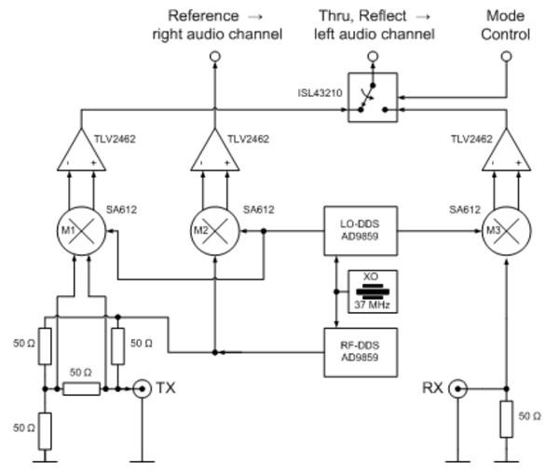
Bridge Concept Used in the NanoVNA
The ‘fourth arm’ of the bridge connects to the TX port
The resistor in the middle supports the Detector
connection (mixer M1)
The local oscillator (LO) and stimulus (RF) oscillator are offset in frequency by a few kHz and measured at audio frequencies with soundcard-type components
Two-port thru measurements use the TX and RX ports to measure the one-way transmission parameters.
A one-port measurement at the TX port can still be performed, even if the device under test is connected between the TX and RX ports for a two-port measurement (i.e., you can measure both S₁₁ and S₂₁
with the same two-port configuration).
24
https://axotron.se/blog/vector-network-analyzer-a-christmas-present-to-myself/

