Slide 1
OVH’S MESHTASTIC NODE
TO BE INSTALLED ON MT. PONE
PRESENTED BY GIL, KM4OZH, JAN 22, 2025

Slide 2
Meshtastic Refresher
Andy, K1RA, presented Meshtastic at August, 2025 meeting. His excellent slides can be found at http://w4ovh.net - logon then click “Learning Center”, then click “Presentations”.
915 MHz at 100 milliwatts. No license required.
Self-configuring network
Low cost - $17.82 plus 4 cents shipping (really!) https://www.aliexpress.us/item/2251832685763835.html?_t=pvid%3A60558c43-b4ca-4971-86aa-2639869bdc02
OVH members using include Gil, KM4OZH; JOHN, KG4NXT; BYRON, AK4XR; KEN, KE2N; RON, K3FR; DAVID, KK4ZUU & BRUCE, KN4GDX

Slide 3
Need for Node on Mt. Pone
Gil has a beam pointed at Warrenton. If you are in Gil’s path, fine.
If you are not in Gil’s path, you may have problems connecting to the network.
Example – Ron had a brief connection that he attributed to bounce off a passing airplane.
We want to make meshtastic more available in the Manassas area.

Slide 4
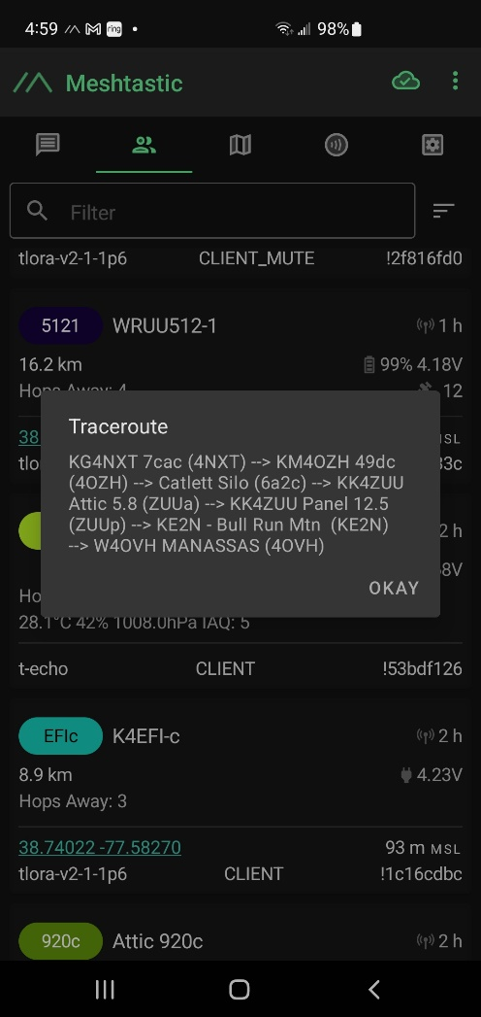
Trace route from KG4NXT TO KE2N

Slide 5
No cost to the OVH club – everything donated
Comet KP-20 Antenna – 8ft – 900 to 930 MHz. 9 dB gain. Rated 100 watts and 112 mph wind load
LILYGO meshtastic node – does not have GPS like T-Beam
12v to 5v converter –
High pass filter – to save module from strong signal from our other repeaters at Mt. Pone.
Weatherproof box with SO-239 for power
SMA to N connector for the antenna

Slide 6
How to power the node
Solar was considered
We decided to use an unused and existing coax line to feed 12 volts to the node
It will be converted down to 5 volts for the LILYGO with SO-239 on box

Slide 7
Donors of time and material
Byron, AK4XR
Gil, KM4OXH
JOHN, KG4NXT
KEN, KE2N

Slide 8
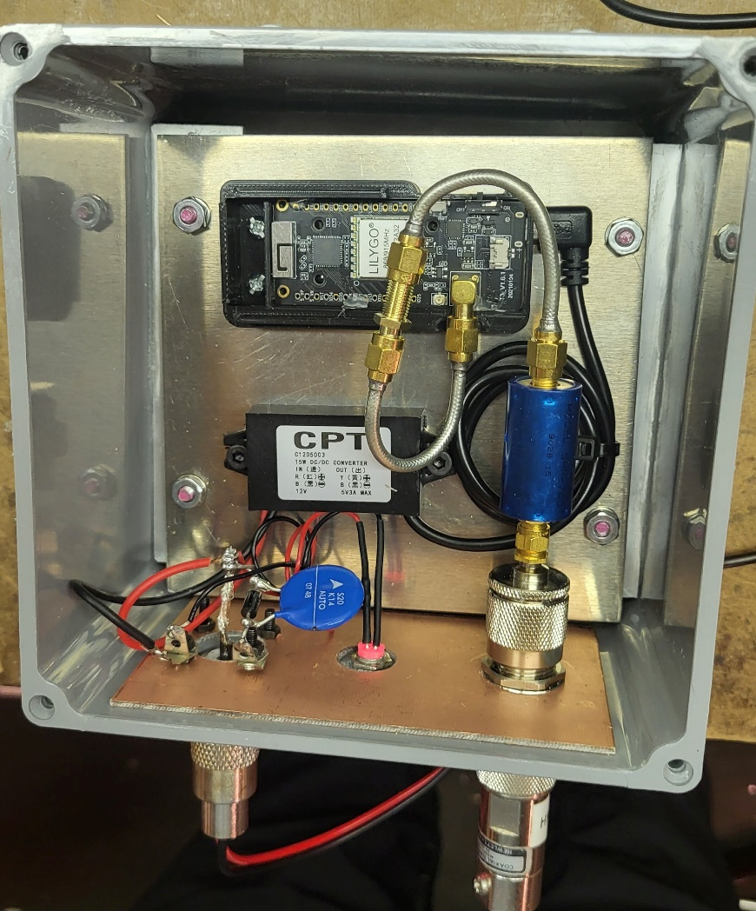
Inside the node
The filter you see there is a high-pass filter, the purpose of which is to reduce signals from the repeaters. It has a cutoff frequency of about 750 MHz. That is, signals below 750 MHz are attenuated.
The final version eliminates that semi-rigid coax (since the radio circuit board itself has a lot of direct pickup, it’s pointless to use fancy coax here) and we have added a bandpass filter centered on 907.5 MHz. This is to reduce pickup of the very strong signal on 929 MHz near Mt. Pone.

