Slide 1

Artificial Intelligence for
Ham Radio Operators
Artificial Intelligence for
Ham Radio Operators
An exploration of benefits and opportunities
July 2025 Update
Alan Skerker KC4ZA

Slide 2
The Main Take-Aways
AI is becoming an increasingly important commodity with far reaching geopolitical and social consequences. In the words of Henry Kissinger and Eric Schmidt we are in the “Age of AI.” We will talk about little about how we got here.
The power of AI derives from a few key computer technologies and the ability to access vast amounts of data: Large Language Models, Neural Networks, Computer Vision.
AI applications are starting to emerge that have the potential to dramatically change our hobby. You will listen to clips by Gerald, OE1QAG using AI in SSB contesting, and hear the AI application RM Noise in action.

Slide 3
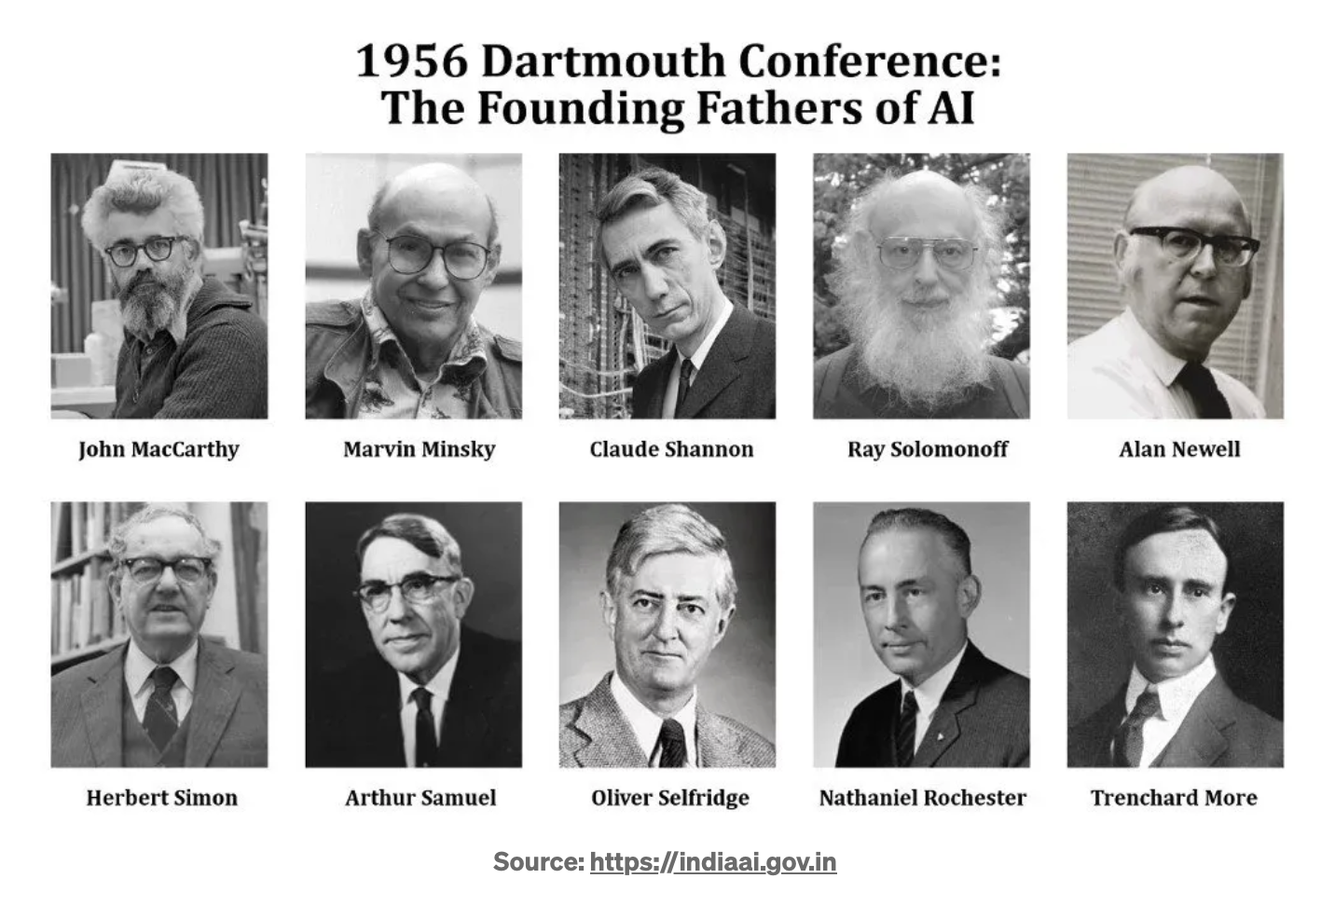
“The study is to proceed on the basis of the conjecture that every aspect of learning or any other feature of intelligence can in principle be so precisely described that a machine can be made to simulate it.”
A Proposal for the Dartmouth Summer Research Project on Artificial Intelligence J. MacCarthy, M. Minsky, C. Shannon, N. Rochester, Aug 31, 1955

Slide 4
What is Artificial Intelligence?
Artificial Intelligence refers to computer systems that perform tasks associated with human intelligence such as learning, problem solving, and decision making.
AI systems may appear to mimic how we think and solve problems; however, these systems work in a very different manner than the inner workings of the human brain.

Slide 5
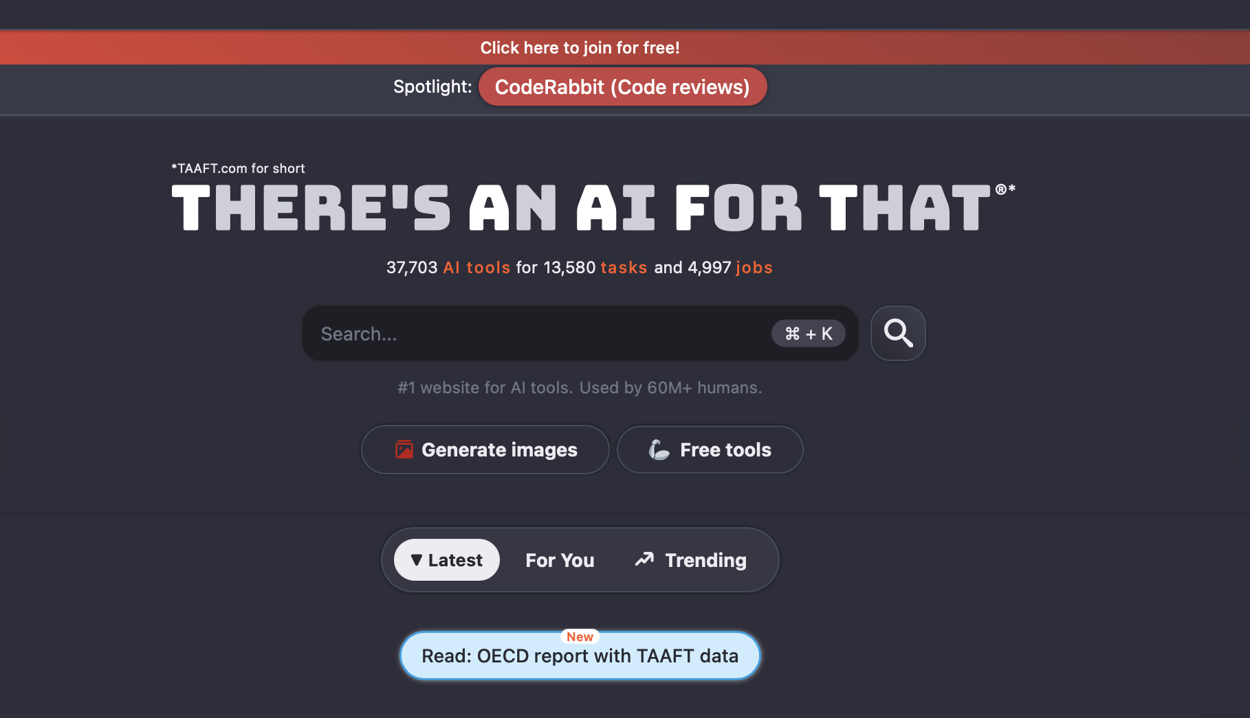
AI is Prevalent Throughout Our Daily Lives
Chatbots: Alexa, Hey Google, ChatGPT
Ride Share apps: Uber, Lyft, Curb
Self driving cars, package delivery and restaurant robots
Computer search engines
Banking and Credit Card fraud detection
E-commerce: connect social media users to products, inventory, secure payment portals
Email apps: automated categorization, auto-reply
Facial Recognition
Generative image applications
Streaming TV/Video services
Smart watches, body worn health monitors
Robot vacuum cleaners, smart door locks, smart thermostats…
Google Maps, Apple maps, WAZE - real time traffic updates, navigation…
Real estate - Zillow
https://theresanaiforthat.com/
37,703 tools 13,580 tasks 4997 jobs

Slide 6
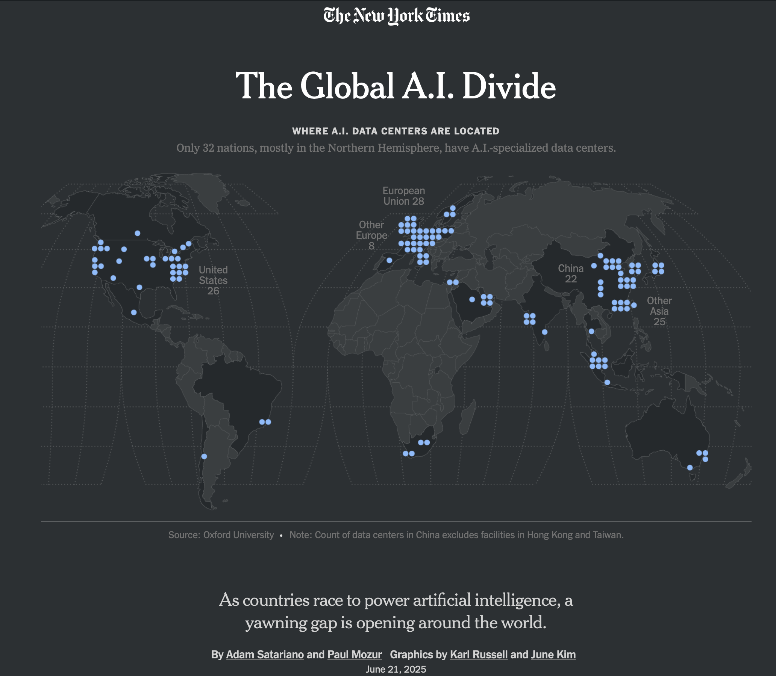
NIMBY… The Data Center quandary!
The US, Europe, and China are positioning to own the data that AI depends upon.

Slide 7
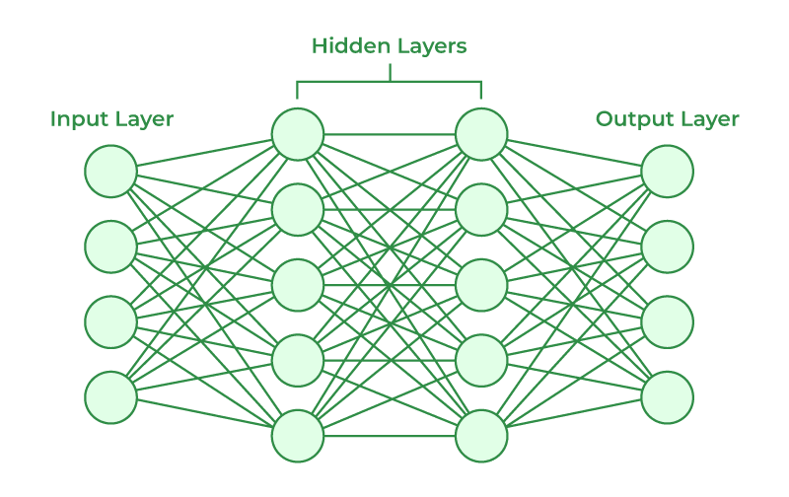
Underlying Technologies
Machine and Deep Learning… Neural Networks
  Neural networks are trained to identify hidden patterns in complex data that lead to solving problems
  Training, which involves the adjustment of weights between neurons to give accurate responses involves 10’s to 100’s of billions of parameters.
Inputs process data… sensor, numerical, images, text, audio
Output layer provides a response
Hidden layers (software “neurons”) transform the inputs into something that the output layer can use. These layers and connections are the “brain” of the network, responsible for “deep learning”

Slide 8
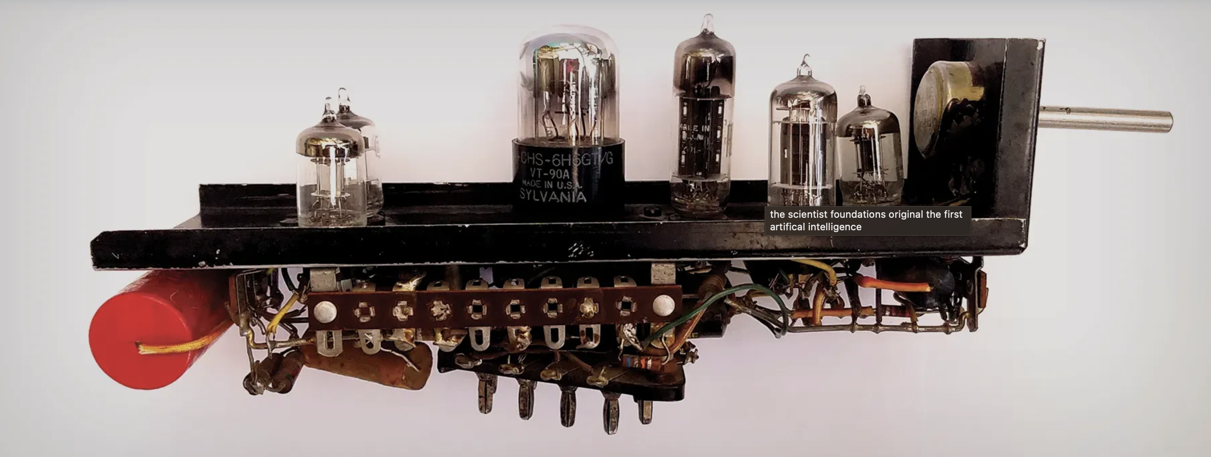
Underlying Technologies
Machine and Deep Learning… Neural Networks
  Marvin Minsky 1951 developed the first randomly wired neural network learning machine: Stochastic Neural Analog Reinforcement Calculator (SNARC)
  Solved the problem of a rat negotiating a maze
One of 40 SNARC neurons… the assembled machine was about the size of a grand piano

Slide 9
Underlying Technologies
Large Language Models
  Parse and generate language and code: may be domain specific or generalized
    Domain-specific: Med-PaLM2 (medical), BloombergGPT (finance), ChatLaw
    Generalized: Meta AI LLaMa (Large Language Model Meta AI), OpenAI’s GPT-3/4
  Utilize Natural Language Processing (NLP) and Natural Language Understanding (NLU) algorithms to accomplish multilingual classification, translation, free-text generation, sentiment analysis, and entity recognition
  Very fast information retrieval and semantic searches
GPT
Generative Pre-Training Transformer
Create new content
Pre-Train on large data sets
Understand context and relationships

Slide 10
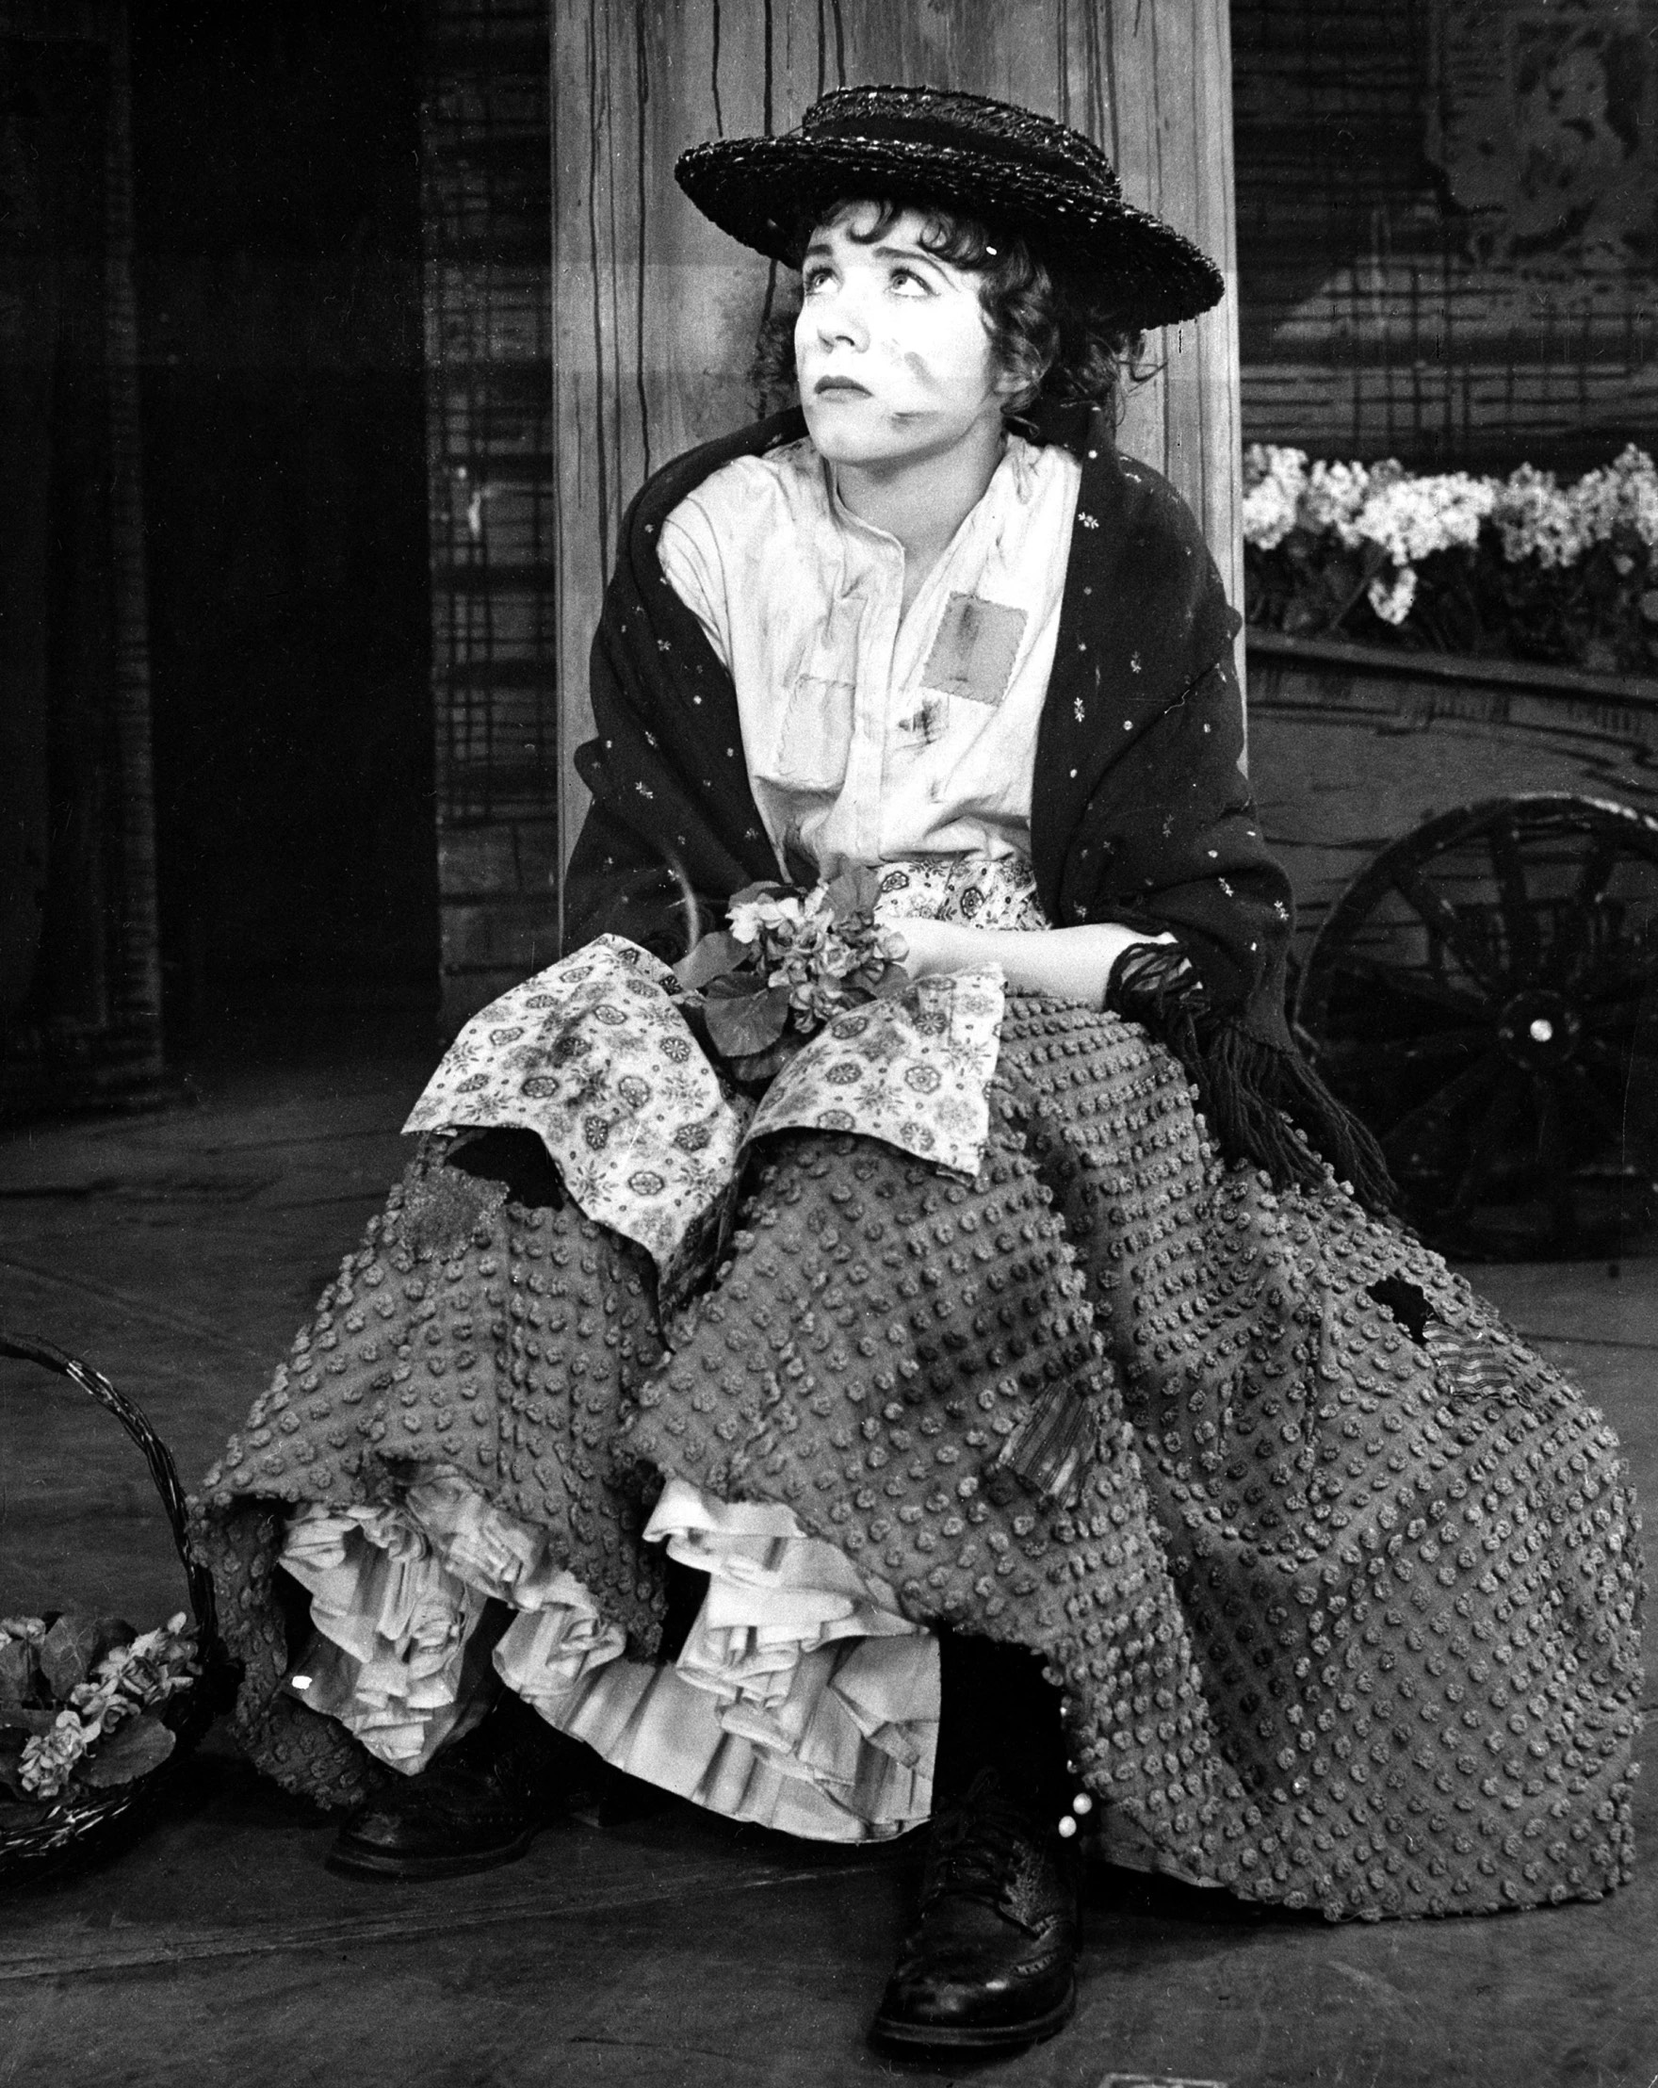
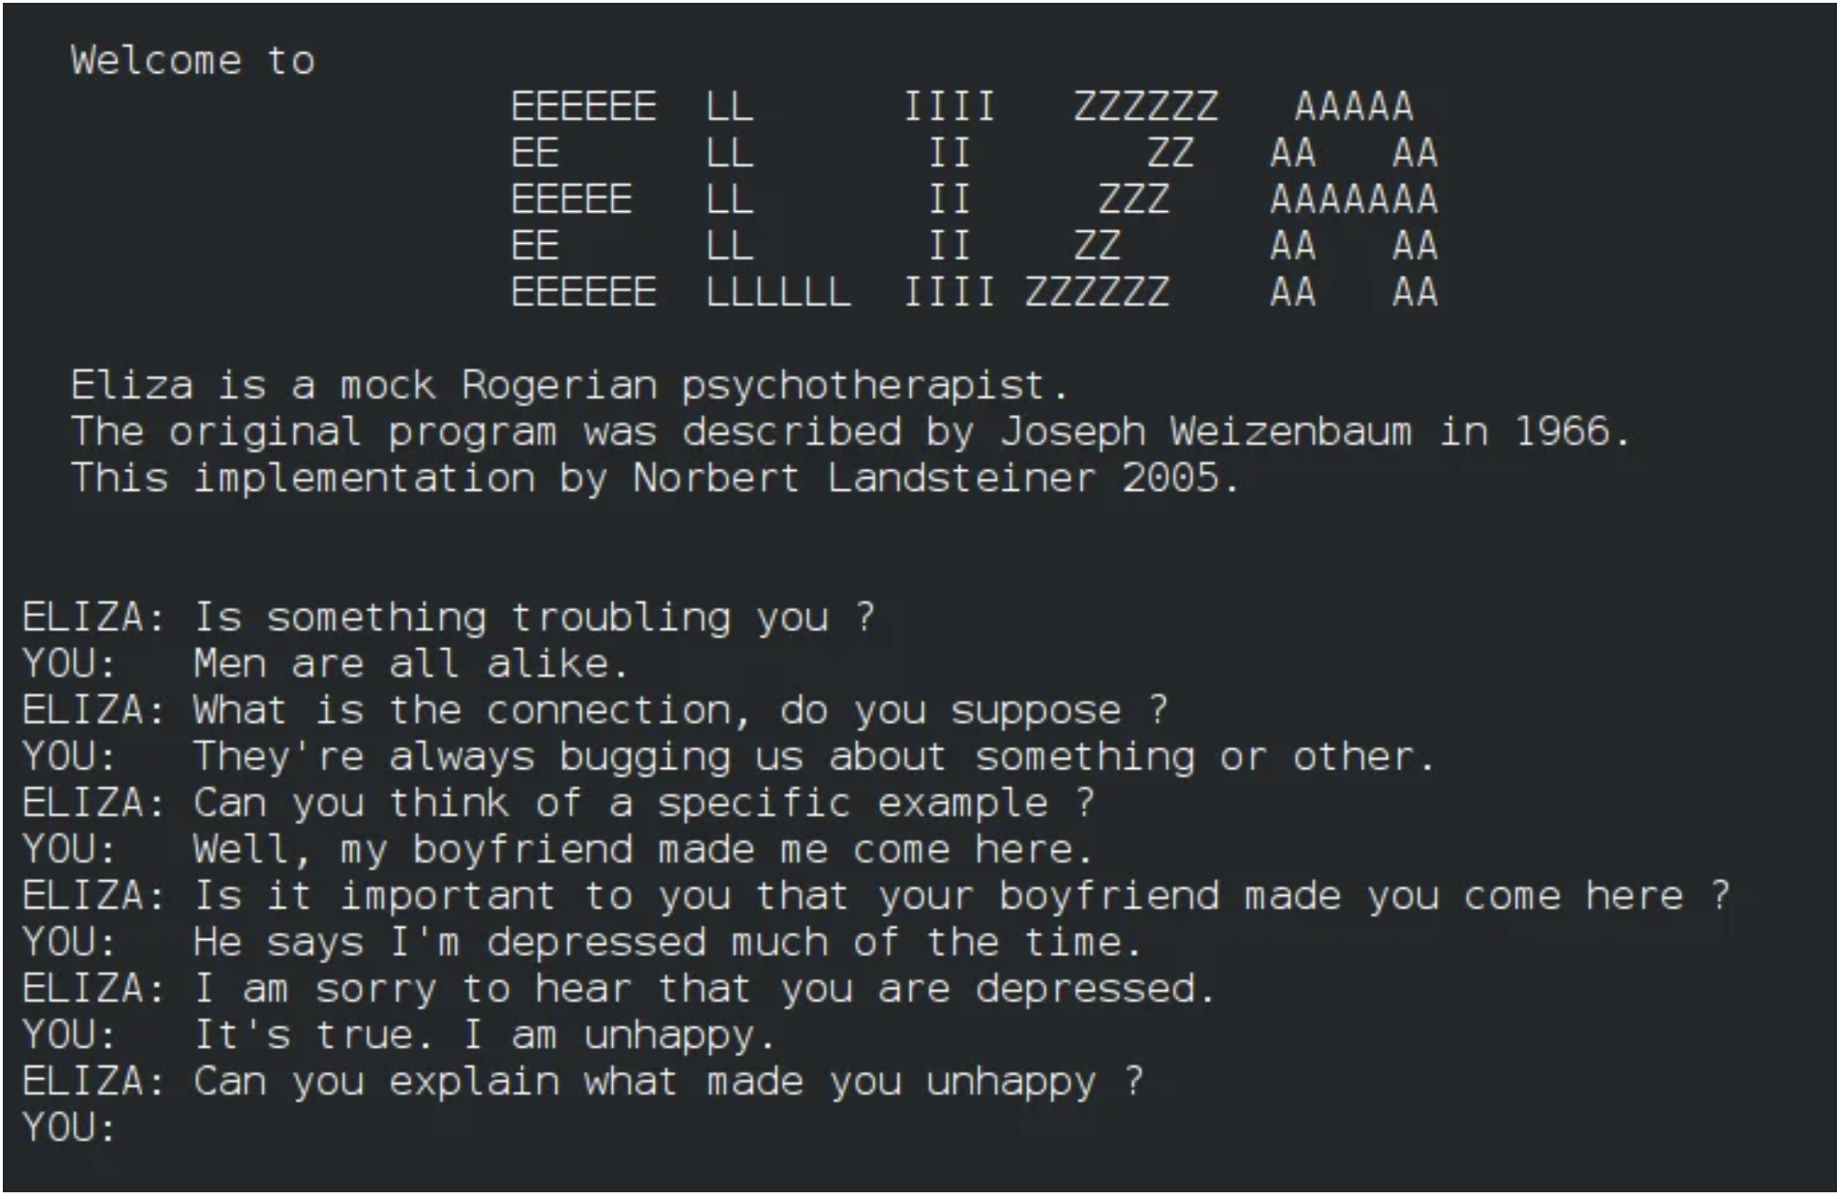
ELIZA the First Chatbot
Not an LLM in the modern sense, but a precursor that demonstrated computer processing of natural language.
Was the first AI ChatBot. Developed in 1966 by Joseph Weizenbaum at MIT. Named after Eliza Doolittle, the protagonist in George Bernard Shaw’s play Pygmalion and in the theatrical production, My Fair Lady by Lerner and Loewe.
Most famous of the Eliza scripts, “Doctor” simulated the Rogerian school of psychotherapy (Carl Rogers); the therapist reflects the patient’s words to stimulate conversation.
Here are two versions of “Doctor” on the web that you can try:
https://web.njit.edu/~ronkowit/eliza.html
https://sites.google.com/view/elizaarchaeology/try-eliza
Julie Andrews as Eliza Doolittle, 1954

Slide 11
Underlying Technologies
Computer Vision
  In general computer vision extracts data through imaging sensors and interprets what it “sees” in order to accomplish some task.
  In the context of radio, computer vision could detect and interpret features on screen displays, track and interpret operator eye movements or gestures to initiate some tasks.

Slide 12
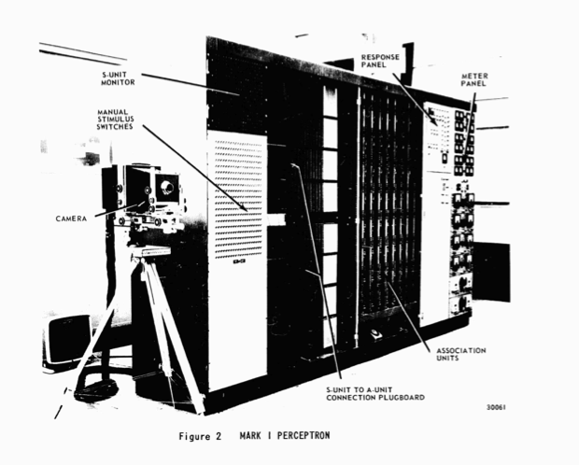
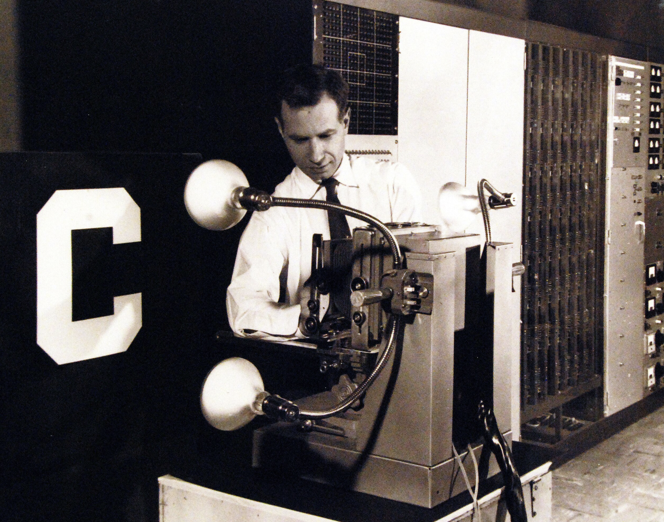
Underlying Technologies
  Frank Rosenblatt’s Perceptron Mark I (1957). Used supervised learning to classify images; first experiment to distinguish whether a mark on a paper was on the left or right. Later experiments learned to classify letters and other simple images

Slide 13
Ham Specific AI Tools are Emerging
Gerald Artner, OE1GAQ experimented with AI automated contest exchanges (with AI generated requests for repeats as needed) during the Feb 1, 2025 EU DX ssb contest. The experiment succeeded in establishing a proof of concept but some QSOs did require Gerald’s manual intervention and was more useful in the contest run mode than search and pounce.
https://www.geraldartner.at/files/GX3WTP.mp4
https://www.geraldartner.at/files/PD0R.mp4
https://www.geraldartner.at/files/G1ZHD.mp4
RM Noise, a Windows client application that dramatically reduces noise while in QSO. The app communicates in real time (delay on order of .3 ms) to the RM Noise project server to remove noise.
https://www.youtube.com/watch?v=YxIc5AIUVL4
Morse Decoder AI uses neural network technology to decode 10-40 wpm with 200-900 Hz tone
https://www.kvasha.us/product/morse-decoder-ai/
:

Slide 14
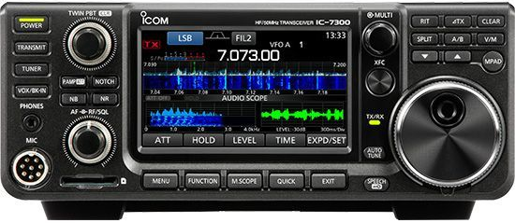
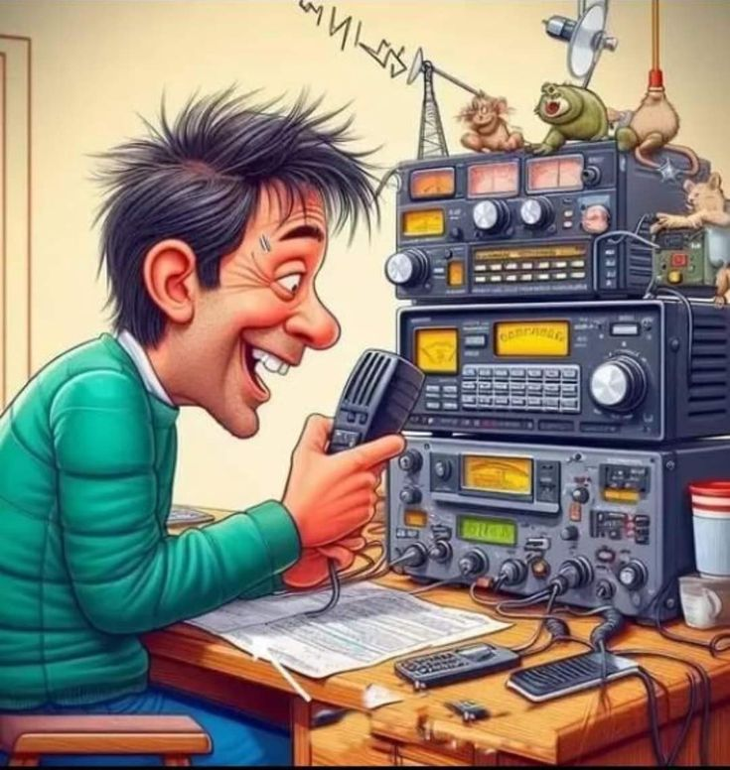
AI Can Help Improve our Operating Skills and Knowledge
Chatbots: personalize learning, operating and maintenance assistance
Intelligent radio interfaces that transform voice commands and prompts into radio-specific codes to perform tasks.
Improve signal reception. Manage modes and bandwidth utilization.
Improve propagation forecasts and prediction.
Hands-free logging and QSL management through natural language processing and AI understanding of the exchange.
Improve accessibility for operators with disabilities. Use of sensory operated radio interfaces such as sign language, eye movements
Enhance emergency communications and situation awareness.
Scarborough Reef is on 10m SSB want to QSY?
GO!!!!!

Slide 15
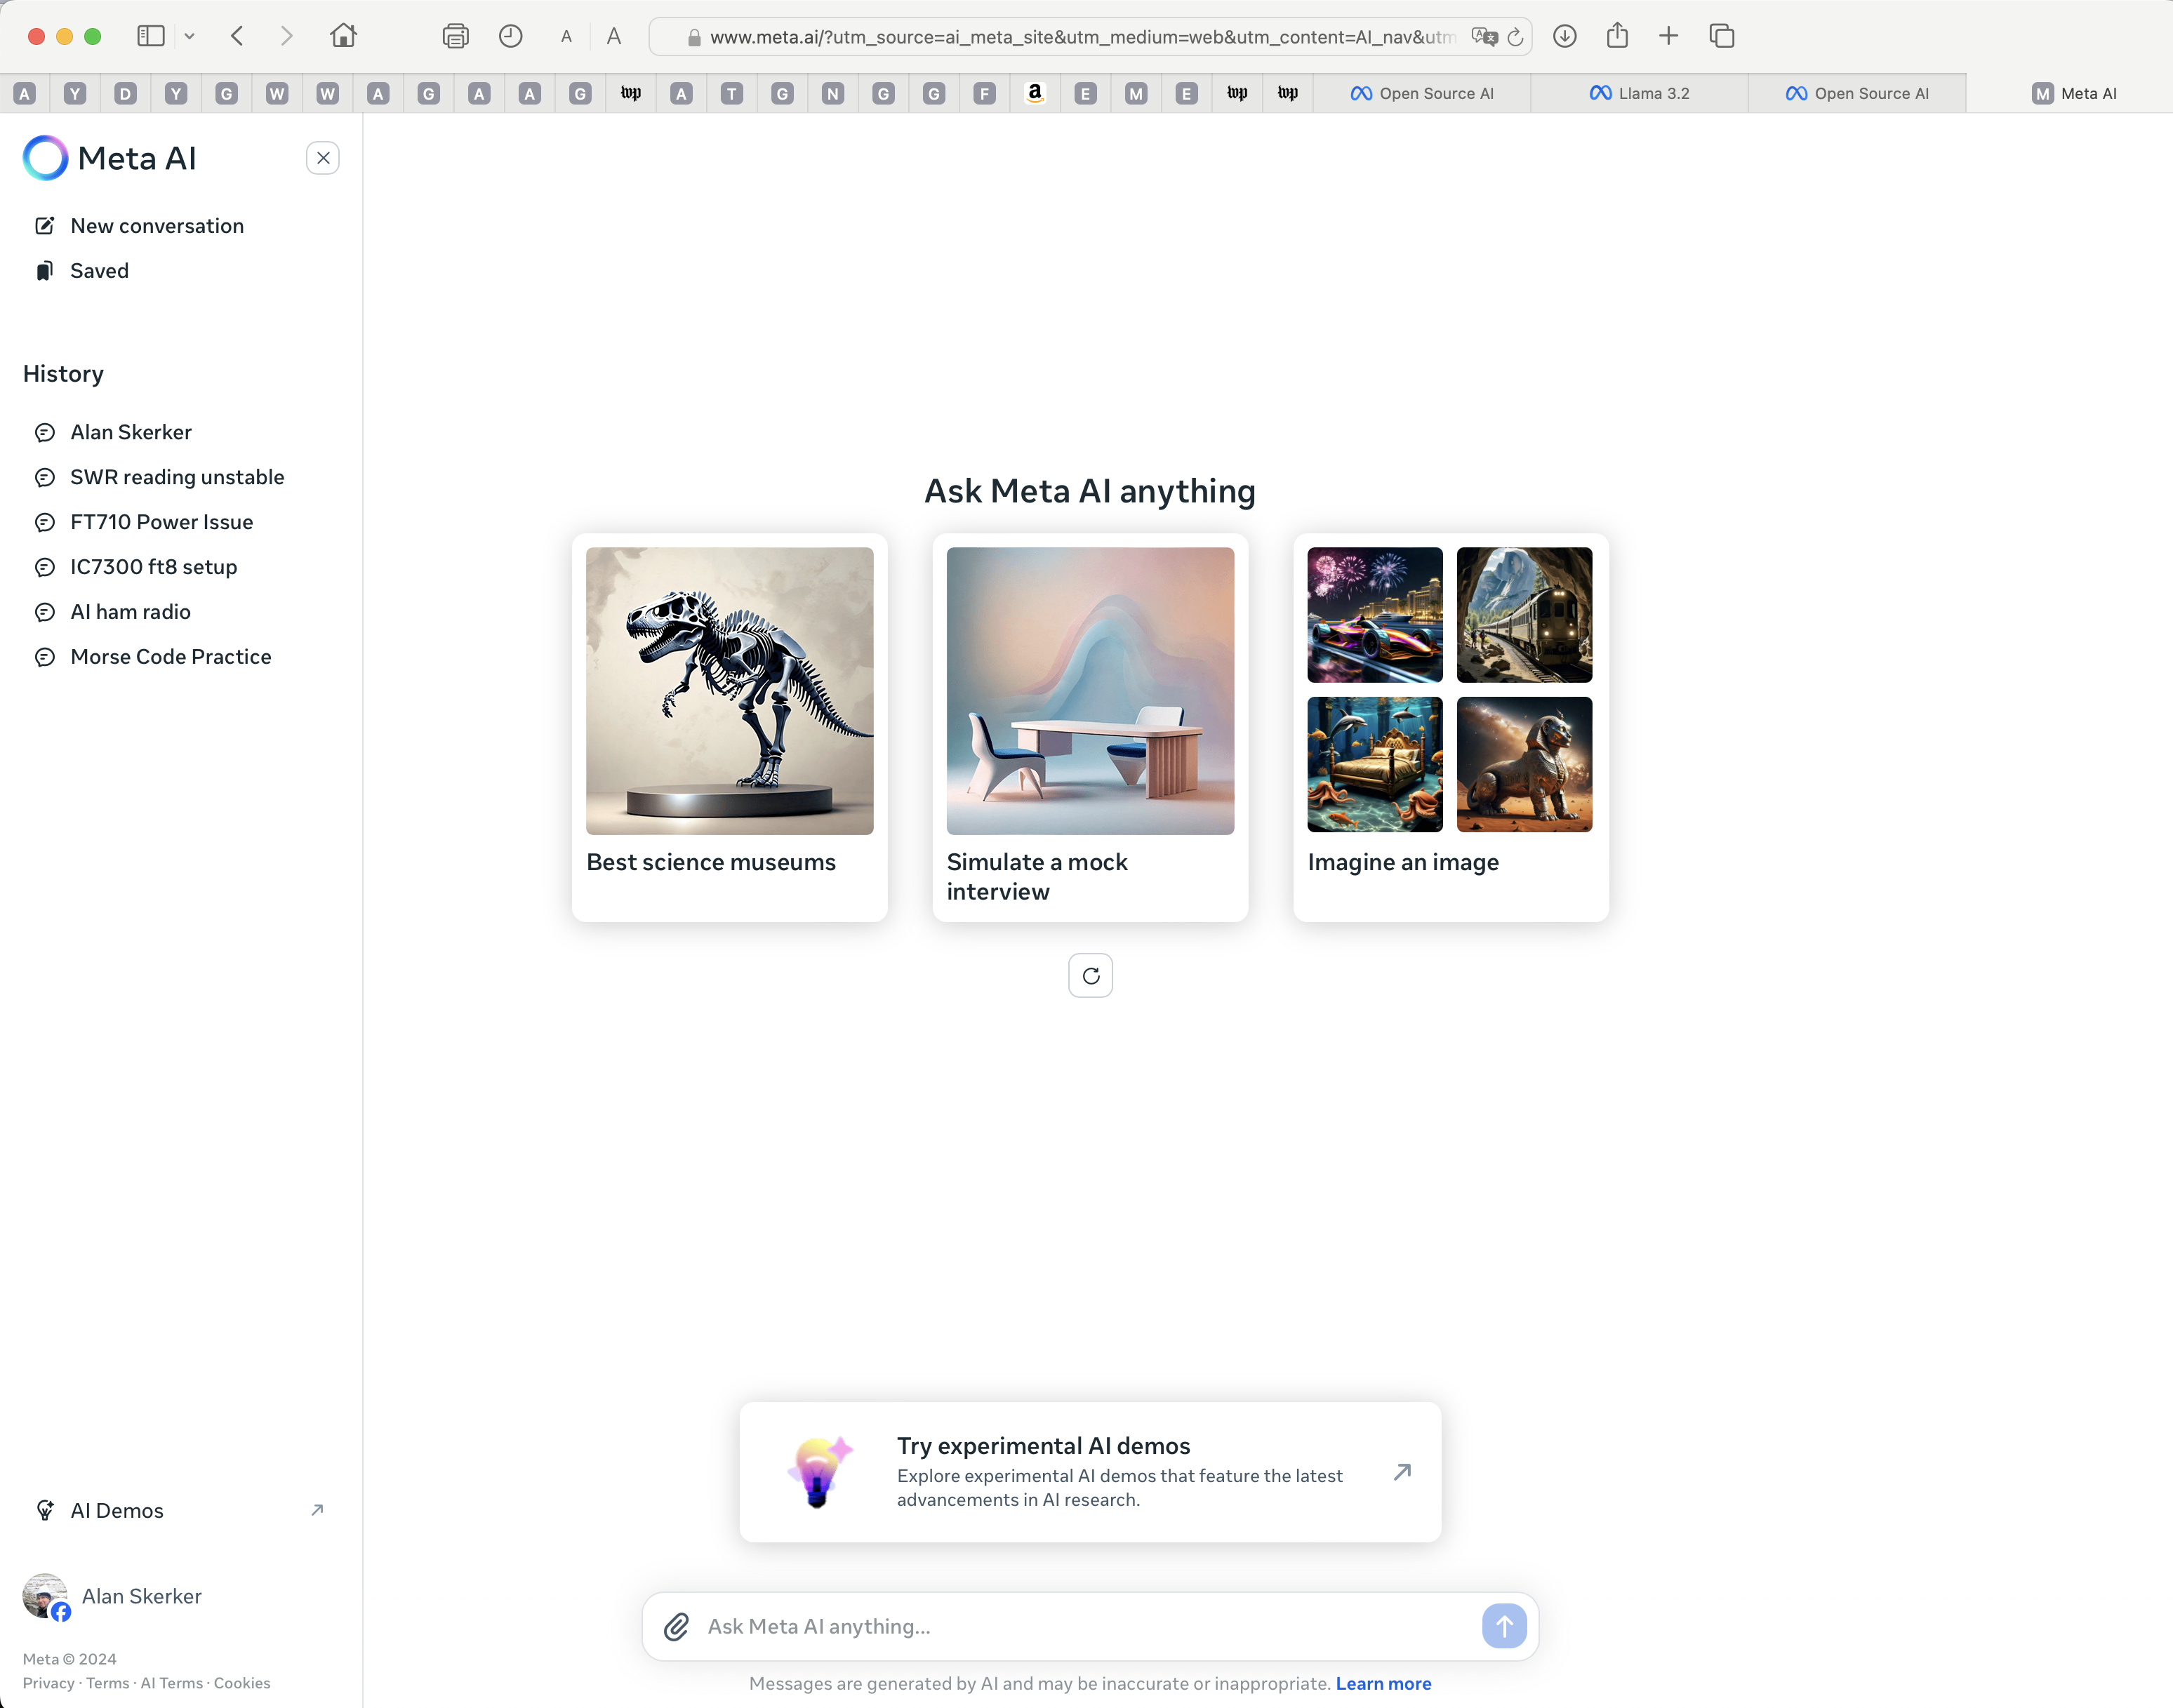
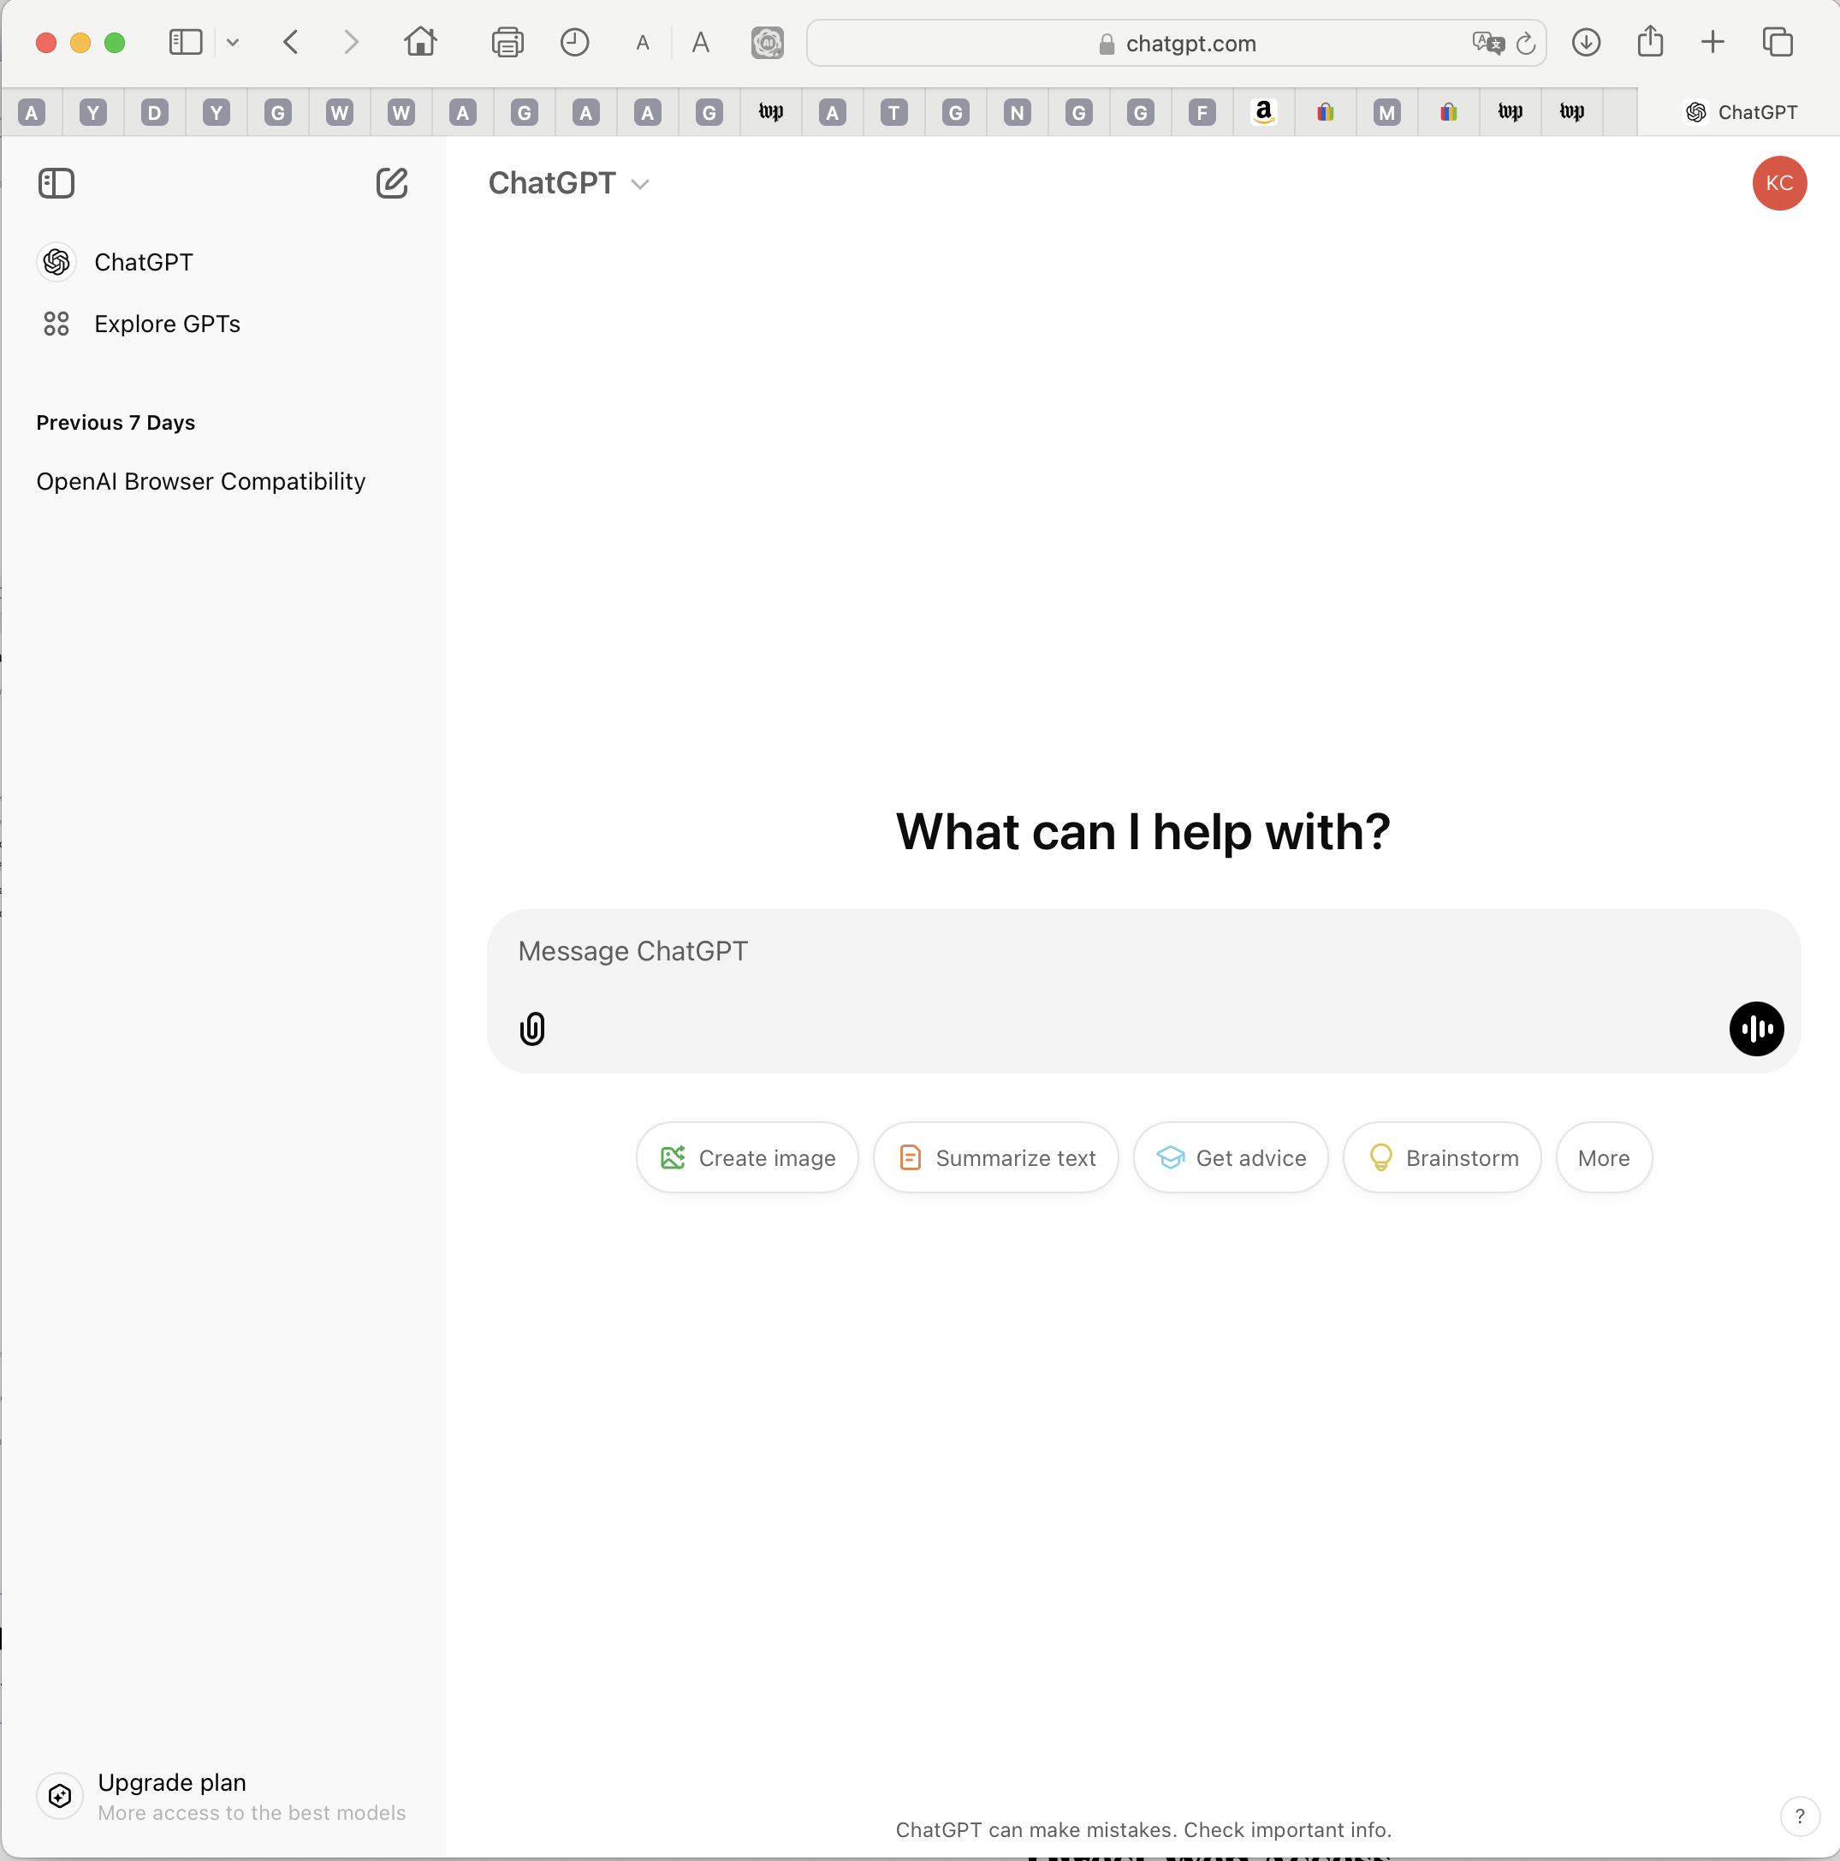
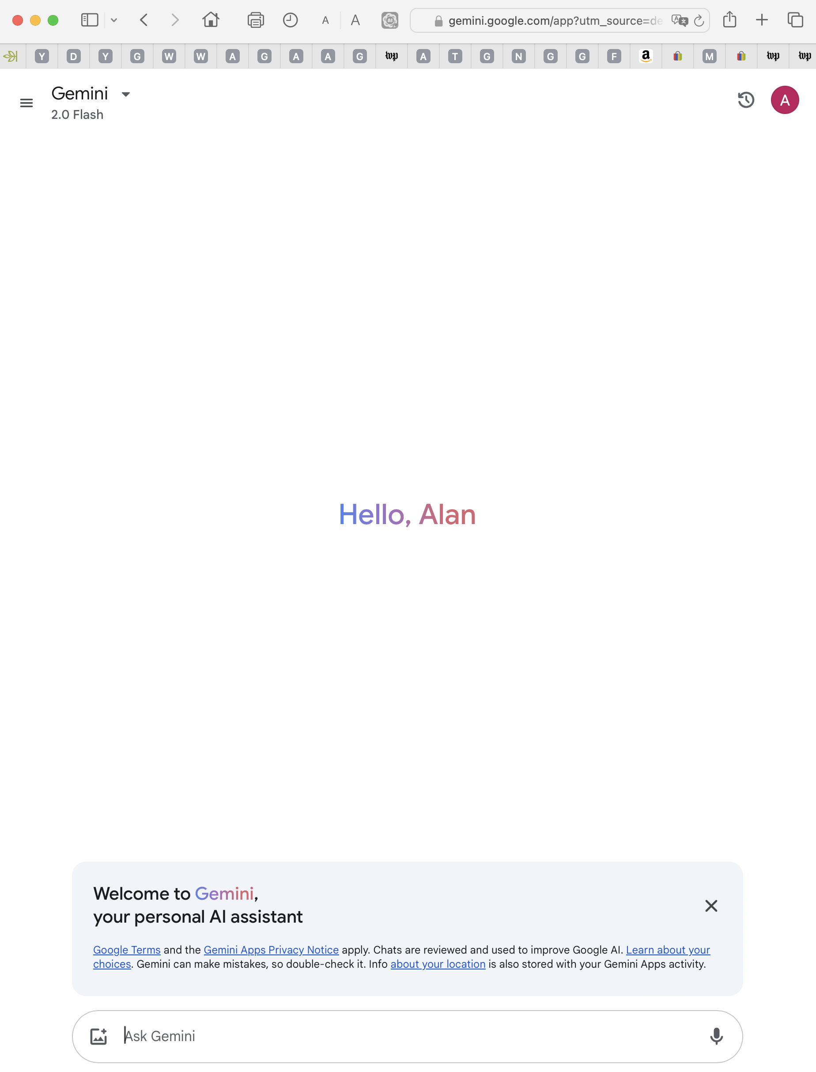
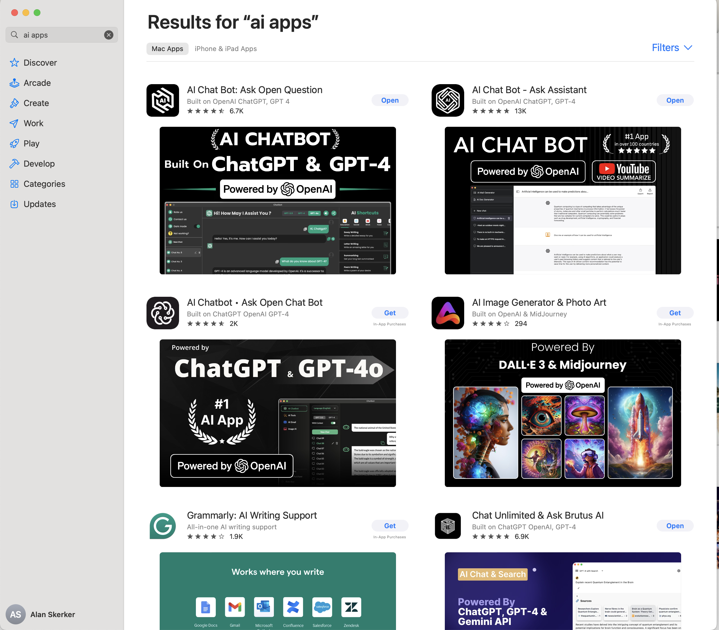
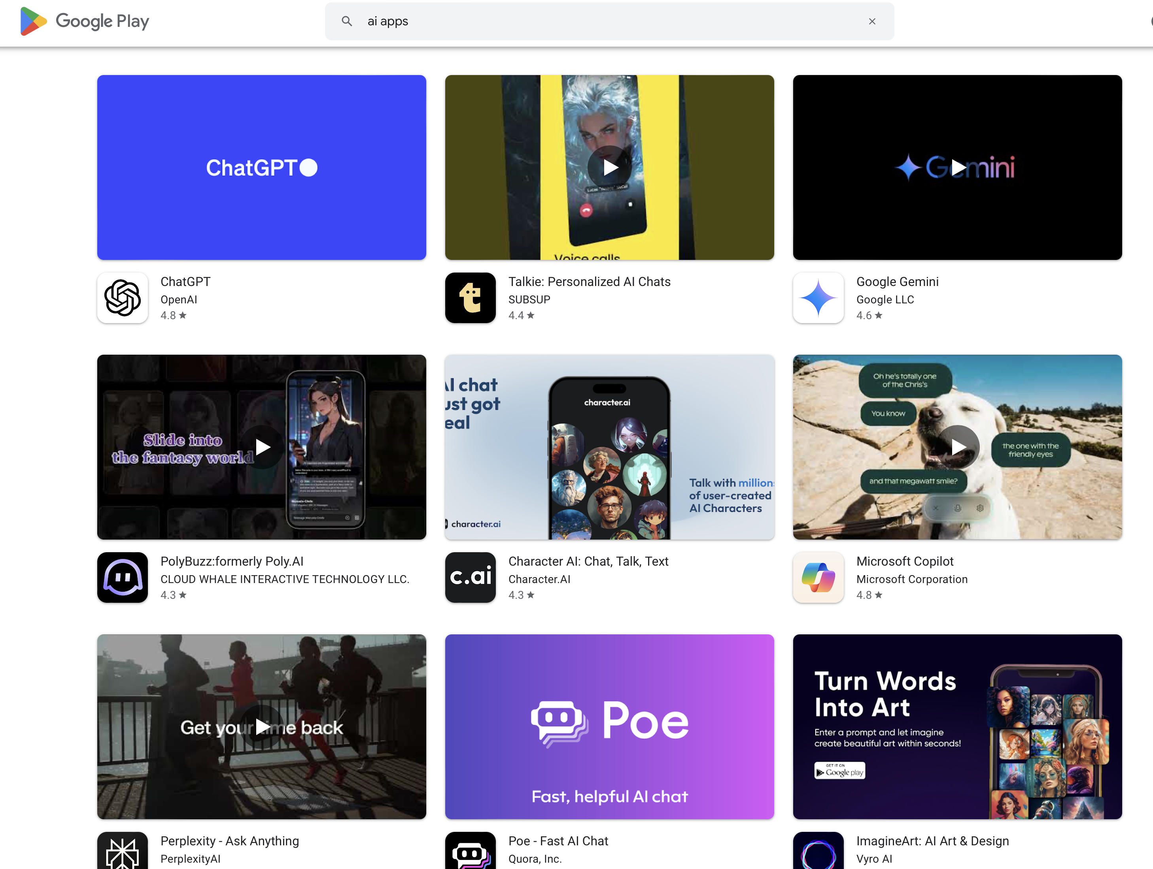
Chatbots are Everywhere
Web Browsers
App Stores
Meta AI Search Page
ChatGPT Search Page
Deep Mind - Gemini
Apple
Google Play
All of the latest search engines on current web browsers incorporate AI to improve search results, provide content summaries, offer personalized recommendations based upon your browsing history, and services such language translation, phishing and malware detection.

Slide 16
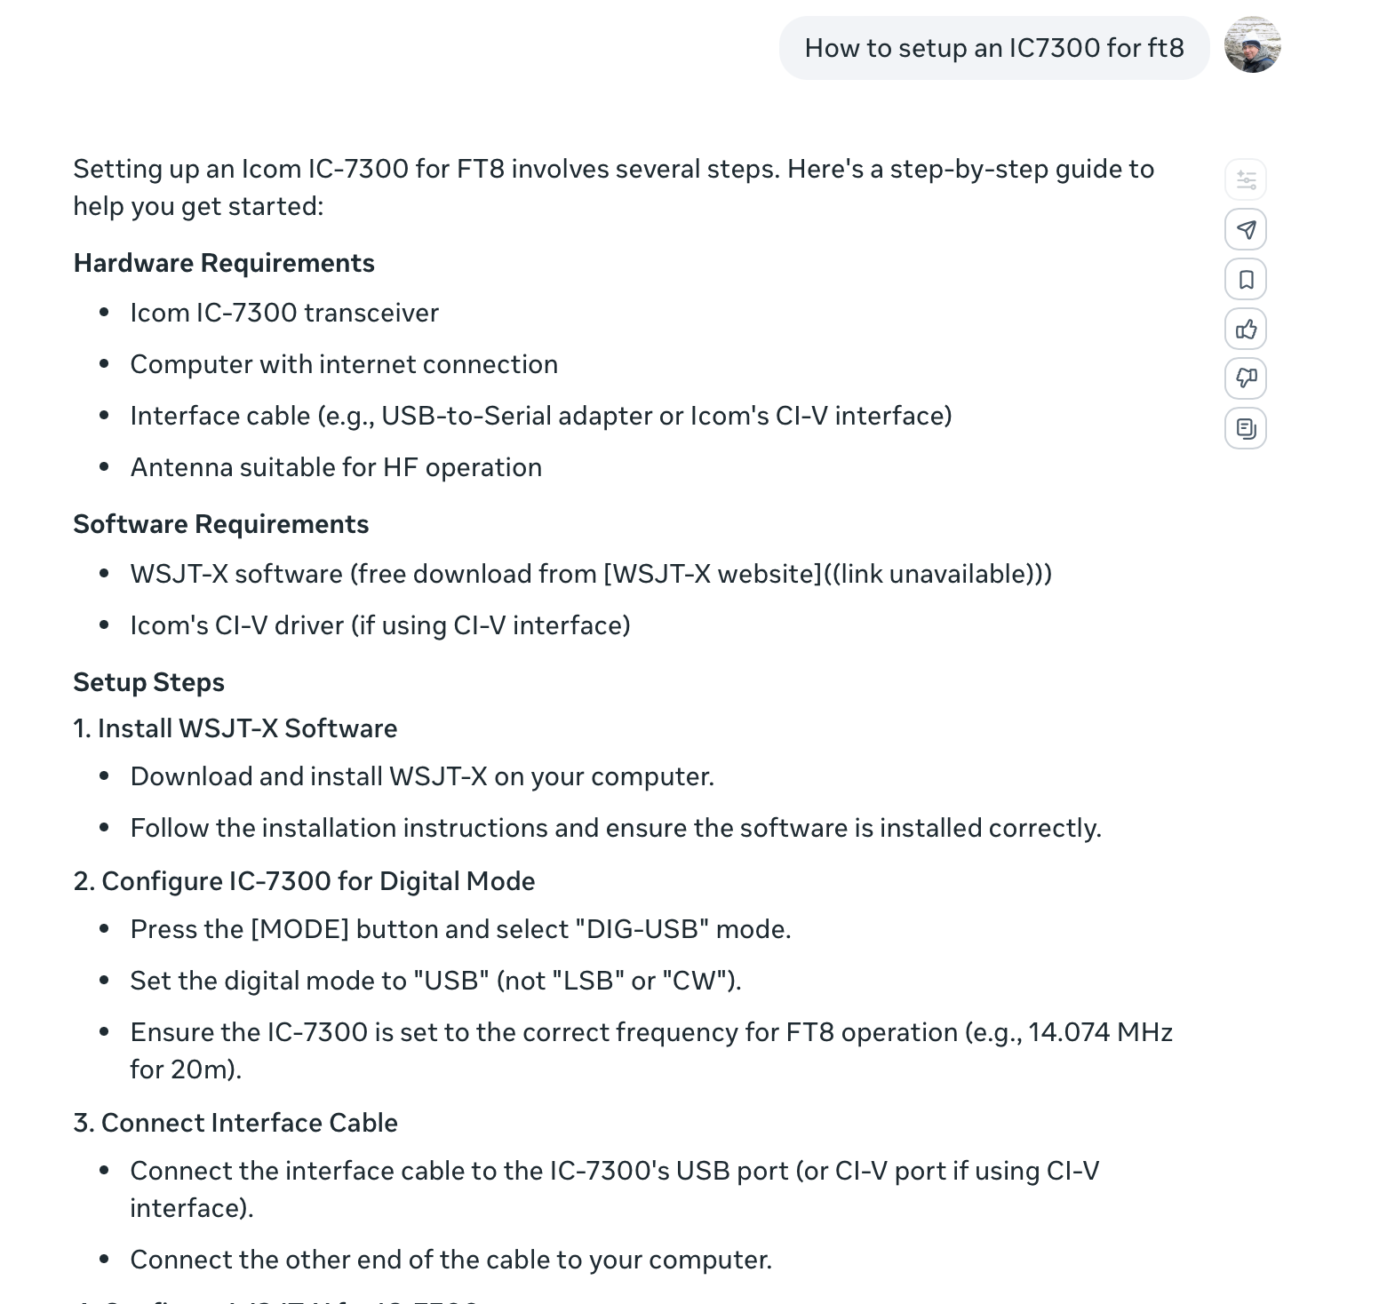
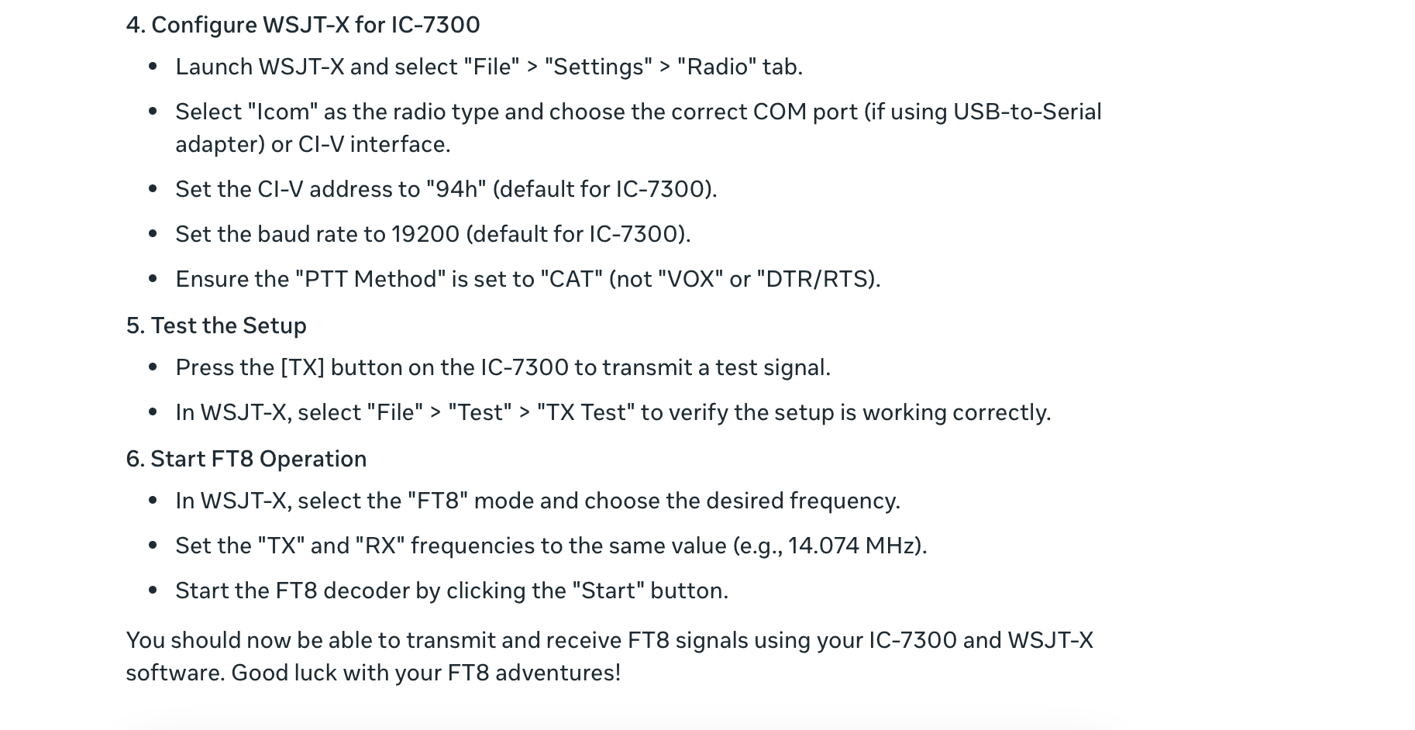
Personalized Assistance, Individualized Learning
A Response From Meta AI

Slide 17
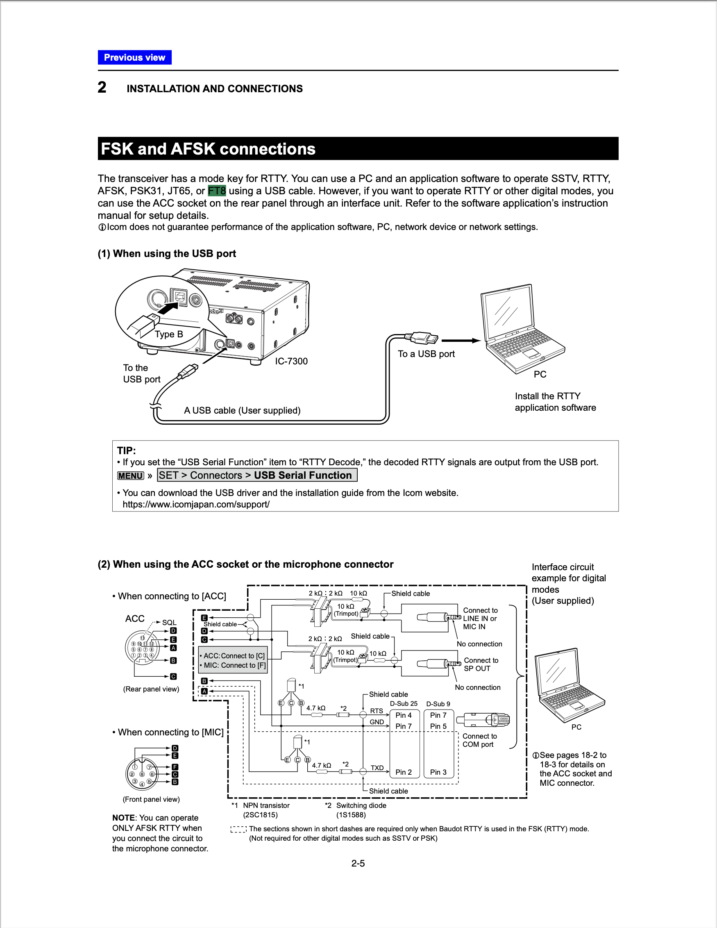
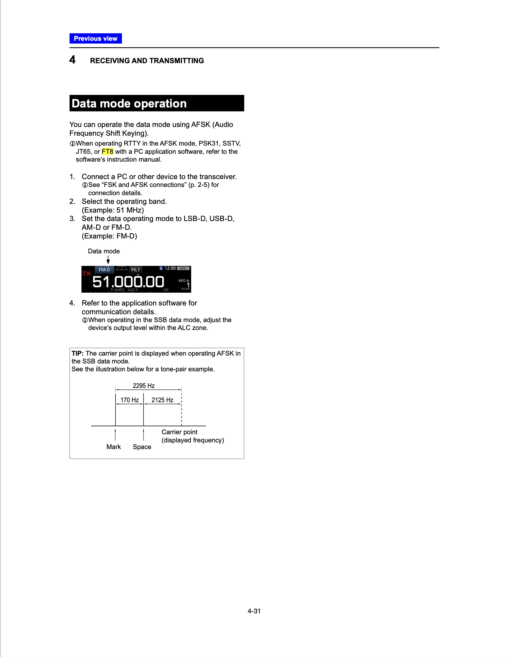
Compare Chatbot Response with Manual
Compare the Meta AI explanation with the results of searching for FT8 in the ICOM 7300 manual.
“FT8” only appears twice in the full manual.
Need to have known other terms to identify details that Meta AI found
Page 4-31
Page 2-5

Slide 18
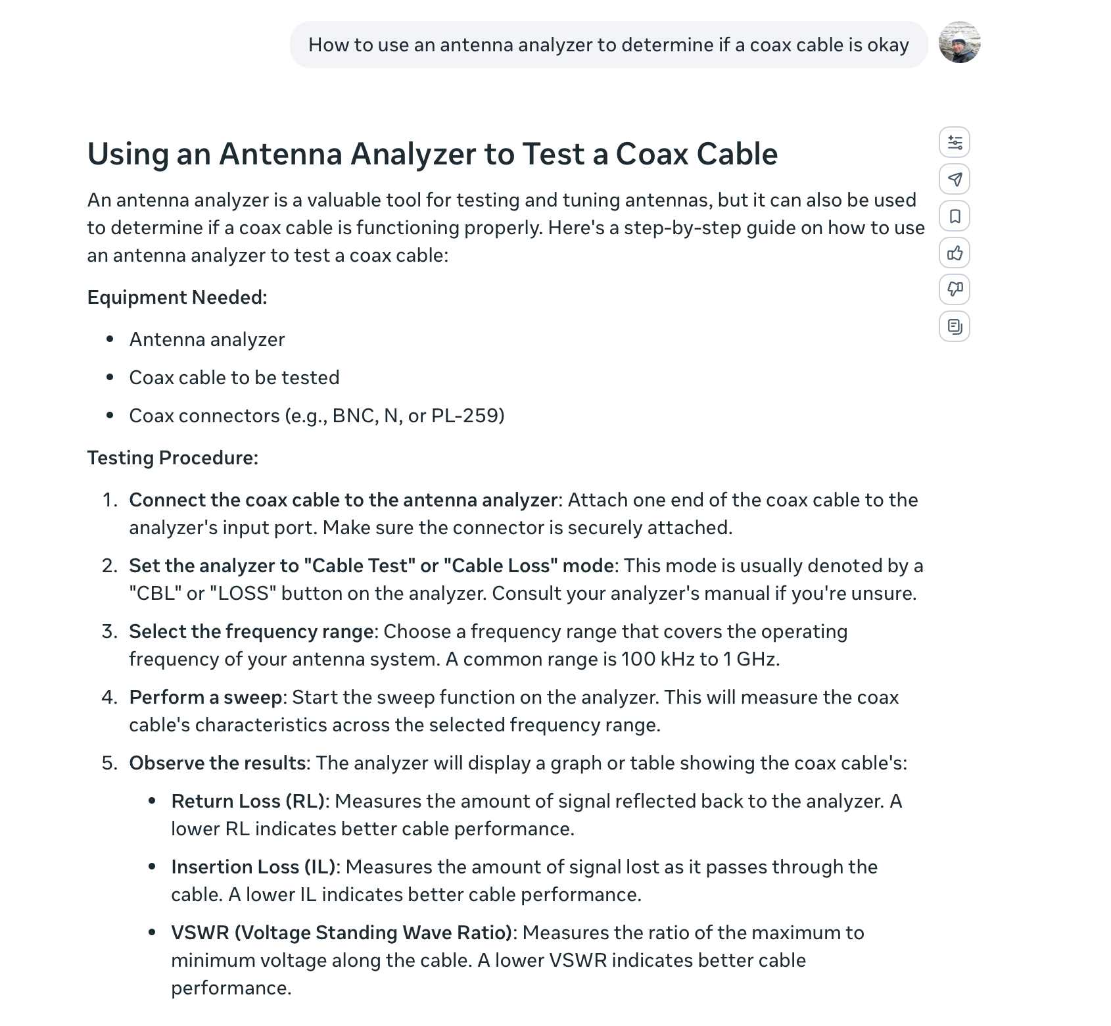
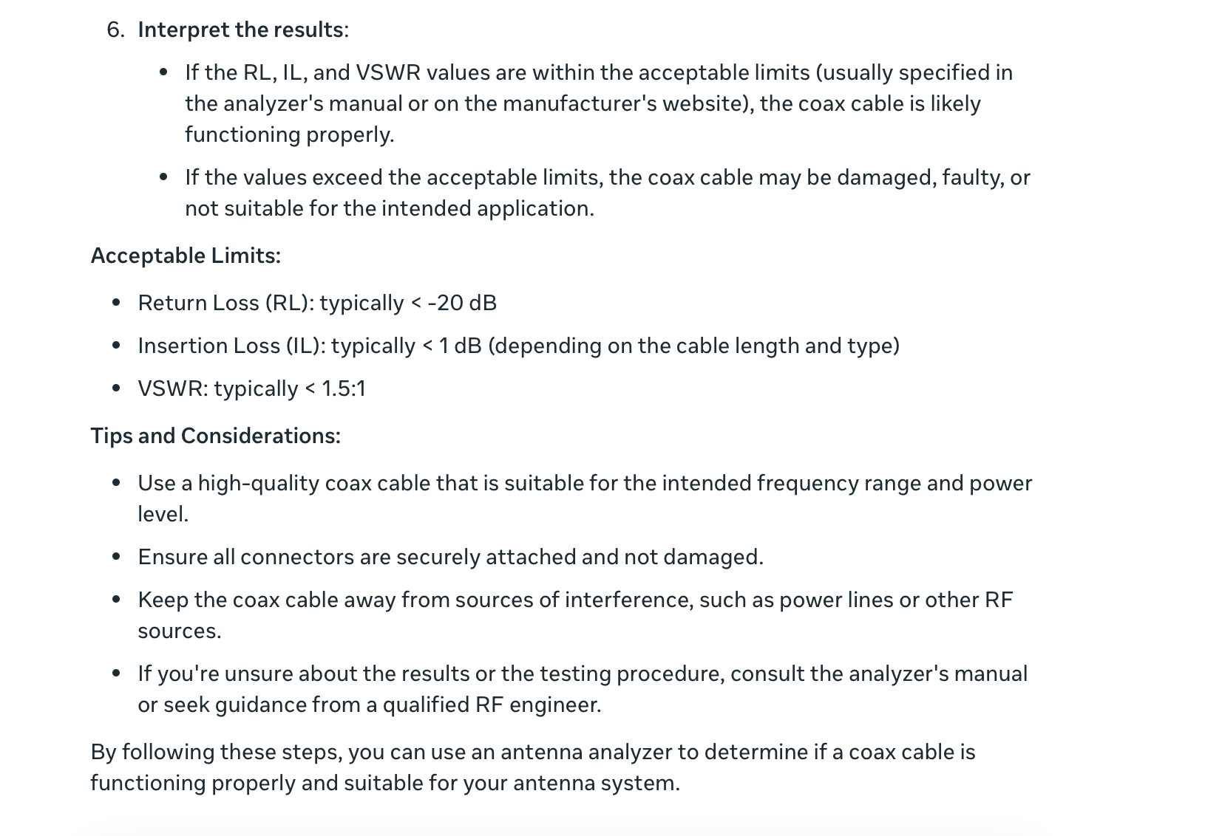
Personalized Assistance, Individualized Learning
From Meta AI

Slide 19
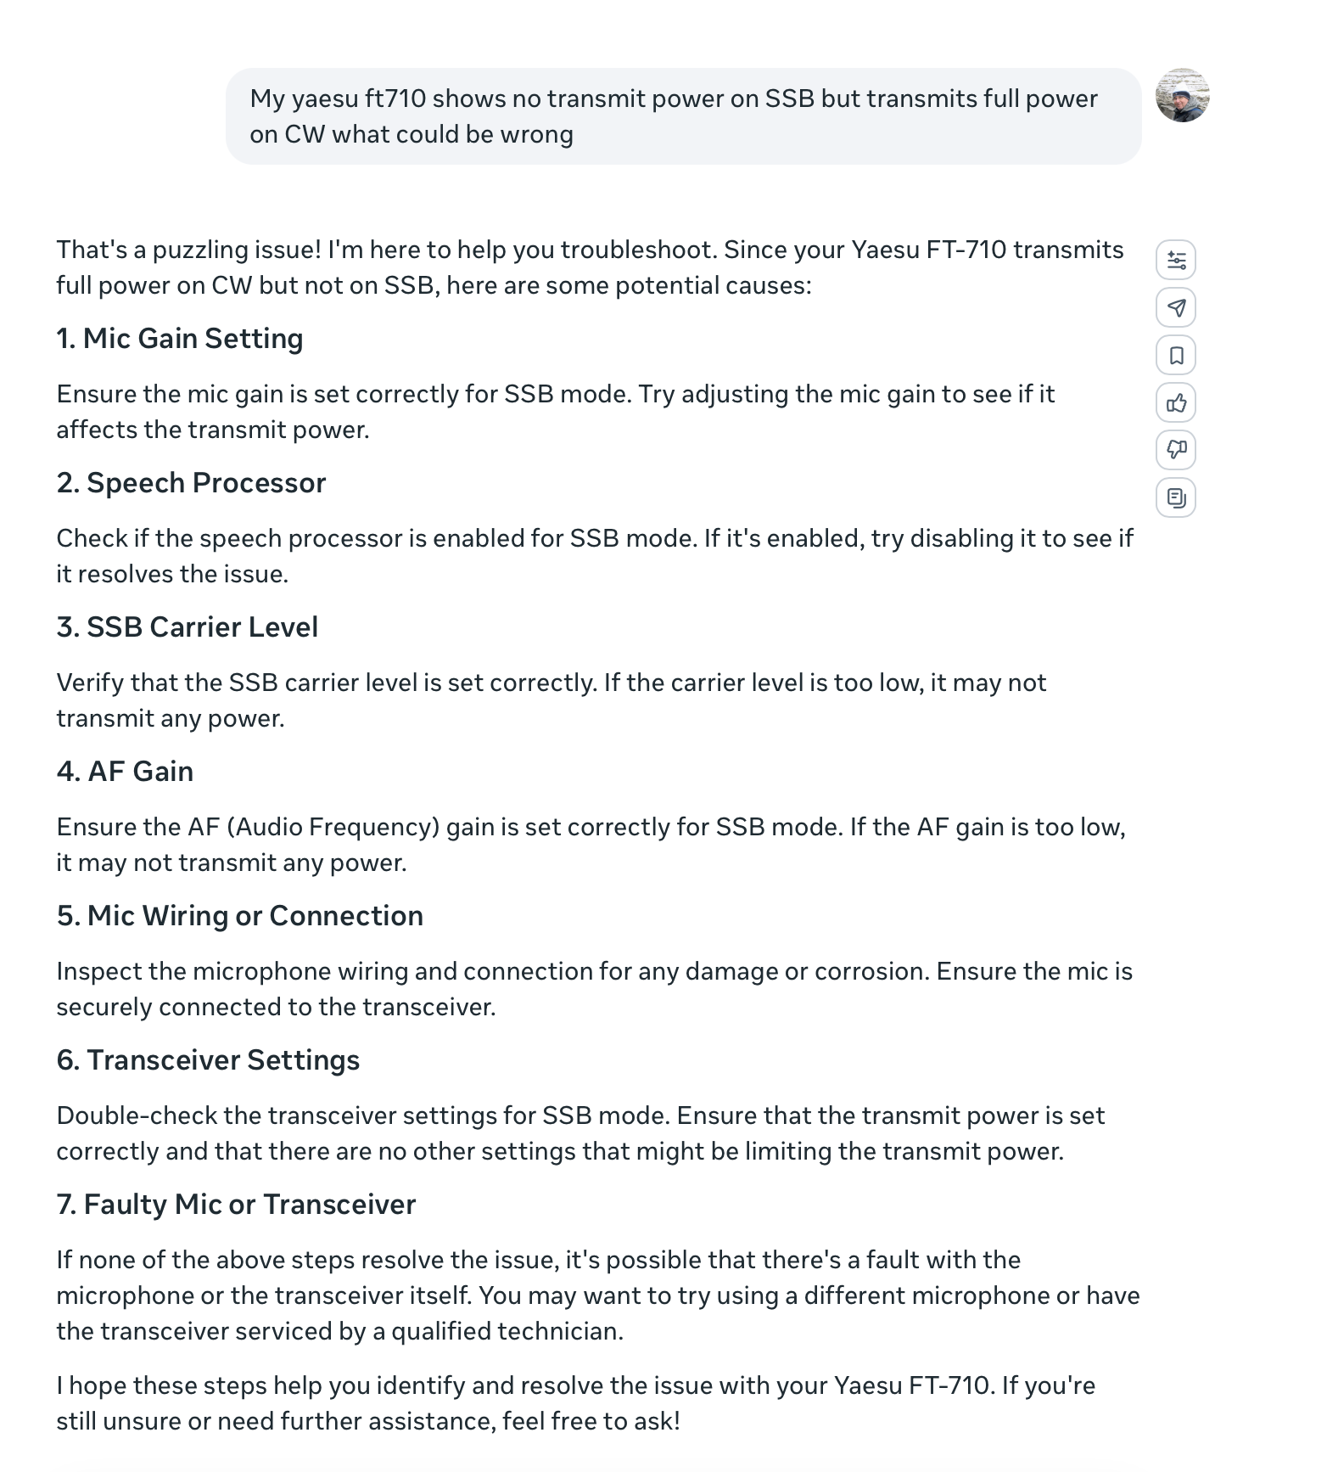
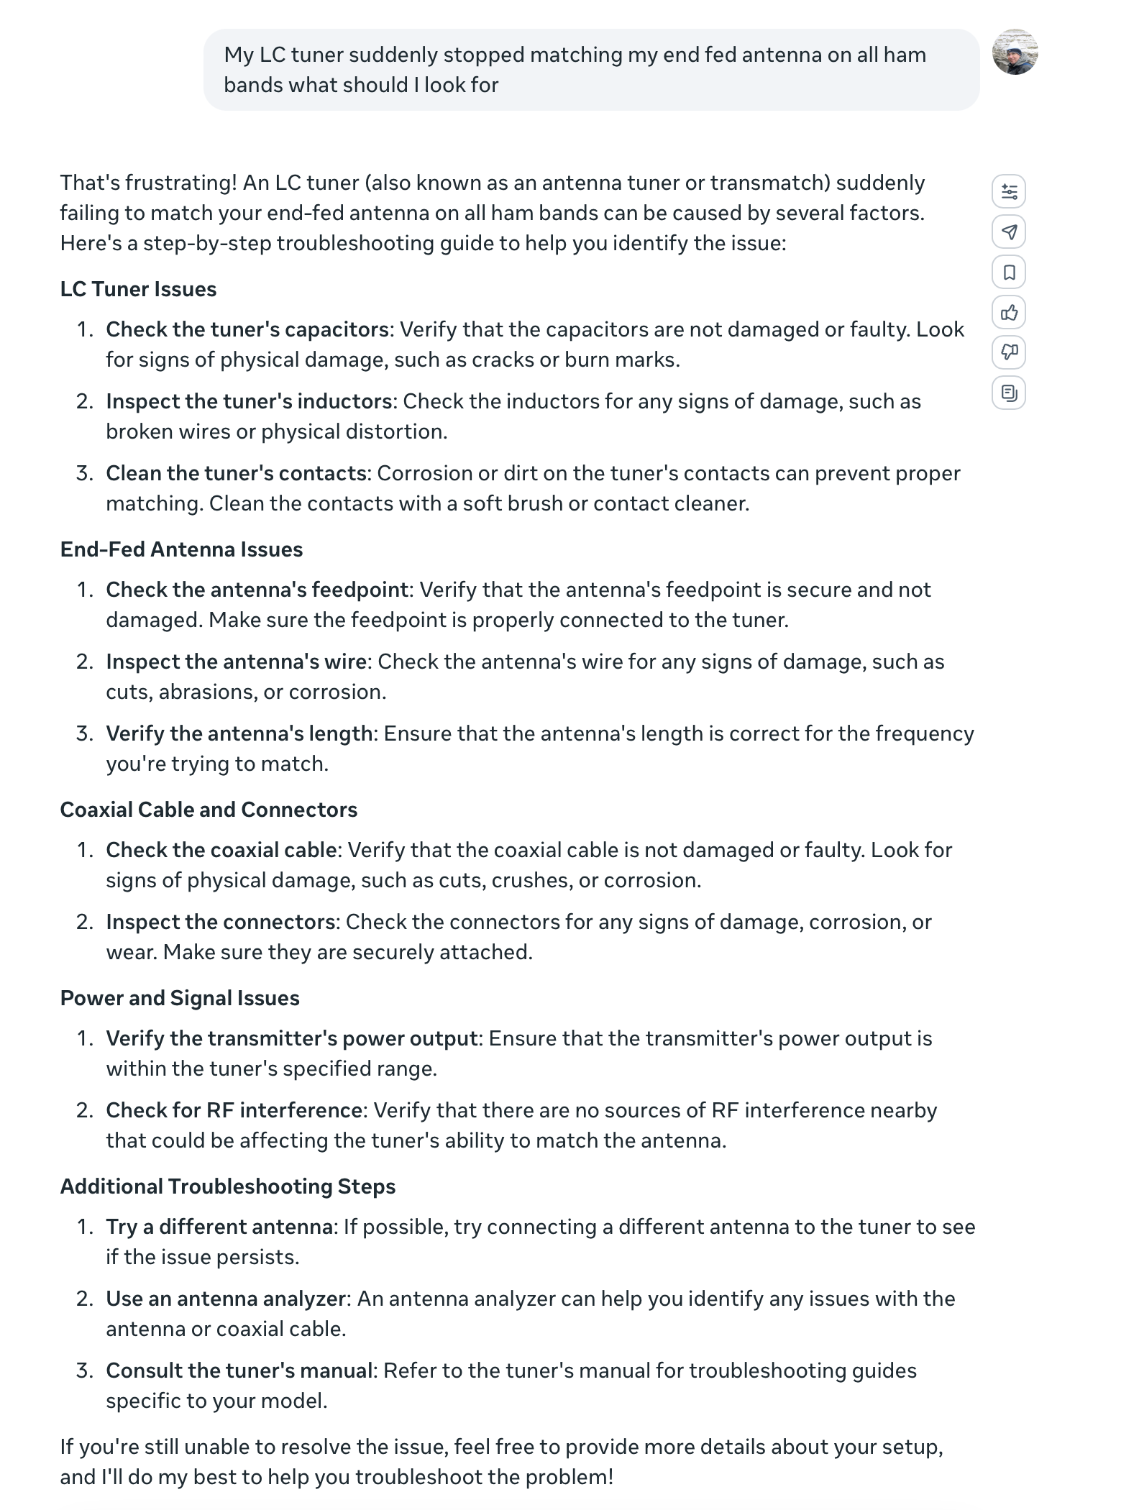
Diagnose Station Issues

Slide 20
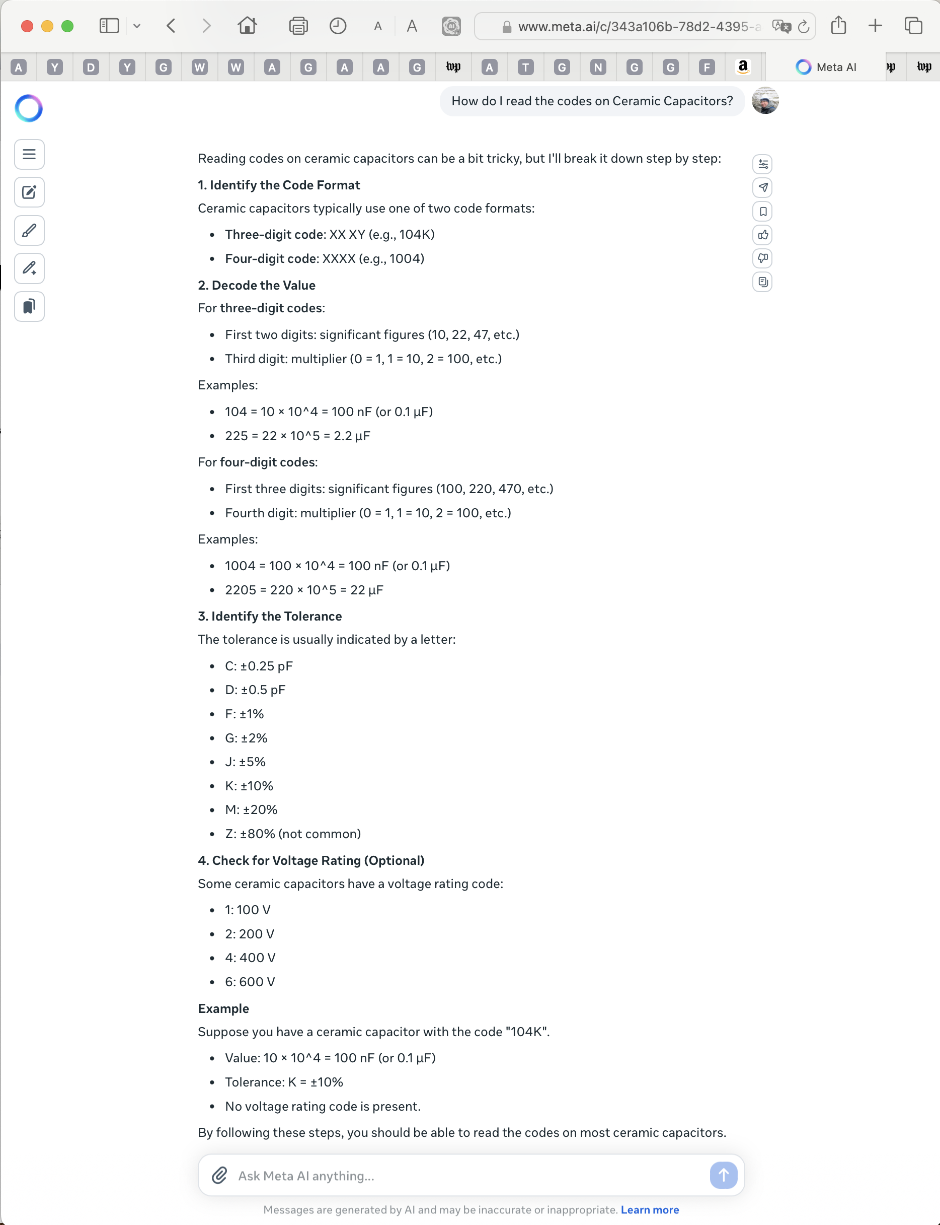
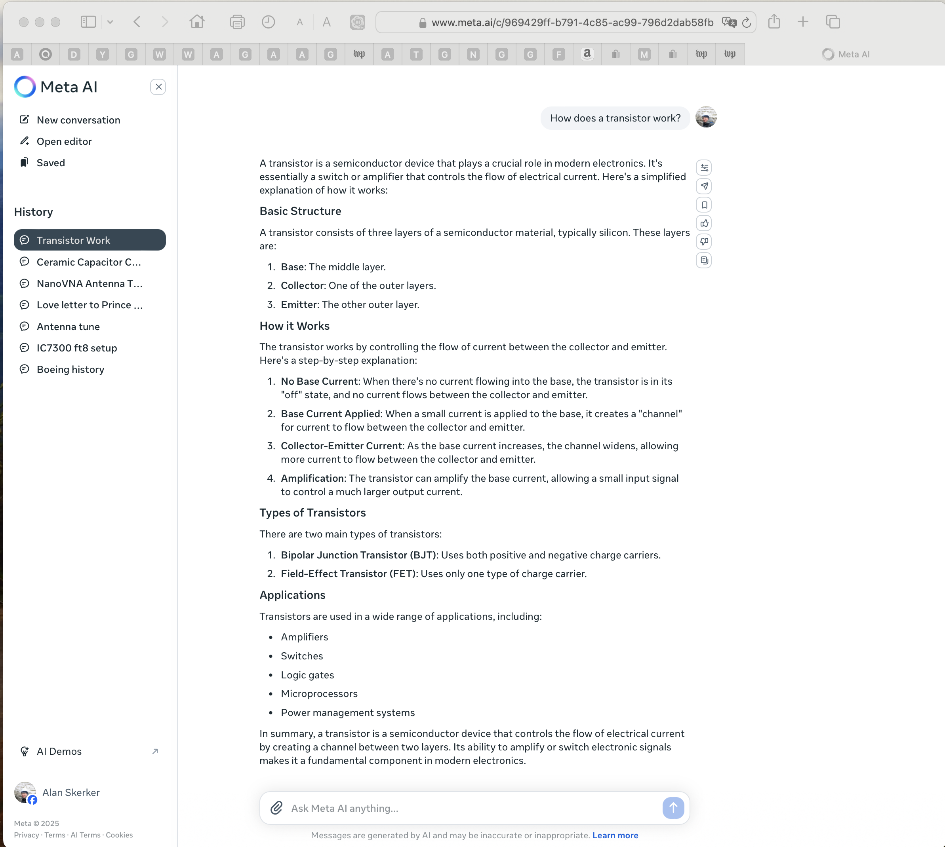
Get Easy to Understand Answers
Your Personal Radio-Electronics Handbook

Slide 21
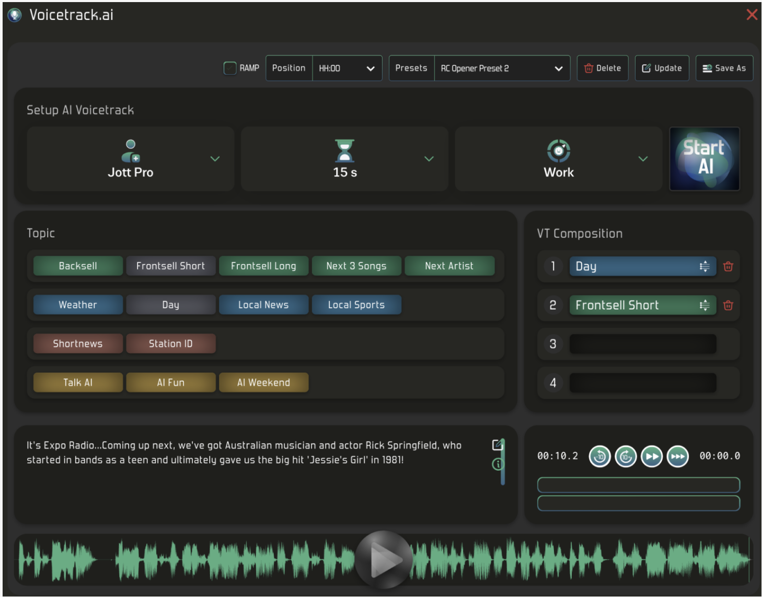
AI Powered Radio Interfaces
Hams already use and experience digitized voice:
  digital voice technologies (e.g., D-Star, DMR, System Fusion, FreeDV (open-source DV standard)
  devices that annunciate such as talking SWR and power meters, repeater time and station info
Unattended Commercial Radio:
  In 1995 the FCC enabled commercial radio to run unattended
  DJ’s using computers could manually setup a voice track that would air automatically.
  AI is now in its wide-spread use in commercial radio to automate voice tracks and create the illusion of a live broadcast
  Enable stations to run through the night and early morning without a live DJ
  SmartFM, SPECai, SuperHiFi, RadioGPT, Voicetrack.ai etc. provide AI assisted operation of commercial radio and TV. For example, AI has changed voice tracking from a purely manual task to one with minimal manual input.
AI Powered Voice Interface for Radio:
  Motorola developed ViQi (“Vicki”), an AI powered voice interface for Police radios.
  Officer can change the radio zone and channel by voice (i.e., CAT control); check license plates and driver’s licenses.
AI powered interfaces would be capable of providing hams with:
  Voice operated CAT
  Voice controlled operating parameters
  AI with translation and understanding could do voice to CW/digital modes and CW/digital modes to voice transmission/reception substituting abbreviations such Morse DE, QTH for natural language or otherwise format or modify our language for intelligibility.
  AI assisted rapid tuning of signals that can be challenging to tune manually such as snippets of SSB in noise.
AI radio apps can select and assemble a voice track of pre-recorded audio segments based upon various parameters to create the illusion of a live broadcast.

Slide 22
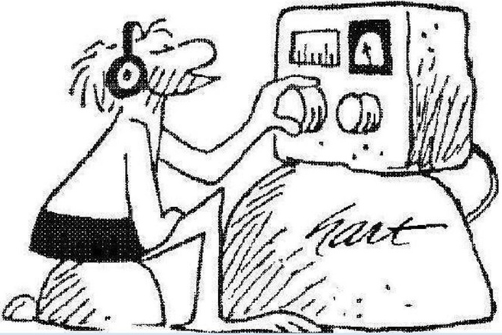
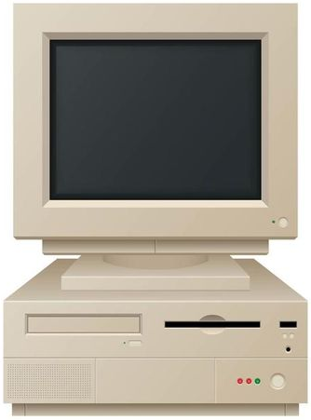
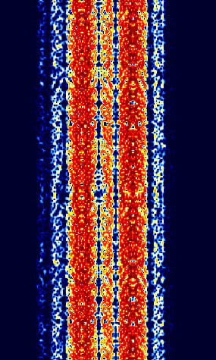
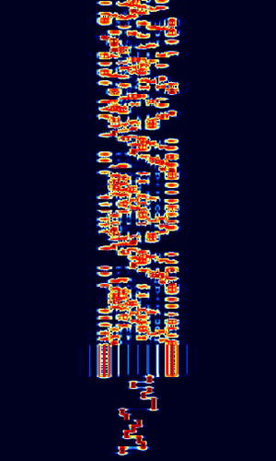
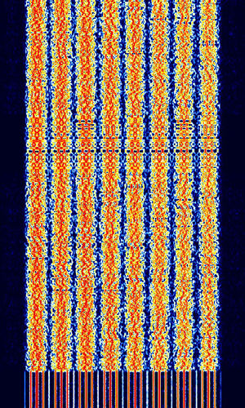
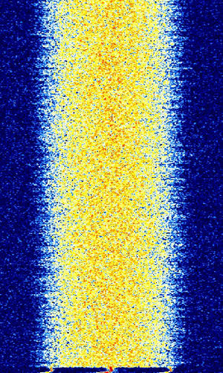
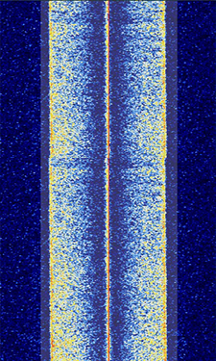
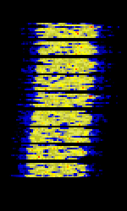
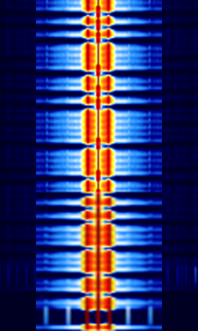
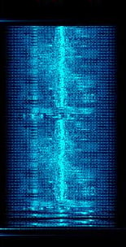
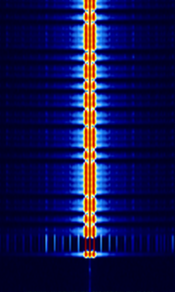
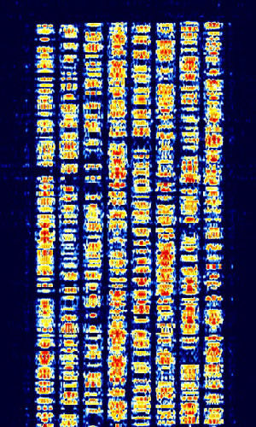
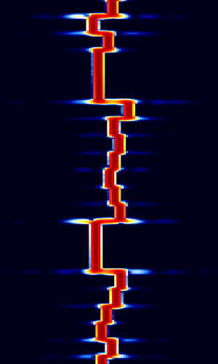
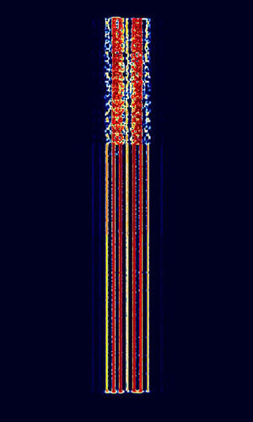
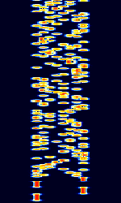
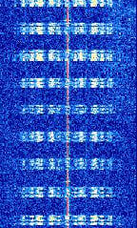


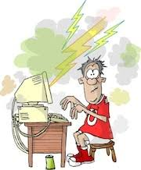
Improve Signal Reception and Understanding
Use predictive and natural language processing capabilities to fill-in errors (e.g., missing pieces of a conversation, words in text, characters in CW) due to the operating environment.
Using machine learning to classify signals and create fingerprints for immediate identification of a signal within a complex environment. Automate digital communications.
K8OGT Lots of QRN and QRM OM… got Hitsville I think your name is Sam
MyKoolHamChatAI
K8OGT, Hicksville,
N.Y. name is Stan Extra Class
Just a few of the signals that may be seen on a waterfall (without noise, fading, or interference)
What are all of these squiggles?

Slide 23
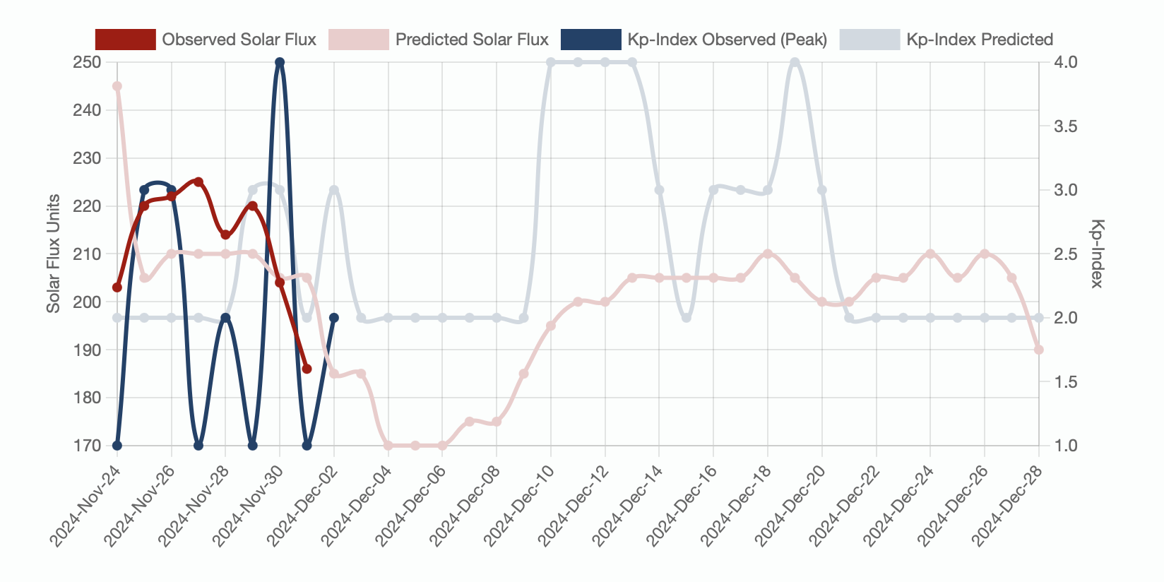
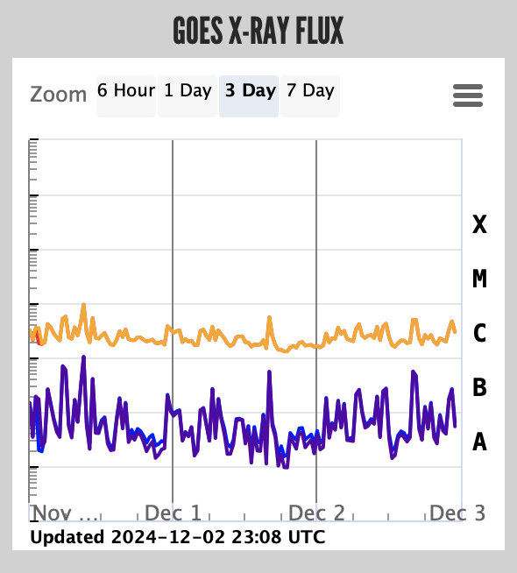
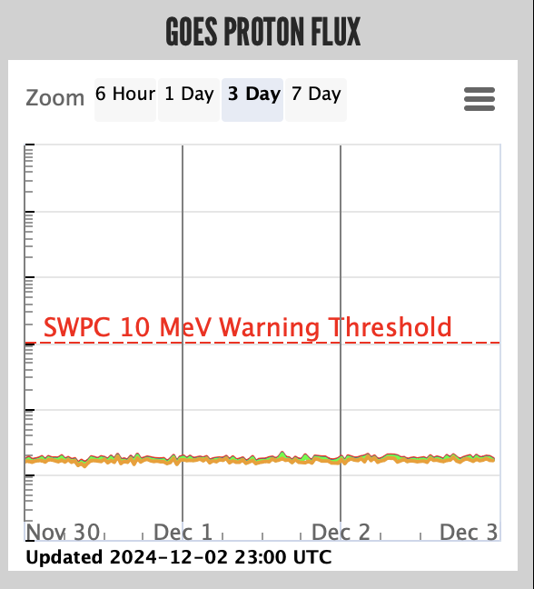
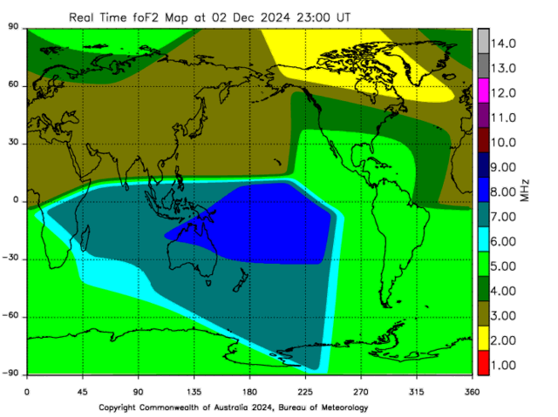
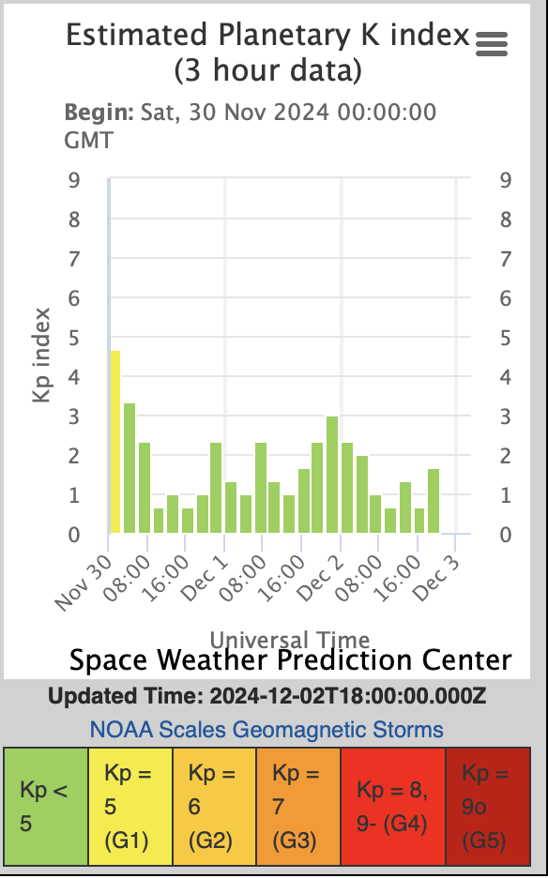
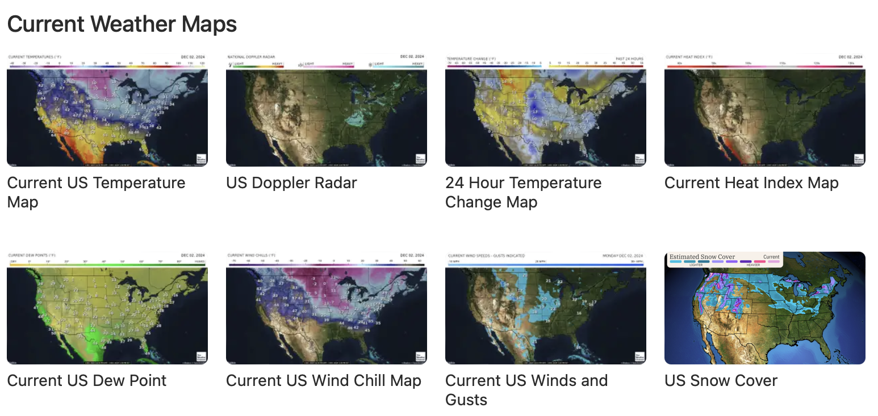






Enhance Propagation and Forecasting
IEEE Antennas and Propagation Society June 2022: “Special Issue on Artificial Intelligence in Radio Propagation for Communications”
AI can process and analyze large datasets that relate to personalized radio propagation forecasts
  Ionospheric and tropospheric conditions
  Worldwide propagation predictions
  Solar and geomagnetic conditions
  Weather patterns
  Terrain and land use
  Station radio and antenna characteristics
Recognize patterns across these datasets and employ machine learning techniques to improve predictions of signal strength, path loss, multi-path and fading effects, and ionospheric and tropospheric delays.
AI Processor
011001010111010010010010010100001111101

Slide 24

Enhance Automated Logging and QSL Management
Automatically save information from voice or digital communications that you want to store in a personal retrievable log and, at the same time, extract and save the relevant data for upload to QSL services.
Assist with callsign, name, QTH, club member number, contact sequence number recognition during difficult conditions.
Analyze log data to provide insights into operating habits, antenna performance, and propagation trends.
Design and create QSL cards using generative AI
Searchable Ham Databases
Analysis tools
Large Language Model
Personal Log
Maintain log in my format
Data recognition
Print QSL
Extract data for QSL services
Auto-Send formatted log files

Slide 25
Improve Accessibility for Operators with Disabilities
AI powered radio interfaces that combine vision and language assistance would provide an important capability for a broad segment of the ham radio disabled population.
  AI powered speech processing can help people with limited mobility or dexterity control a radio through voice commands
  AI vision and language capabilities can translate sign language and other hand or eye movements into radio control operations
  AI can learn and adapt to people with non-standard speech patterns and other language impediments to enable intelligible communications with other hams.

Slide 26
Emergency Communications and Situation Awareness
Generation of automatic alerts
  Changes in conditions affecting communications quality
  For voice or digital operations generate alerts to appropriate authorities based upon natural language understanding in addition to a pre-programmed dictionary of key words and phrases.
By providing situation awareness of the communications systems, AI can dynamically allocate resources and frequencies to optimize the flow of communications during emergency event
AI can provide situation awareness of logistics and other aspects of operations to optimize management of emergency resources

Slide 27

An AI-generated image of a Ham operating indoors with various types of antennas and what looks like a magic wand or conductors baton in his hand (from the lesson/course generation app “Mindsmith”)

Slide 28
As we've seen today, AI can potentially transform Ham Radio in many ways
Existing Chatbots offer personalized assistance, individualized learning, and help with understanding and resolving station issues
AI is beginning to drive useful applications for ham radio such as the client-server noise removal tool RM Noise and the ability to decode CW under less than ideal conditions.
73, and we'll catch you on the airwaves!

