Slide 1

DMR Presentation for Old Va Hams
Kenneth Fowler N4VKF
Trustee:
TGIF DMR Talkgroup 1033 “The Scanner Junkies”
TGIF DMR Talkgroup 14715 “RVARC”
DMR ID: 3151100

Slide 2
NoVA area DMR Repeaters
441.3375 + CC1 (Tyson’s Corner)
441.650 + CC1 (Tyson’s Corner)
443.0625 + CC1 (Tyson’s Corner)
442.4375+ CC1 (Herndon)

Slide 3
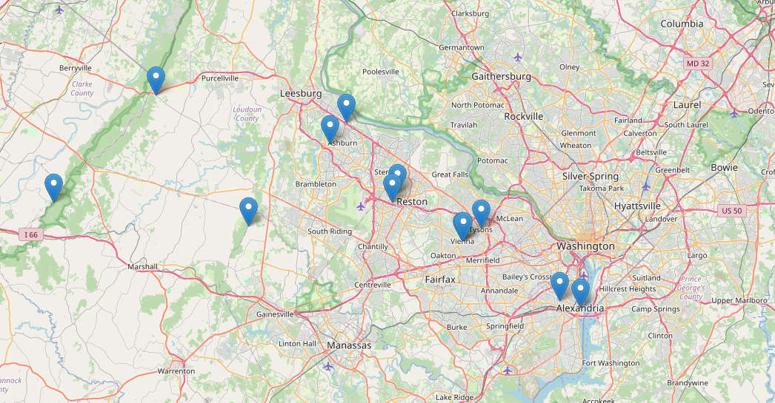

Slide 4
Repeater and network information
www.delmarvadmr.com (Interstate DMR)
www.dmrva.com (DMR VA)
www.brandmeister.com (Brandmeister)
www.repeaterbook.com

Slide 5

DMR: What is it?

Slide 6
Defining Digital Mobile Radio (DMR)
Digital Mobile Radio (DMR) is an international digital radio standard developed by the European Telecommunications Standards Institute (ETSI)
Improved voice quality
Improved functionality such as Location information)
Improved security (i.e. Authentication and Encryption)
Improved channel efficiency (2 slot TDMA)
AMBE +2 Codec

Slide 7
Fcc Authorization for DMR use by Amateurs
In FCC Decision FCC 14-74 issued on June 9, 2014, the FCC outlined its decision to officially approve TDMA for ham radio use, as in doing so would be “consistent with the basis and purpose of the amateur service”. While this is great news for the nearly 3,600 US hams who are currently using DMR, it will serve more as closure to the longstanding issue of technical non-compliance of TDMA with the FCC’s Part 97 Rules. To address this technical non-compliance, the FCC issued a blanket waiver in 2011 at the request of the Amateur Radio Relay League (ARRL) for ham radio use of TDMA, however speculation within the ham radio community as to whether TDMA and by association, DMR, would officially be permitted in the Part 97 Rules has ranged on until now. With this decision, clarity has now been provided to US hams, which should allow DMR to gain even more traction within the US ham radio community.

Slide 8
DMR Tiers
Tier
Tier I: Unlicensed Digital Radio (DPMR446)
Tier
Tier II: Licensed Conventional Radio Systems
Tier
Tier III: License Trunking Radio Systems.

Slide 9
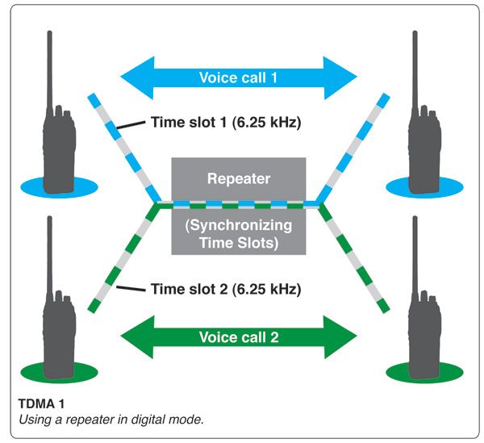
Two logical channels
The DMR standard also specifies the use of TDMA technology. TDMA stands for Time Division Multiple Access. TDMA provides two logical channels and each 12.5-kilohertz channel space (see diagram below). This provides a useful doubling of capacity within the same analog channel space.

Slide 10
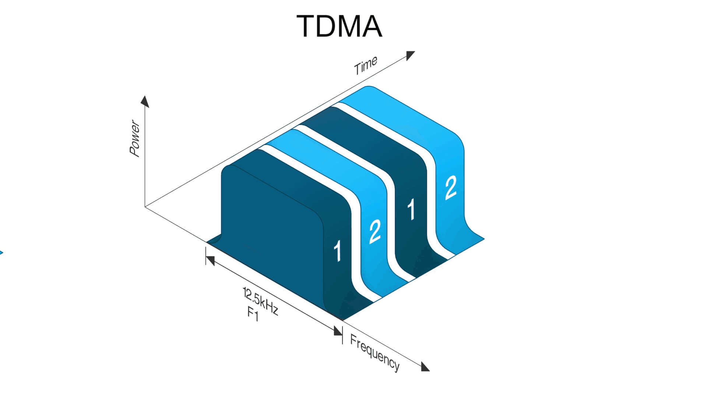

Slide 11
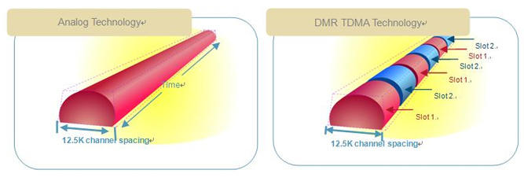

Slide 12
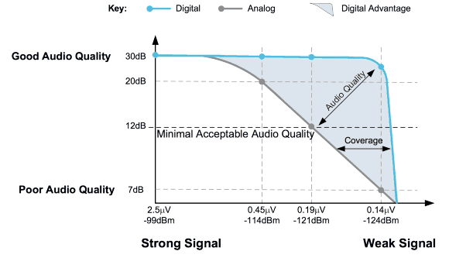
Digital vs Analog audio Quality

Slide 13
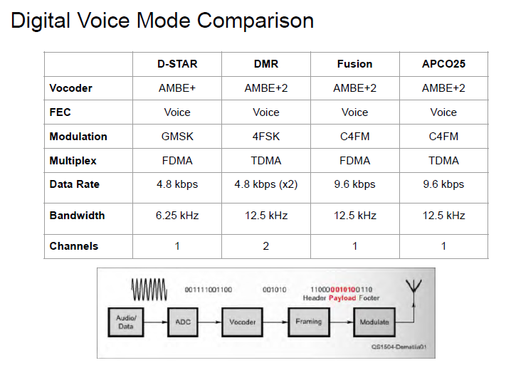

Slide 14
FREQUENCY | BAND | TALKGROUP ID | TIMESLOT* | COLOR CODE
441.0000 | UHF | 99 | 2 | 1
446.5000 | UHF | 99 | 2 | 1
446.0750 | UHF | 99 | 2 | 1
433.4500 | UHF | 99 | 2 | 1
145.7900 | VHF | 99 | 2 | 1
145.5100 | VHF | 99 | 2 | 1
DMR Simplex Frequencies
Below are the recommended simplex frequencies to be used with DMR in United States and Canada. In addition to this information, please note the following radio configuration items:
Admit Criteria: Please set this to “Always”
In Call Criteria: Please set to “TXI” or “Always”
CC = 1
TS = 2 (for most radios this does not matter) The more expensive radios can accommodate 2 TSs on simplex. However, to negotiate a time slot all the radios must be within simplex range of each other.

Slide 15
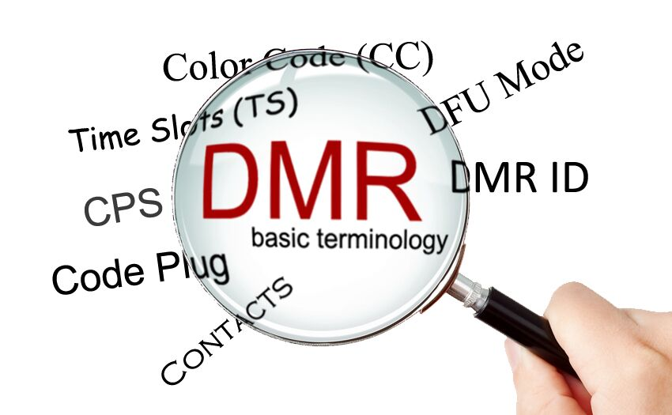

Slide 16
DMR Jargon
Timeslots (1 or 2)
Color Codes (Think of CTCSS or DCS)
Talk groups – What group am I talking too?
Digital Contacts – List of DMR IDs/Licensee Info

Slide 17
DMR Jargon
Zones – Group of DMR Channels in your radio
RX Groups – List of Talk groups I wish to monitor
Scan Lists – List of Channels I want to monitor
CPS (Customer Programming Software)

Slide 18
What is a codeplug?
Channels
Zones
RX groups
Scan Lists
Digital Contacts – Both Talkgroup and Individual IDs
DMR ID

Slide 19
Dynamic vs. Static Talkgroups
A dynamic talk group, or sometimes referred to PTT of a talk group, is a temporary activation of a particular talk group by the end user either being through a repeater or hotspot device.
A static talk group is set by either the repeater owner/trustee or hotspot user on a particular timeslot and is set to permanently allow traffic to be sent. This means all traffic will pass through the repeater/hotspot to the end user radio when there is active traffic or communications.

Slide 20
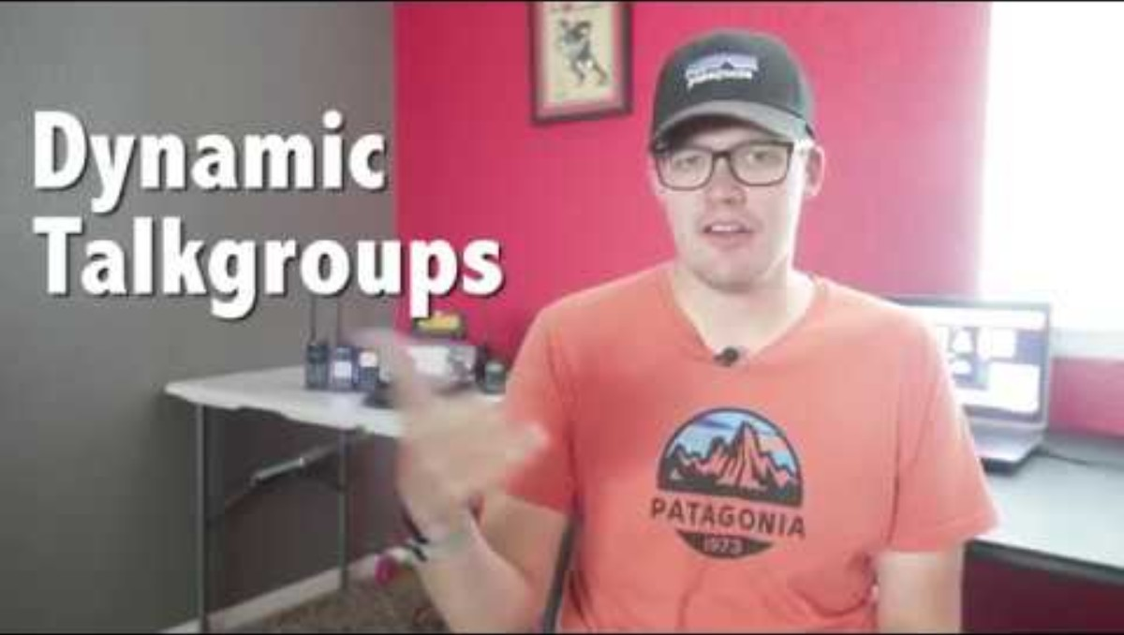

Slide 21
Repeater Networks in Virginia
N4HRS
DMR Virginia
K4USD
Interstate Repeater System
Brandmeister

Slide 22
DMR Etiquette
IDing every 10 minutes during a conversation is essential.
Before you can listen to a conversation’s progress to connect to a talkgroup, you must first “Kerchunk” the mic by giving it a quick press, unlike a regular repeater or conversation.
This is for PTT activated talkgroups or using a hotspot
After tuning your desired talkgroup and once you've Kerchunked, you're going to want to listen first because you'll almost immediately hear activity on a busy talkgroup. So, once you kerchunk, you're going to want to listen first before you ID.

Slide 23
DMR Etiquette
Remember that even if you're accessing a home hotspot, it is somebody else's talkgroup that you are talking on, and courtesy is of the utmost importance on the ham band.
We want to avoid using wide area talkgroups to carry out lengthy conversations. Suppose you're in North America, the USA worldwide, or even on a busy statewide talkgroup. Talkgroups exist for offloading long QSOs to lesser used talkgroups.
Select the appropriate talkgroup before transmitting and consider the impact of your transmissions.
For example – if two users are on the same repeater and want to speak to each other, the best talkgroup to use is Local.

Slide 24
DMR Etiquette
When using a talkgroup it is a good idea to ID your station and state the following: ex. N4VKF listening on “Spotsy Local”, Rappahannock Regional” or “Virginia Statewide”
When identifying yourself, especially in international talkgroups, make sure to use the proper phonetic alphabet.
Leaving the TG or ending the QSO, give your call sign and say “clear”.

Slide 25
Current DMR Radios

Slide 26


