Slide 1

EDM* training & black sky operations
Training on Winlink and VarAC
Some Information Sourced from ChatGPT
*EmComm Direct Messaging

Slide 2
goals
Create Awareness of EDM Training Processes
Justify Local Amateur Groups/Operators Interest in EDM
Describe ‘Black Sky’ Conditions and the Relevant Operational Environments
Encourage Operator Involvement in EDM and/or Other Training and Exercise Groups
Describe Advantages and Disadvantages of Common Digital Data Applications
  Emphasis on Winlink and VarAC as Used in EDM
  Empasis on Selection, Tailoring and Training on a Viable Technical Approach to EmComm Needs

Slide 3
Black Sky Conditions
Black Sky = No Reliable Internet Services
  Local Area
  Broad Area
No Cellular, No Winlink RMS/CMS Gateways, No Email, etc.
County/Locality EmComm
  Established EOC with ARES Coordination Plans
  Compromised, Personnel Shortages, etc.
  Limited Operations Areas
EmComm FM Voice via VHF/UHF Potentially Viable
  Dependent on Repeater Backup Power
  Used for General Coordination and to Help Position Resources to Relay Form Information to EOC

Slide 4
Training and exercise community
Why Do We Train?
  FM Radio Talk is OK, When Available; But Has Limited Value to EOCs
  EOCs Typically Require Form Data
  Available Tools Providing Form Data Require Operator Expertise
  Internet is Useful IF And Only IF Available
  Training Emphasis On Direct Delivery of Form/Message Traffic
    Including Large Data Sets
EDM Trains on Winlink and VarAC
Winlink Wednesday and Winlink Thursday Train on Winlink, only
  Emphasis On RMS/CMS Operations; Or Telnet
  WW Also Encourages P2P Message Traffic (Ardop/Vara)
NBEMS (Narrow Band EM Software/ARRL) Trains on Fldigi Modes
Other Regional Exercises, MDC, VDEMS, etc.
EmComm Resources
EDM
Groups.io: EmComm Direct Messaging
ETO and Winlink Thursday
Groups.io: EmComm Training
Emcomm-training.org
Winlink Wednesday (National)
winlinkwednesdays.net
NBEMS (National)
arrl.org/nbems
MDC (Maryland/District of Columbia)
www.arrl-mdc.net

Slide 5
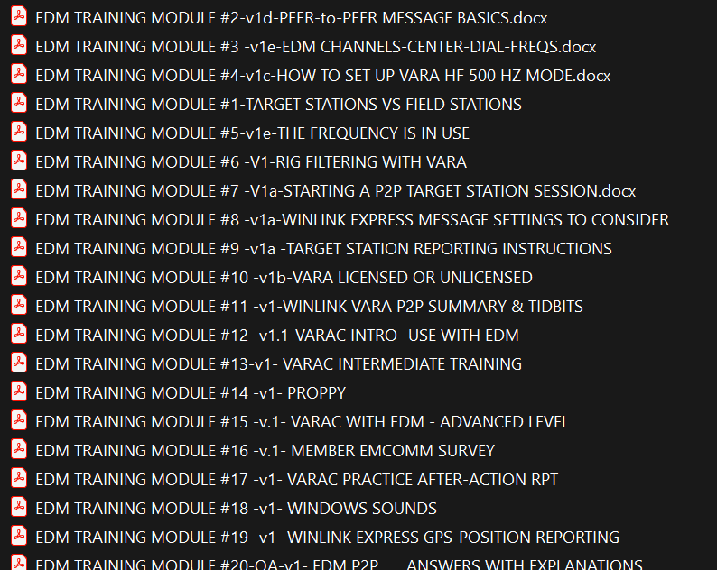
What is edm?
Training Examples
Training and Exercise Group
  Focus on HF Communications
  Regional and National Level Exercises
  Detailed Training Syllabus
  Monthly Exercises use Target Station (‘EOC’) and Field Station (Operators) Context
Focus on Winlink Peer to Peer (P2P) Modes
Recent Emphasis on VarAC for Situational Awareness; with Vmail (Forms, Messages)
Managed by Professional Trainers and Experienced EmComm Operators
Emphasis on Post Exercise Lessons Learned and Feedback

Slide 6

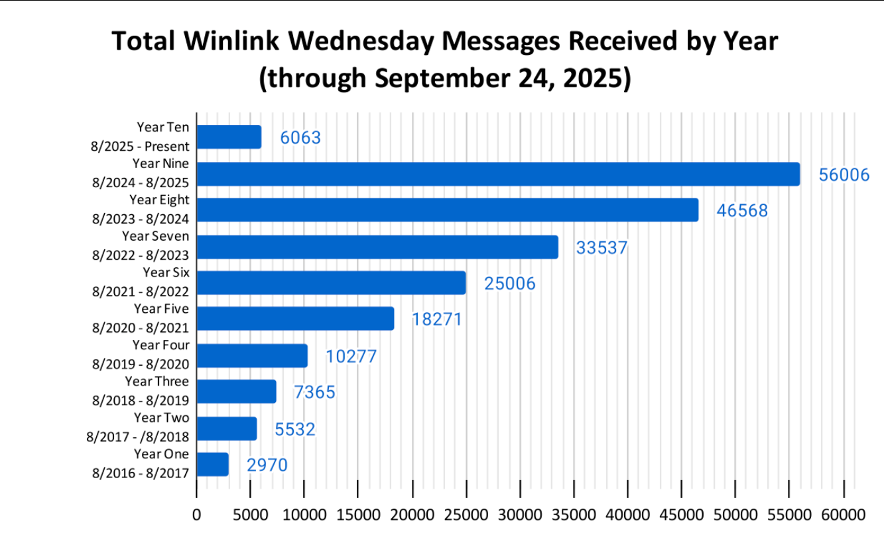
exercises
Many Exercise Groups Hold Weekly Exercise/Training
  Winlink Wednesday
  Winlink Thursday
  NBEMS
EDM Hosts Monthly Training Exercises
  After Action/Lessons Learned Reports
  Continuous Feedback into Training Modules
Several Groups Support Annual Thematic Exercises
  September Hurricane Scenarios
  October Earthquake Scenarios – “The Great Shake-Out”
  Exercise Groups Provide Liaison with National Groups, e.g. USGS and Local EOC/ARES Groups

Slide 7

Why exercises are important
Application of Training Skills Sets
  HF Communications – Regional and National
  VHF/UHF Communications – Local
  Operational Modes/Options
  Frequency Plans
Identify Shortfalls in Preparedness
Validate Interfaces with Local or National Emergency Management Groups
Validate Operator Skills and Readiness
  Equipment, Including Mobile and Remote Operations Gear
  Power, Including Local Backup and Batteries
  Liaison Constraints with Local EOCs and ARES Coordinators
  Situational Awareness Among Capable Operators and Conditions
  Operator, Equipment, Environmental, and Liaison Strengths and Limitations

Slide 8
Winlink and varac
Winlink P2P Provides ICS Forms or General Message Traffic, Text, etc.
  Remote Operator to EOC
  EOC Remote Locations May Benefit from VHF Digipeaters
  Winlink P2P is a small step beyond Winlink RMS Messaging via CMS (Internet Servers)
VarAC Provides ICS Forms or General Message Traffic, Text, etc.
  Provides EmComm Mode and Operational Enhancements
  Provides Beaconing, Relay and Broadcast Modes; Supports Separate Channel Allocations for P2P Connections
  Widely Used in HF ‘Chat’ Scenarios – This is the Mode Many Amateurs Know
  ‘Vmail’ Supports ICS Forms (i.e. a Text File) (TBR)
  Provides Insight to Multiple Users in the Network
  ‘De Facto’ Standard Among EmComm Groups
  Extensive Training Available Through Several Sources, e.g. Emcomm Direct Messaging (groups.io)
VHF or HF? - VHF Recommended for Local Applications Due to Ease of Antenna Deployment and Potential Digipeater Access
JS8Call – Has Weak Signal Advantage
  Not considered viable for significant messaging traffic, speed, etc.
.
40M Band – Allocated ‘NCS’ Frequencies
Primary Channel – Beacons, Team Traffic
NCS Channels A-E – Direct Message Traffic
14.105MHz, USB
7.105, etc.
750Hz
750Hz
Slot 5
Slot 4
Slot 3
Slot 2
Slot 1
Slot 11
Slot 12
Slot 13
Slot 14
Slot 15

Slide 9
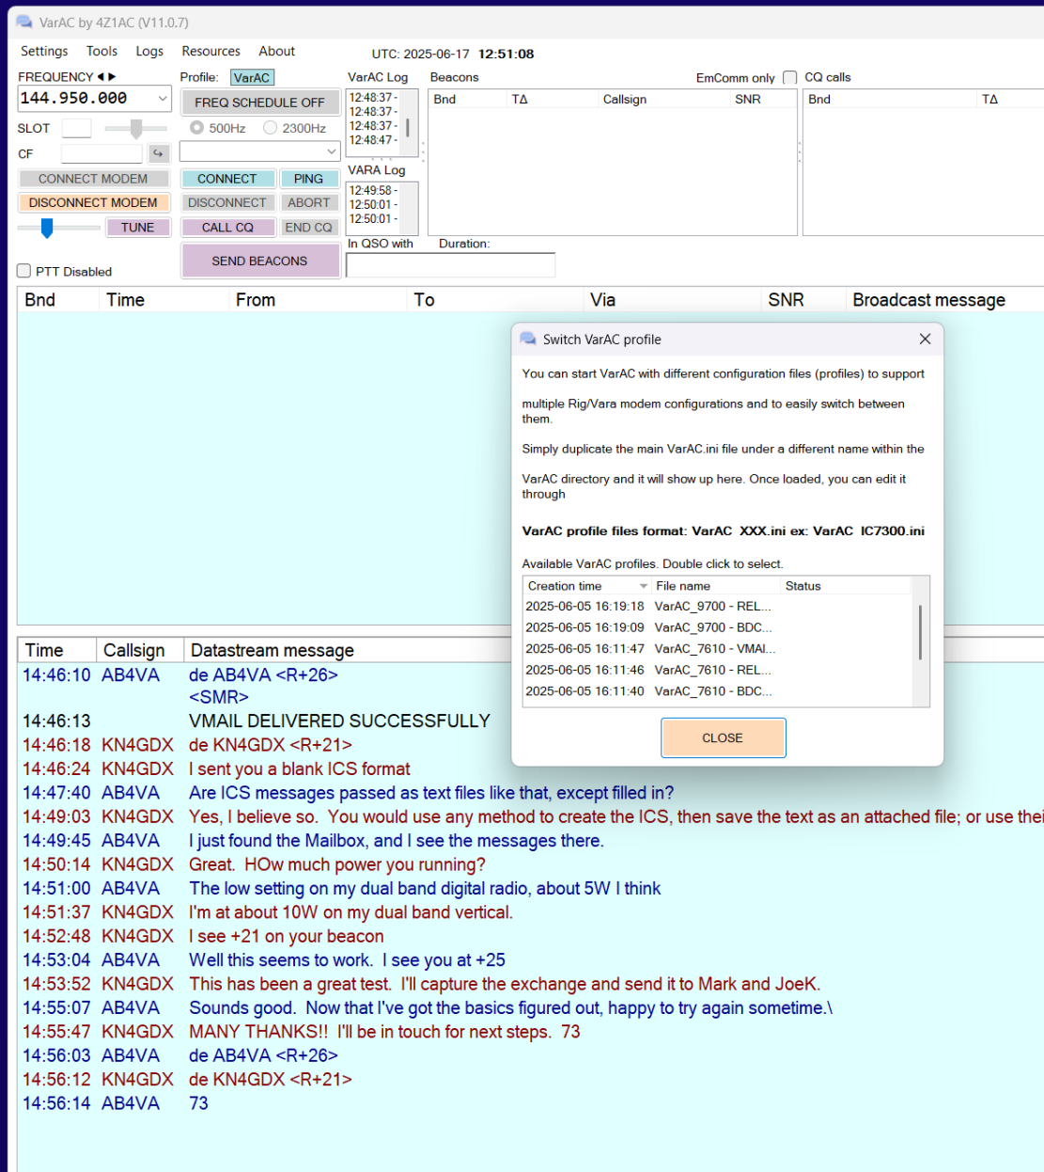
Varac session example
Beacons
Slots – used in HF VaraChat – NOT here
Settings menu … quick selection of alternate profiles
Broadcast Messages are here for all stations on the channel
Your VarAC app maintains complete logs of sessions, configurations and traffic
Vmail deliver, e.g. ICS Form
General chat

Slide 10

Locality operations Example
Normal or Black Sky
TARGET STATION
Beacons, Broadcasts and Coordination Information Shared on a Primary VHF or UHF Channel
Field Stations Share Availability Information and General Traffic
Traffic Data, ICS Forms Passed to EOC Using P2P or Vmail
Portable/Mobile
Digipeaters
EOC
Radio Node
(Format/Print)
Data
Fixed
Computer Infrastructure – Win/Linux?
FIELD STATION
Operators
Radio Gear
Antennas
Data
VarAC
Data
Vara*
ICS Form Data
ICS Form Data
Data
EOC Operations Staff
Winlink RMS
Vara FM*
Message
Traffic
RMS Node
RMS Node
Normal
*Separate Modules are Shared by Both Apps with Only One Modem Active at a Time

Slide 11
Regional operations (EDM Example)
Target Stations (Representing EOCs) Located in 6-10 Regions of US
  E.g. Virginia, Florida, Georgia, Texas, California, Arizona, Oregon, Minnesota, Michigan, New York
Field Stations (Representing Operators Reporting to EOCs)
  Nation-Wide
Target Stations Broadcast ‘I Am on x,y,z-Band, on a,b,c-NCS Frequency on Dates and Times- --- Using Primary NCS Channels
Field Stations Monitor Likely Primary Channels for Coordination Information; Broadcast Availability Information, etc.
Beacons Used for ‘Markers’ on Primary Channels – Same as in ‘Classic’ VarAC

Slide 12
Situational awareness
EDM Evolution from Winlink to Winlink and/or VarAC => Major Situational Awareness Improvements
In EmComm, Situational Awareness Using VarAC EmComm is Similar to ‘Classic’ VarAC
  In Classic, Stations Beacon on a Central Calling Frequency, Then QSY to a Standard Offset Channel in the Same Band
  In EDM VarAC EmComm, Target Stations Beacon and Broadcast on a Primary Frequency, by Meter-Band, and Coordinate Times/Dates of Availability on any of the Primary or Secondary Frequencies Across All Meter-Bands.
  Field Stations Share Plans/Availability by Time/Date/Band
EmComm Situational Awareness, Whether HF-Regional or VHF-Local, Is Achieved Rapidly Because Field Stations Access a Specific Frequency/Band for Coordination During a Disaster

Slide 13
Typical edm* exercise (Sept/2025)
3 Hour Exercise in 15 Minute Windows
Windows Cycle Through HF Bands (80/40/30/20)
T and F Use Primary Frequency on Each Band to Broadcast Availability on Saturday
Special Stations Identify NCSs for Thurs/Sat by Call Sign
10 Hours, Unstructured
Ts Are ‘Open’ on NCS Frequencies in HF P2P for Connections from Fs; NO BEACONS
Ts Choose Times and Bands for Their NCS Channel
Fs Must Connect by T Call Sign
Fs Send P2p ICS Reports to Ts
VarAC Beacon/Broadcast, Vmail
THURS 2000-2300L
TUES 2000-2300L
SAT 1000-2000L
VarAC Broadcast
Winlink P2P (No Beacons)
3 Hours, Unstructured
Ts Beacon and Broadcast Availability by Time/Band (Each T is a Specific NCS)
Fs Send Vmail ICS Reports (Storm-Related Messaging) to Ts
Fs Must Know NCS by Call Sign for Vmail Connection
Post Exercise, Target Stations Package Vmail and P2P Messages Using Winlink and VarAC Tools and Email Exercise Results to EDM for Post Exercise Analysis and Lessons Learned
* Target Stations, T; Field Stations, F

Slide 14
Vara* performance, comparisons
For Perspective: Weak Signal Modes are Well Known and Extremely Popular
  WSJTX-Modes (FT-8/FT4, etc.) – SNR to levels ~ -30db
  JS8Call – Similar Performance, But Does Have Situational Awareness Features
  50Hz Bandwidth
  Very Limited Data Throughput – Tens of Characters
Vara Modes:
  License Required Above Basic Data Rates
  HF Use of 500 (up to 500bps), 2300 or 2750Hz ( up to 3Kbps) Bandwidth; Lowest SNR levels to ~-18 to -14db [EDM Uses 500Hz Exclusively for Vmail on HF]
  HF Pactor-4 Levels, 7200bps, Under High SNR Conditions
  VHF/UHF Performance on 12.5 or 25KHz Channels – ~3-25Kbps Depending on Radio and Repeater Bandwidth Capabilities [3-6Kbps on NBFM, Simplex, Good SNR]
NBEMS/Fldigi
  Ranges from ~ 100-500bps (Olivia 32/1000); Relatively Slow, But Highly Resilient to Poor Band Conditions
*Some Information Sourced from ChatGPT

Slide 15
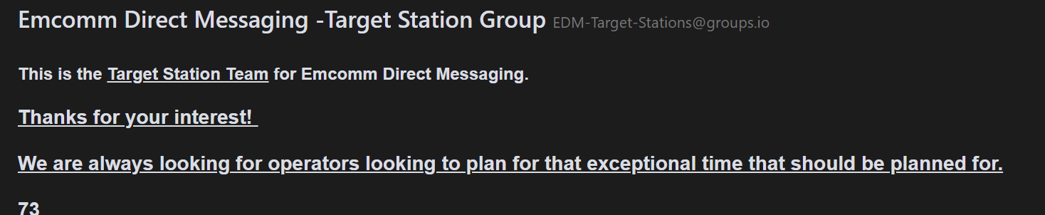
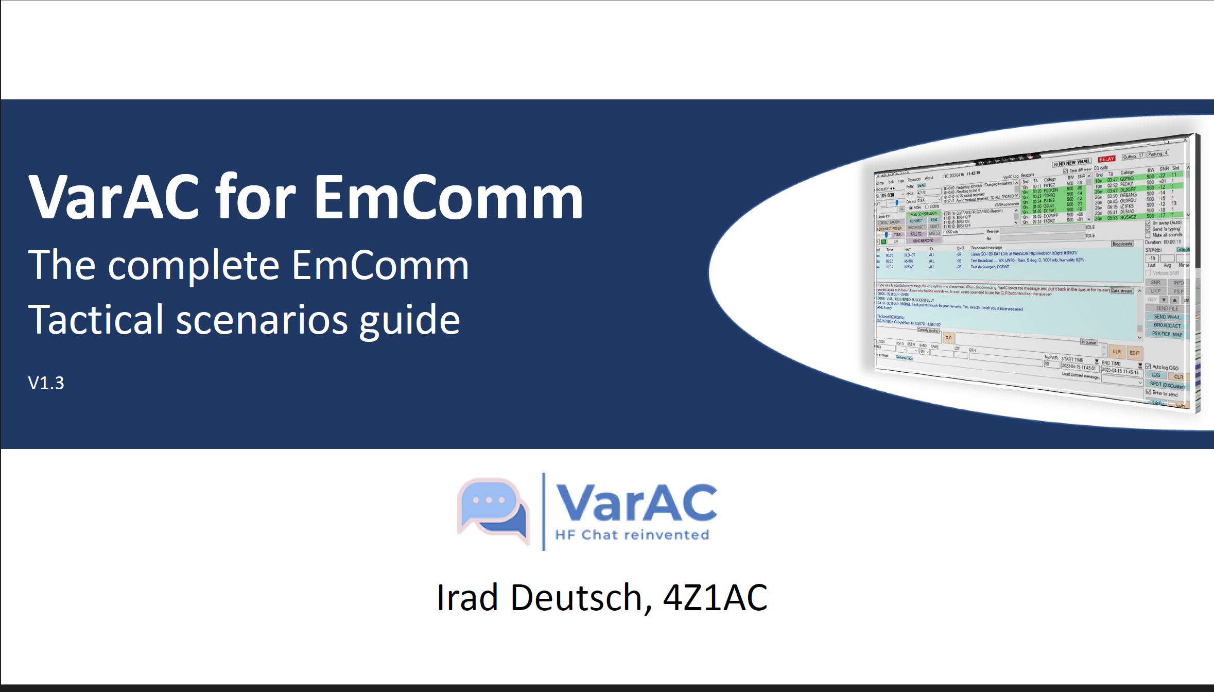
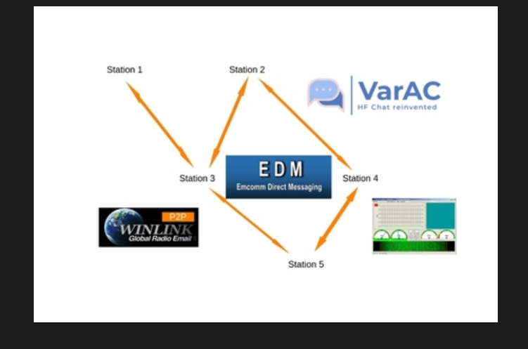
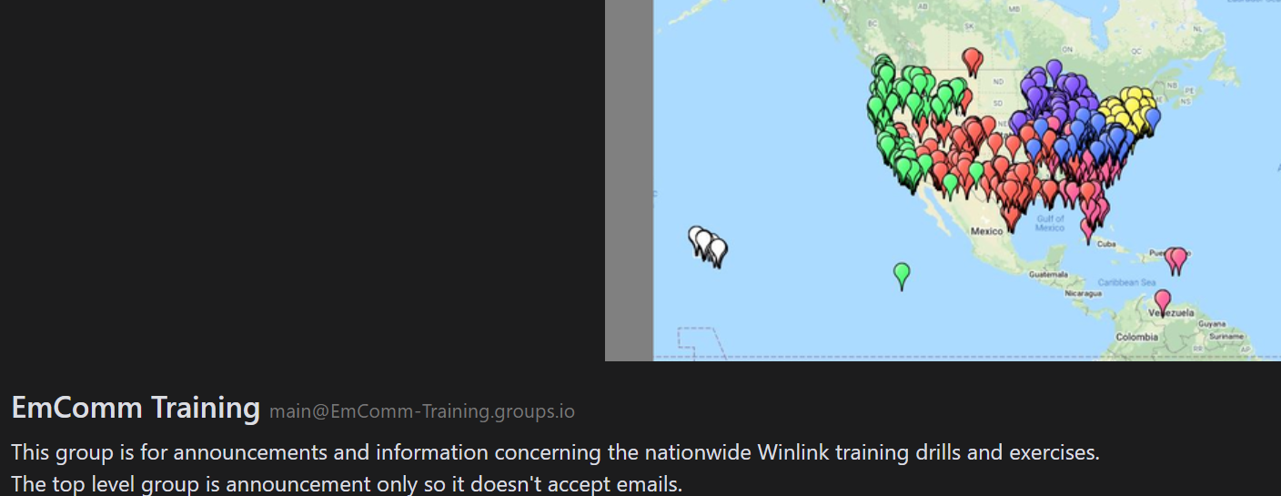
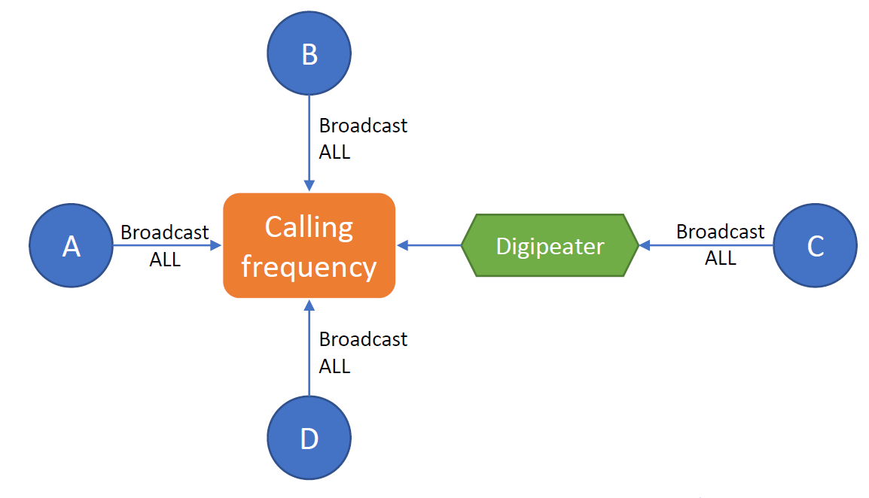
Resources
*
* Thorough and very professional- supported by ARES groups like us

Slide 16
Questions???
Thanks for Attending
KN4GDX, Bruce at
kn4gdx@gmail.com

