Slide 1
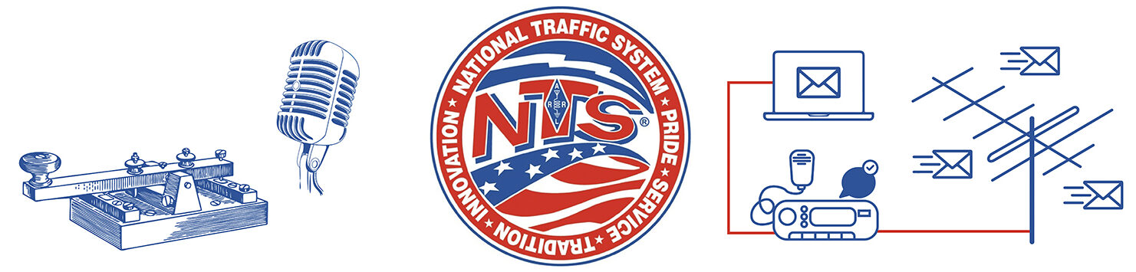
National Traffic System Overview
George Stone, WA1JQC
Virginia Section Traffic Manager

Slide 2
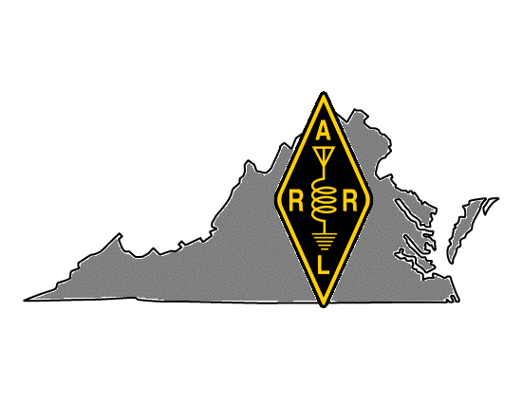
Section Traffic Manager (STM) Responsibilities
Appointed by Section Manager
Coordinate with Section Emergency Coordinator
Organization & planning
Develop traffic handling program
Ensure traffic nets are staffed
Assign net liaison coverages
Ensure digital systems are polled daily
Establish training programs
Recommend Net Manager and Official Relay Station candidates to SM
Monthly traffic reports to ARRL

Slide 3
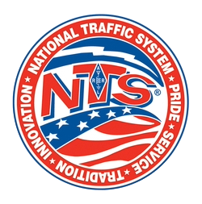

Goals
Understanding of:
What NTS is, what it does, how it functions
NTS & ARES nexus
How to participate in NTS
Notes:
This is an overview of the National Traffic System. My goals today are to provide a basic understanding of what NTS is about, how it fits in the context of EmComm and ARES, and whet your appetite to give traffic handling a try!

Slide 4
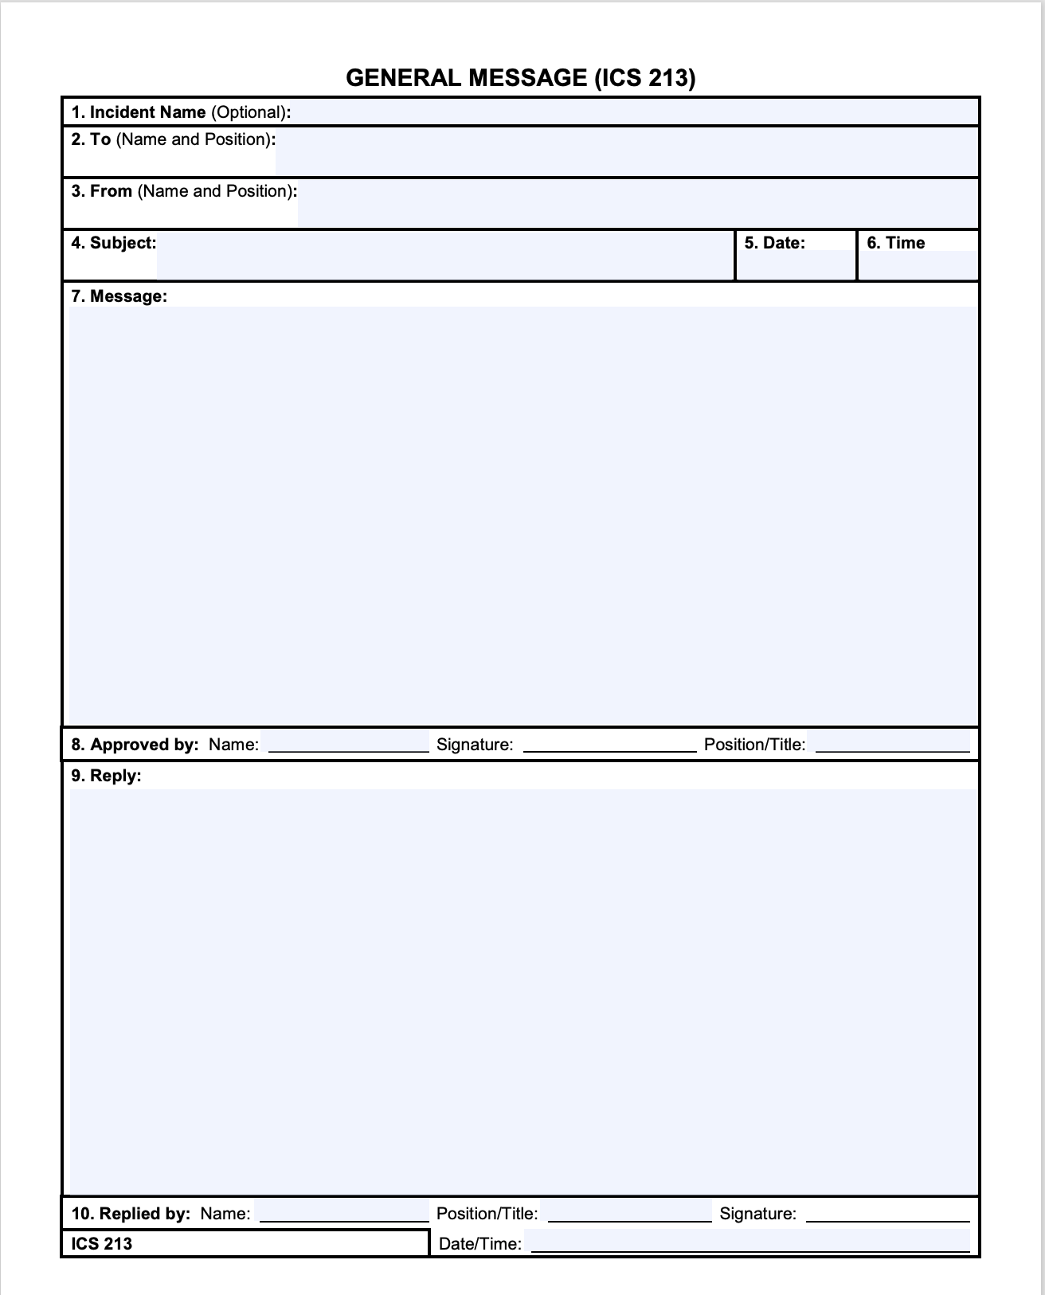
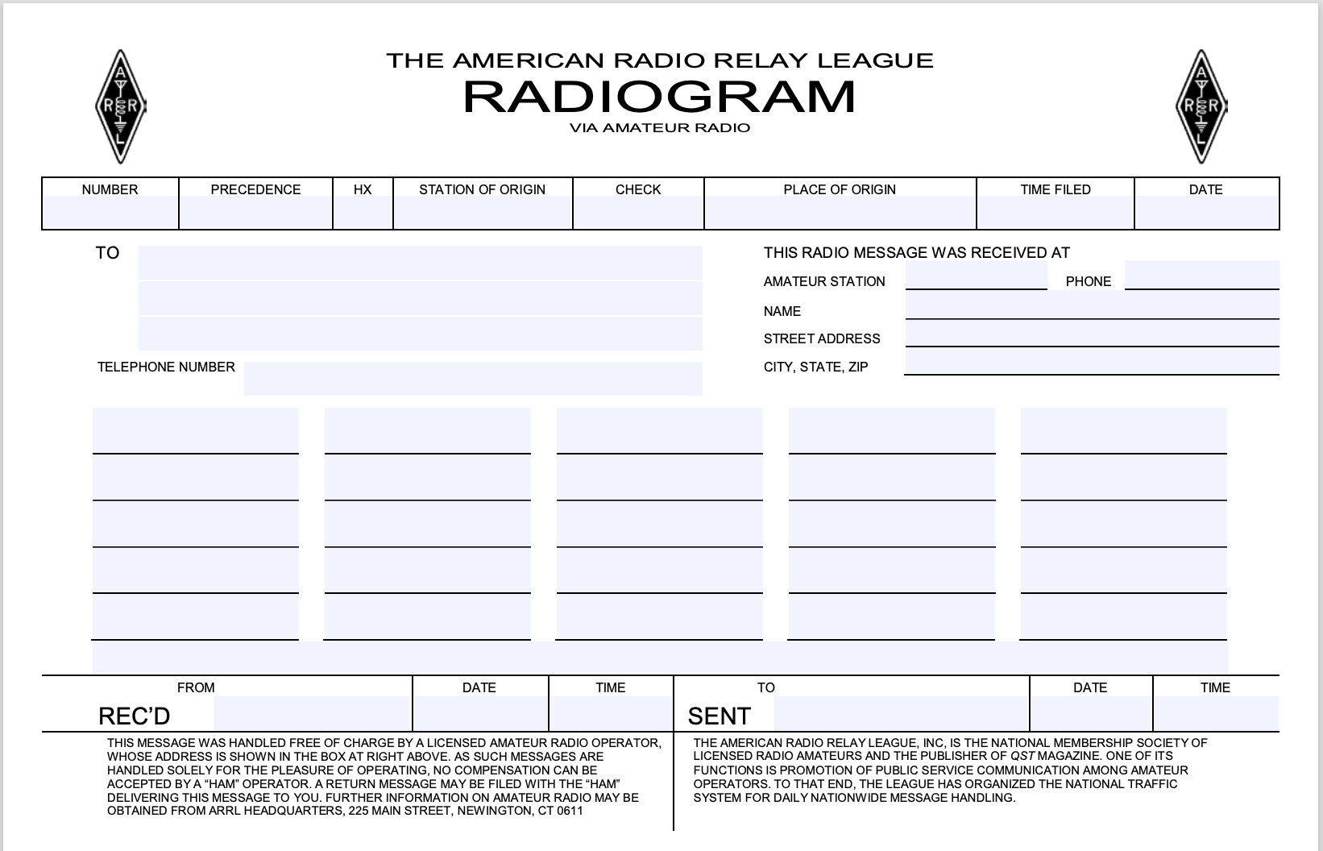
What is NTS “traffic”?
Radiograms – like a telegram
ICS-213 General Message form used in ARES/Incident Command System

Slide 5
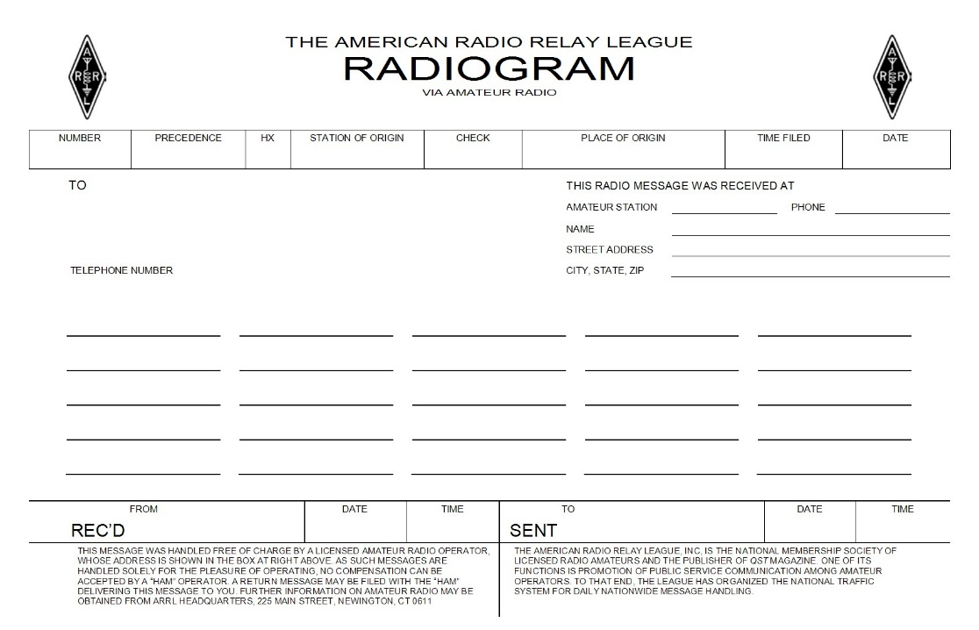
Anatomy of a Radiogram
Preamble
Address
Text
Signature
Relay information

Slide 6
National Traffic System: the “Relay” in ARRL & RRI!
A network that allows for rapid movement of traffic mainly for Canada & US over RF
Trains operators in relaying messages timely and accurately; reinforces good on-air procedures
Public service per FCC Part 97 rules justifying ham radio’s existence
Co-managed by ARRL and Radio Relay International (RRI)
Pass routine messages during normal times; health & welfare traffic during emergencies
Notes:
NTS is based on a series of layered. and sequenced traffic nets. NTS participation helps train hams through learning about handling formal traffic. It reinforces good on-air practices similar to how we run or weekly ARES net. Participation teaches hams how to originate, receive, relay and deliver messages.

Slide 7
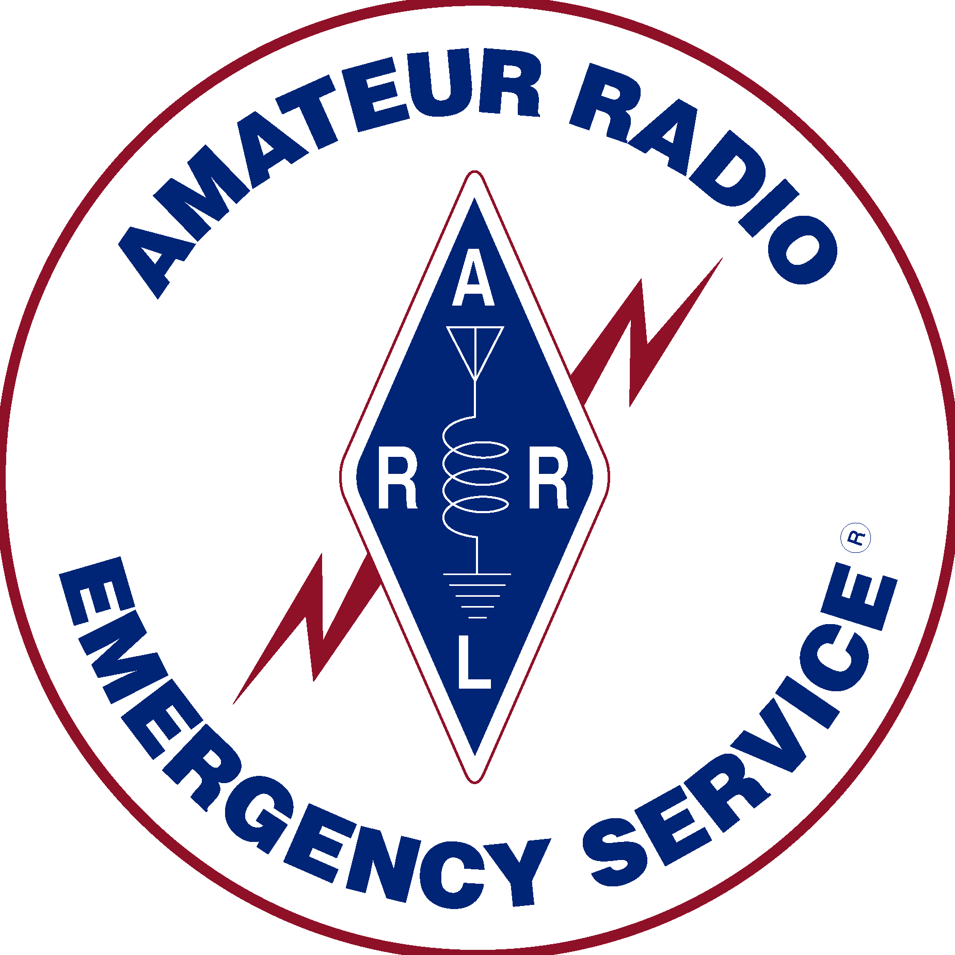
NTS & ARES
The ability to establish radio connectivity for EmComm is no longer enough these days.
One must be able to:
  Communicate accurately and efficiently
  Keep a concise radio log
  Transcribe information without error
  Perform administrative functions required of a message center or EOC.
Traffic nets are the place to practice sending and receiving messages using standard prowords, proper ITU phonetic alphabet, and concise procedures.
Some dismiss traffic handling because they see the content of routine messages as “unimportant,” but they are missing the point. The real value proposition is in the practice of transmitting variable message content. Every address is different. Network management data varies from message to message
Source: James Wades, WB8SIW, RRI Board Chairman
Notes:
Regarding EmComm and ARES, it was once the case that the main things hams were responsible for was setting up a station and antenna. Such is no longer the case. Ham radio is now a component of the National Incident Management System through the Information and Communications Technology (ICT) Functional Guidance released by FEMA in March 2023. Expectations are that participating hams are trained and have a basic understanding of NIMS policies and procedures. In short, we need to know how we fit in!

Slide 8
How NTS Works
Traffic nets
Replaced pre-WWII trunk lines from Hiram Percy Maxim, W1AW
Time-sequenced, layered networks
Voice & CW modes
Digital Traffic Network
Augments – but does not replace – traffic nets
Messages offloaded from DTN to traffic nets
Nodes and “store and forward” mailboxes
Protocols: PACTOR & VARA HF
Standardizing message formats facilitates interoperability between modes
Messages must be able to be relayed seamlessly between traffic nets and digital system
Messages prioritized by precedence categories
Notes:
The traditional voice and cw net structure and sequence came about after WWII and replaced what were known as trunk lines. Those were initiated by ARRL founder Hiram Percy Maxim, W1AW. The digital traffic network augments the manual nets. It serves to get a message as close as possible to the recipient before offloading to a traditional net.
Interoperability necessitates structured message formats. A message needs to be transferable between traditional and digital nets.

Slide 9
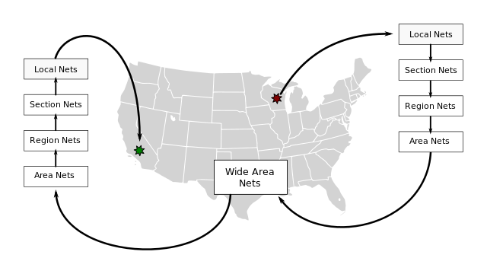
Net hierarchy
Think: airline hub and spoke system
Notes:
Local
Generally, cover a comparatively small area such as a city, county or designated zone within a section. They are usually operated on VHF serving as traffic or emergency nets. Coverage depends on the range of the repeater and its links. No local nets in metro Richmond
Section/State
Operate at ARRL Section Level and may consist of more than one state within the section, depending on availability of operators, traffic and terrain. Mode: May be phone or CW but generally Cycle 4 is CW. Mostly 80 or 40m in General parts of bands. This is the appropriate point of entry for most hams interested in handling formal traffic.
Region
Coverage basis is usually a call area. In some areas this may differ because of time zone changes, etc. Participating hams are appointed as liaisons by net managers.
Area
Are the highest-level nets and consist of Eastern, Central and Western areas. Participants are appointed by Area Chairs and staffs.
Trans-Continental Corps / Inter-area
Not nets per se. Rather, designated operators and stations.
Independent nets Not officially designated by ARRL or RRI but provide liaison with NTS nets. (ex: Virginia Fone Net)

Slide 10
Virginia Section Nets (daily)
Net | Freq | ET
Virginia Sideband Net* | 3947 kHz | 6 pm
Virginia Net (CW)* | 3553 kHz | 7 pm
Virginia Fone Net (independent) | 3947 kHz | 4 pm & 7:30 pm
*ARRL/RRI affiliated net

Slide 11
Message Precedence & Delivery Standards
Emergency
(30 minutes)
For life-or-death situations requiring immediate action.
Rare in normal times; used for disaster relief requests, medical emergencies, or official welfare agency messages during emergencies
Priority
(3 hours)
Important messages with a specific time limit.
Includes official traffic not in the emergency category, press dispatches, and urgent but not life-threatening matters.
Welfare
(24 hours)
Inquiries about the health or welfare of individuals in disaster areas, or advisories that all is well.
Ensure timely, accurate delivery of personal or unique organizational messages
Routine
(5 days)
Certified
(48 hours)
Bulk traffic
Most everything else
Notes:
There are now five precedence levels for radiograms. The new "certified" precedence is beginning to catch on. Use it for messages sent to people you know. All bulk traffic is routine. Examples of bulk traffic include welcome to ham radio and your license is expiring soon messages.

Slide 12
NTS Modernization
Radiogram web portal for public use
QTC: Online radiogram traffic management tool
ARRL-RRI MOU: coordination & designated responsibilities
New "Certified" precedence category
Monthly NTS newsletter
Relay and delivery standards, system testing

Slide 13
NTS Modernization
Improve delivery methods for radiograms, including digital and web-based tools
Expand outreach and NTS awareness to the public and public agencies
Address reliability concerns and testing the system
Enhance training and documentation
Expand wide-area communication services for ARES, SKYWARN, RACES, and served agencies
Move Beyond Radiograms, e.g., images and videos

Slide 14

Training from ARRL & RRI
ARRL
Getting Started In Traffic Handling
Traffic Handling 101 Series
  The Basics – NTS Overview
  Radiograms
  Sending Traffic
  APRS Gateway
RRI
Voice Net Procedures
CW Net Procedures
Recommendations for the Origination, Relay and Delivery of Radiogram-ICS-213 Messages
Notes:
There's plenty of traffic handling training available from ARRL and RRI. Granted, some is outdated and pretty dry!

Slide 15
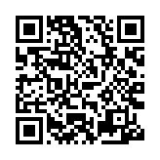
ARRL’s Virtual NTS Training Net: Wednesdays @ 7 pm on Zoom
Week 3
  Passing book/bulk traffic
Week 4
  Traffic net operations and procedures
Week 1
  Passing traffic
  NTS overview
  Radiogram form explanation
Week 2
  ARL numbered messages
  Service messages
  Health and welfare message handling

Slide 16
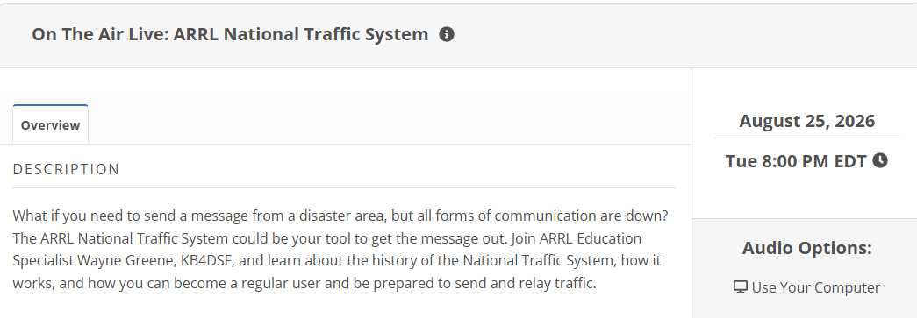
ARRL On The Air Live

Slide 17
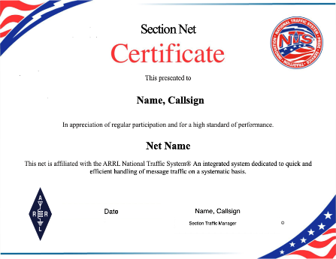
ARRL Volunteer Recognition: Certificates
Local Net
Section Net
Official Relay Station
Net Manager Participation
Net Control Participation
Notes:
There is recognition for traffic handling participation for ARRL members in good standing.

Slide 18
My “Ask”
Help VA NTS provide statewide coverage on traffic nets
Try One Net/Once a Week
Originate 2-3 Radiograms monthly via
  Nets
  WinLink
  ARRL Radiogram portal
Designate NTS liaison on ARES nets

Slide 19
Summary
NTS traffic: radiograms & ICS-213 General Message forms
NTS & ARES nexus
Traffic nets: hierarchy and time sequence
Virginia traffic nets
Training opportunities from ARRL & RRI
Keeping informed about NTS modernization
Recognition
Participate in NTS nets and originate more radiograms

Slide 20
Additional STM Presentations Available (15 minutes each)
Introduction to NTS
Traffic Nets
Handling Formal Traffic
Radiograms: the details
“NTS 2.0” modernization
Resources, Training & Recognition
Digital Traffic Network

Slide 21
Questions?

