Slide 1

R3EC* Data Management for
Digital Communications
(BBS)
Options and Approach for EmComm Data Sharing
Local
Regional & U.S.
*R3EC – Rappahannock-Rapidan Regional Emergency Communications
r3emcomm.org
kn4gdx@gmail.com

Slide 2
R3EC Digital Comms Mission Needs Statements
R3EC maintains an established voice/repeater network
  Established and Reliable FM repeater with backup
  Established and effective Net Management and participation
  Data management controlled through internet web portal(s)
R3EC recently established a digital communications capability
  Weekly check-ins augmented with data sharing, training and technical advice
  Based on proven digital methods* from national and regional groups (SEEN, AmRRON and EDM)
R3EC has a need for data collection, distribution and management
  Data (files) accessed from regional or national sources
  Data (files) provided to regional or national users
  Resources and users are generally restricted among groups/policies
  Data management across any/all digital communications methods within R3EC
  Capability via HF and VHF communications – national, regional and local
r3emcomm.org
Grid-Down Comms
*NBEMS – Fldigi/Flamp/Flmsg for Net; VarAC and JS8Call for pre-net information sharing
kn4gdx@gmail.com

Slide 3
R3EC Digital Comms Potential Approaches
Information sharing and situational awareness tools existing/expanding
  CommStat – provides visual internet and JS8Call accessible map/messages/conditional stop-lights
  VarAC Broadcast – textual message sharing among unlimited users; directed messaging; high data rates
  JS8 Call – textual message sharing at low data rates
Cross-Emcomm collaboration focus on HF NBEMS (AmRRON, SEEN* etal)
  Regular nets with file sharing, standard protocols, and persistent presence frequency allocations
  Emcomm training on proven methodologies
  Encourage check-in behaviors with ‘rolling’ regional approach
R3EC BBS system approach needed to consolidate Emcomm information for sharing
  Local, regional and national
  Ingest and share
BBS systems are prevalent among the national Emcomm methods
  HF Packet – archaic and minimal; VHF Packet/BBS still viable
  HF Vara – prevalent method for user to BBS access; VHF Vara practical in local/regional use
  HF VarAC BBS – new and growing capability with situational awareness features; VHF practical
*SEEN – SouthEast Emergency Network
r3emcomm.org
kn4gdx@gmail.com

Slide 4
R3EC Digital Comms – BBS Evolution
Potential BBS approaches under study – current R3EC
  KQ4LWP – established VarAC BBS* (whitelisted, experimental)
  KN4GDX – established testbed
    Developing BPQ services across platforms/modes/bands
    Established HF/VHF VarAC BBS capability (not in use)
Potential BBS approaches under study – target solution(s) HF
  Target ingest – national or regional BBSs (SEEN model)
  Target R3EC BBS sharing – national or regional users; limited local users
Potential BBS approaches under study – target solution(s) VHF/UHF
  Target ingest – local or regional BBSs (SEEN model)
  Target R3EC BBS sharing – local or regional users
Current BBS approach in testing **– HF /VHF Vara; VHF /HF Packet
Now -Fully
Operational
*VarAC BBS – limited to file sharing
**R3EC BBS – file sharing and/or chat
r3emcomm.org
kn4gdx@gmail.com

Slide 5
R3EC Digital Comms – Weekly Operations
Weekly Check-ins – Digital Multimode
Exercise Planning – Future Goal
Technical Assistance and Training
Architecture Testing
Members’ BBS on HF and VHF
R3EC Example message traffic and file forms
Signal Updates – R3EC Membership
Q&A
Special Sessions as needed
R3EC Credo
Daily/Weekly On-Air Digital Information
Comprehensive Local and Regional Nets on Multiple Digital and Voice Modes
Information Sharing via Persistent Presence
HF and VHF (wide) regional BBS hosted for R3EC and SEEN
Regional and National Grid-Down Emcomm
Incentivize Technician Ops: VHF/UHF Digital Comms
r3emcomm.org
kn4gdx@gmail.com

Slide 6
R3EC Digital Comms – Potential Exercises
Notional One Day Exercise
  Hour 1-2:
    Voice Net checkins
    Identify participants, locations, capabilities and resources (time, power ..)
    Instructions for later segments (also provided prior exercise – detailed technical/operational)
  Hour 3-8:
    Access Files on R3EC DB (HF and/or VHF)
    Utilize NBEMS for messages (HF)
    National Participants by invitation
    Regional Participants by R3EC exercise plan
    Local Participants by plan R3EC exercise plan
  Hour 9
    Voice Net Hot Wash
Resources
  FM Repeater (throughout the exercise)
  R3EC Database(s)
  NBEMS, VarAC, JS8Call, CommStat (R3EC - focused region), Vara HF, Vara VHF, Packet?
r3emcomm.org
kn4gdx@gmail.com

Slide 7
R3EC Digital Comms – BBS Architecture - Database
National DBs
R3EC
Data
Comms
Sync
Shared Files
HF/VHF
BPQ
Win11
LinBPQ
Rpi
VHF
Local Users
Regional DBs/Users
*SEEN – SouthEast Emergency Network
r3emcomm.org
kn4gdx@gmail.com

Slide 8
R3EC Digital Comms – BBS Architecture - Communications
National DBs
R3EC
Data
Comms
Sync
Shared Files
Packet 1200 VHF/UHF
Vara VHF/UHF (Wide)
Vara HF
BPQ
Win11
HF
BPQ**
Win11
VHF
Local Users
Regional DBs/Users
*SEEN – SouthEast Emergency Network
Vara HF
Packet or Vara VHF/UHF
** Packet 1200/9600 Users via LinBPQ on RPI
r3emcomm.org
kn4gdx@gmail.com

Slide 9
R3EC Digital Comms – BBS Architecture - Communications
Extended EmComm Exercise add VarAC
National DBs
VarAC BBS
Access
R3EC
Data
Comms
Sync
Shared Files
Packet 1200 VHF/UHF
Vara VHF/UHF (Wide)
Vara HF
BPQ
Win11
HF
BPQ
Win11
VHF
Local Users
Regional DBs/Users
Vara HF
Packet or Vara VHF/UHF
VarAC BBS
Access
r3emcomm.org
kn4gdx@gmail.com

Slide 10
R3EC Digital Comms – BBS Architecture - Communications
Extended EmComm Exercise add CommStat
CommStat
CommStat
VarAC BBS
Access
VHF
National DBs
R3EC
Data
Comms
Sync
Shared Files
AUX*
DB
AUX*
DB
Packet 1200 VHF/UHF
Vara VHF/UHF (Wide)
Vara HF
BPQ
Win11
HF
BPQ
Win11
VHF
Local Users
Regional DBs/Users
Vara HF
Packet or Vara VHF/UHF
CommStat
VarAC BBS
Access
CommStat
CommStat
CommStat
*AUX DB Access on Operational Systems//CommStat Web + RF-Based Situational Awareness
kn4gdx@gmail.com

Slide 11
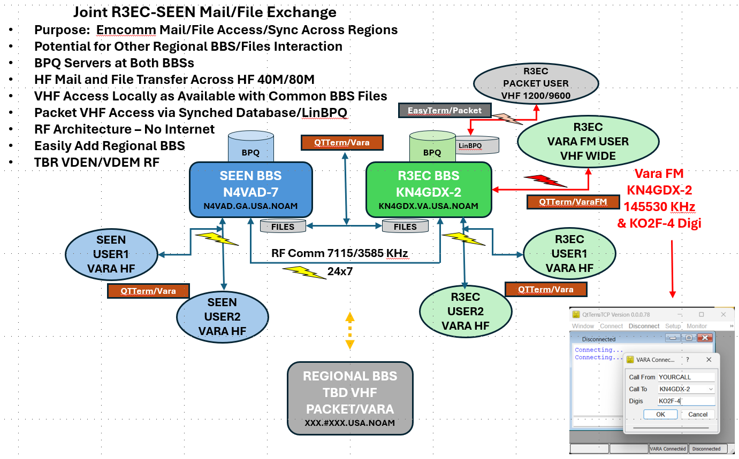
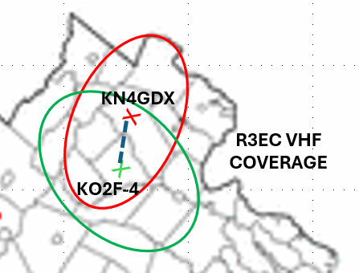
Current R3EC BBS Configuration and Access*
* R3EC Membership – Open to All
r3emcomm.org
kn4gdx@gmail.com

Slide 12
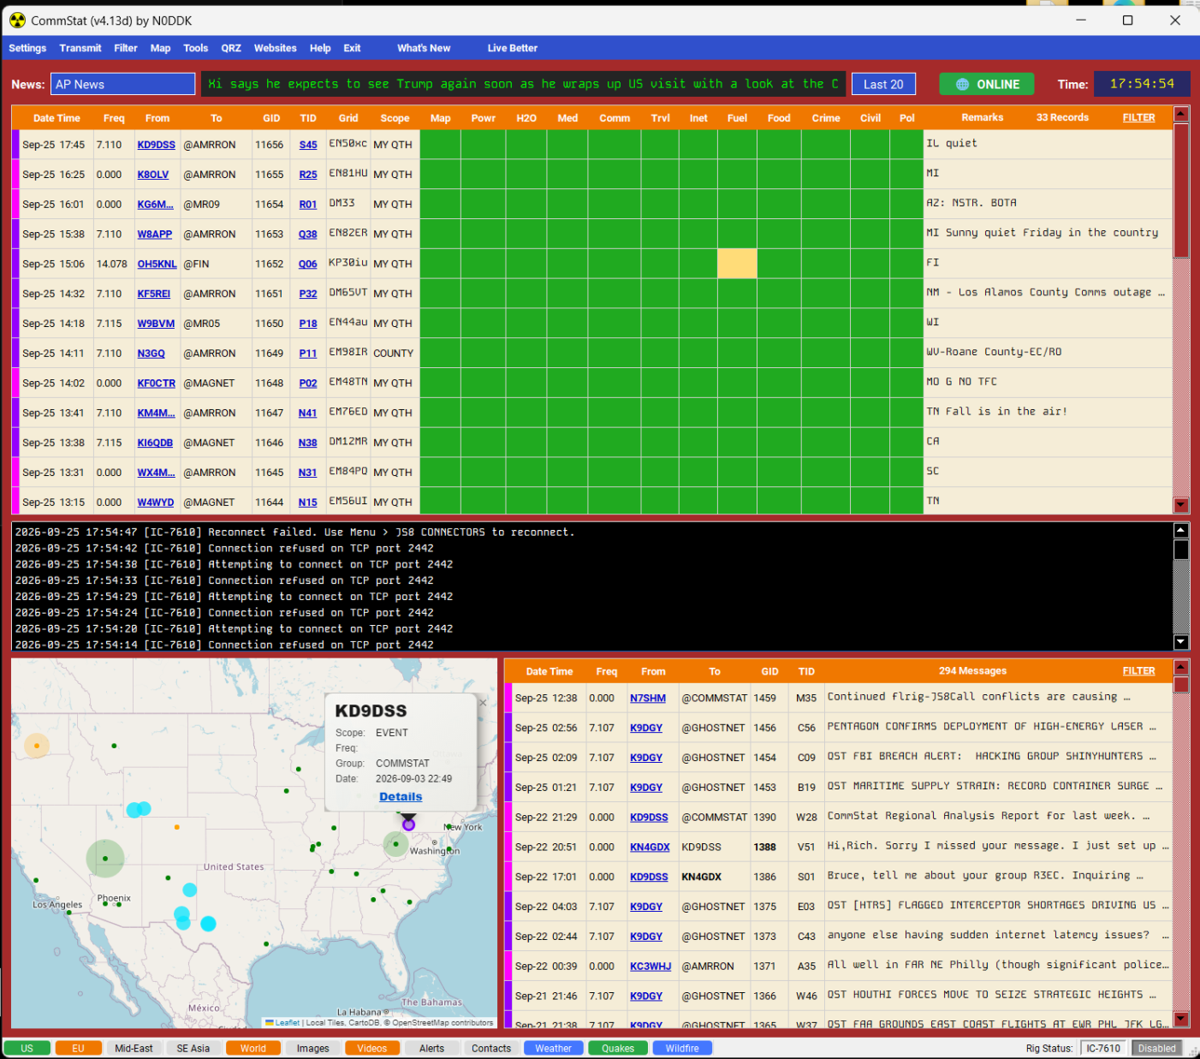
R3EC Digital Comms – CommStat
Internet and/or JS8Call Entry – Situational Awareness/Messaging
CommStat
EmComm Groups
  General/Specific
  Filtered
Internet + JS8Call Entry
Grid-Up/Grid-Down
EmComm-Tailored Stoplights
Area Focus and Time Filtering
Exercise Tracking
Messaging
  All
  Peer to Peer
Alerts and News Feeds
Windows/Linux/Mac
r3emcomm.org
kn4gdx@gmail.com

Slide 13
R3EC Digital Comms – 3.570MHz Waveform/Waterfall
Wednesdays beginning at 1815L - Training Venue
3.5709 (900Hz)
3.572+ (2000+Hz)
R3EC Digital Comms
3KHz Bandwidth at 3.570MHz
All Modes may Occupy Simultaneously
R3EC Net Encourages both Pre-Net and Net Activity
Pre-Net Spectrum Usable during Net for Experiments and Training
NetOps Records all Signals Across the Waterfall during Nets
New Users Always Welcome
3.5715 (1500Hz)
VarAC
C-4/250
JS8Call
Channels
MHz/USB
MFSK32
3.570
Dial
3.5705
3.571
3.5715
3.572
3.5725
3.573
Early Check-In
1845-1900L
Pre-Net Ragchew
1815-1845L
R3EC Net
1900-1930+L
r3emcomm.org
kn4gdx@gmail.com

Slide 14
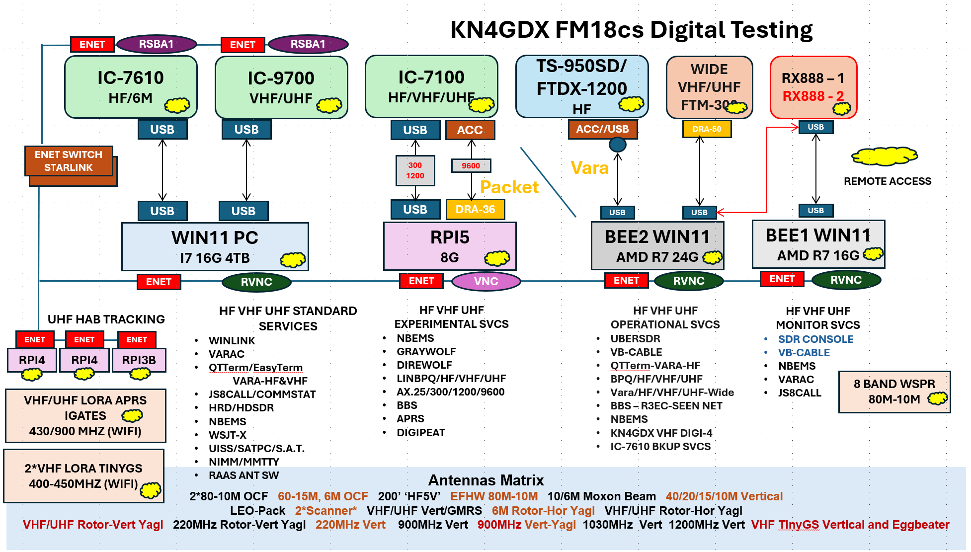
KN4GDX – Shack Configuration – Testing Facilities
kn4gdx@gmail.com

Slide 15
Thank You from R3EC
Digital Management Team
Alyssa: KQ4LWP
Bruce: KN4GDX
Mike: KD7PUF
Questions?
r3emcomm.org
kn4gdx@gmail.com

Slide 16
Backup
Bbs setup and testing procedures
r3emcomm.org
kn4gdx@gmail.com

Slide 17
R3EC Digital Comms – Test Thread 1
Testing: ShackWin11 - IC7610 HF, IC9700 VHF/UHF
Threads1: Test Signals
1A: Winlink Packet 1200 - Soundmodem - IC9700 (generate test packets for RPI/7100/LinBPQ-VHF/UHF Ch1))
1B: Winlink Packet 300 - Soundmodem - IC7610 (generate test packets for RPI/7100/LinBPQ-HF Ch3)
1C: QTTerm Vara - Vara HF - IC7610 (generate test traffic with Vara BBS in LA) (tested with N4VAD-7)
1D: QTTerm Vara FM - Vara FM - IC9700 (generate test traffic with BBS local) (needs setup/no use case)
(Set up Vara FM folder - separate from Winlink - for configuration and identify
a Vara FM test station -- no Vara setup on RPi (requires Wine OS))
r3emcomm.org
kn4gdx@gmail.com

Slide 18
R3EC Digital Comms – Test Thread 2
BPQ/BBS Operations: RPi - IC7100 HF Packet - Graywolf Ch3,
IC7100 VHF/UHF Packet/APRS - Graywolf Ch1,
and Beelink2 – FTDX-1200 HF Vara QTTerm
Threads2: BBS Operational Tests
2A: Validate KN4GDX LinBPQ - RPi Packet - IC7100 VHF/UHF (interact with test packets from 1A) (complete VHF)
  (UHF Ch2 testing is trivial; established VHF/UHF 'side' of LinBPQ access and file mgmt)
2B: Validate KN4GDX LinBPQ - RPi Packet - IC7100 HF (interact with test packets from 1B) (To Do) (Complete)
2C: Validate KN4GDX BPQ - Beelink2 - FTDX1200 (To Do) (Complete)
(Get BPQ setup; configuration and validation) (Complete)
2D: Validate 1C Vara test signals with 2C configurations - QT/Vara Win11 to QT/Vara Bee2 (To Do) (Complete)
2E: Validate KN4GDX QTTerm - Vara HF – FTDX1200 (generate traffic with N4VAD-7 BBS in LA) (To Do) (Complete)
r3emcomm.org
kn4gdx@gmail.com

Slide 19
R3EC Digital Comms – Operations Notes
Other Notes:
Primary HF BBS communications will be Vara (not Packet) (Packet is a reserve capability)
  (Target Persistent Presence Frequency monitoring on HF with FLrig)
Primary HF BBS Ingest and Server will be Vara on Beelink2 - FTDX1200
Primary VHF/UHF BBS Ingest and Server will be Vara on RPi - IC7100
BBS Files will reside separately on RPi (VHF Packet transport) and Bee2 (HF Vara transport)
Consider consolidated File system via local SAN - HITL coordination
Consider dead internet (no starlink) local wifi viability for HF Emcomm and BBS
(Local backup generator -- no internet; local wifi via starlink wifi)
r3emcomm.org
kn4gdx@gmail.com

